Slide 1
Status of the ITK Toolkit
Hans J. Johnson

Slide 2
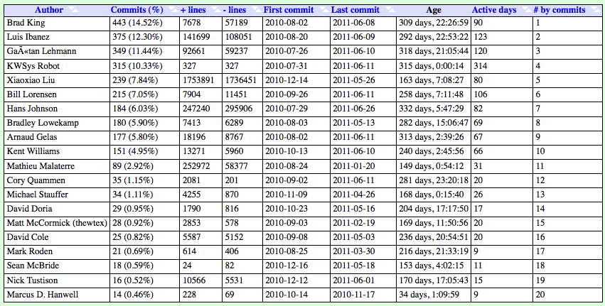
./gitstats/gitstats -c commit_begin=5f6b8ec8de1967a364a0bb2d476455b1e99564c9 \
-c commit_end=HEAD ~/Dashboard/src/ITK ITKv4_Report

Slide 3
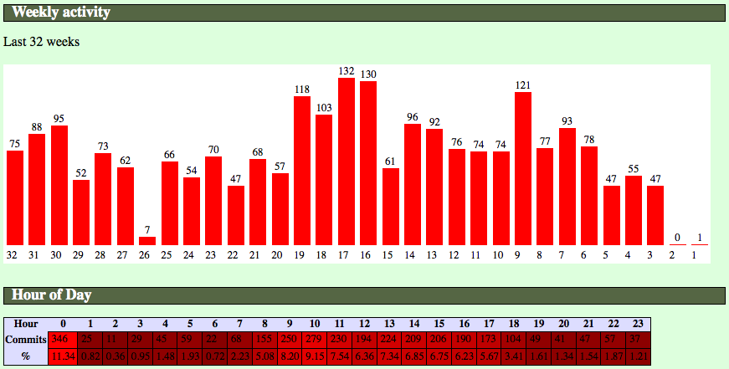
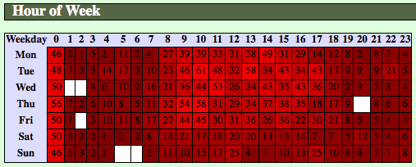
When? Git Commits

Slide 4
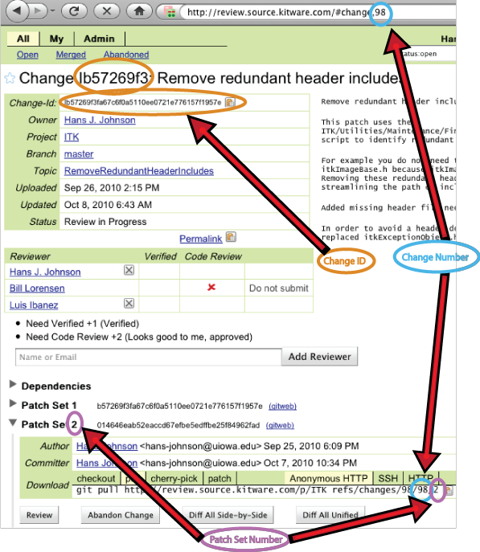
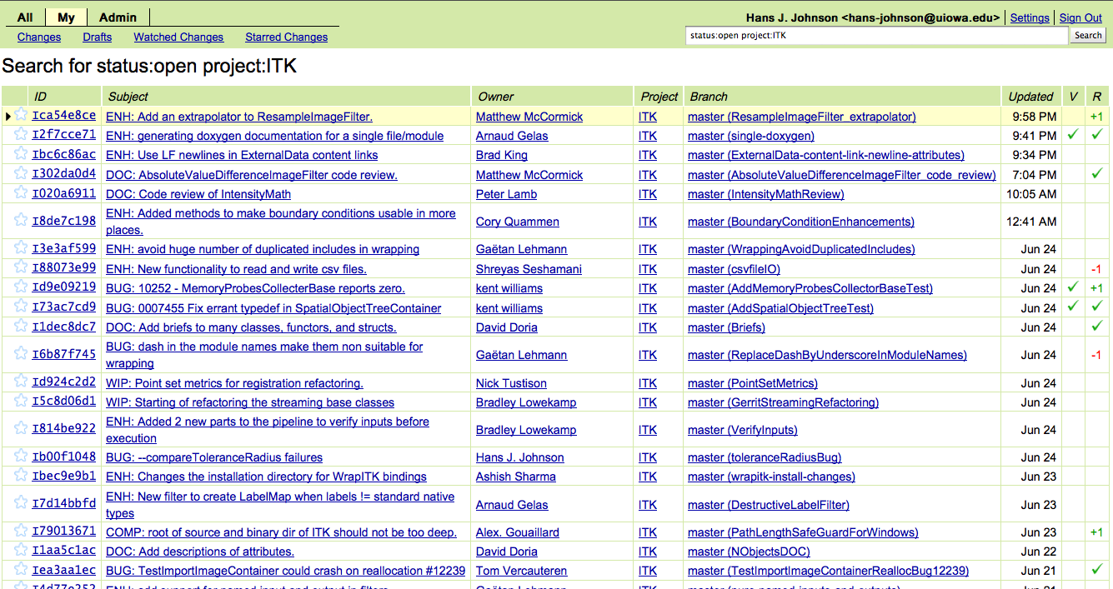
How? Gerrit

Slide 5
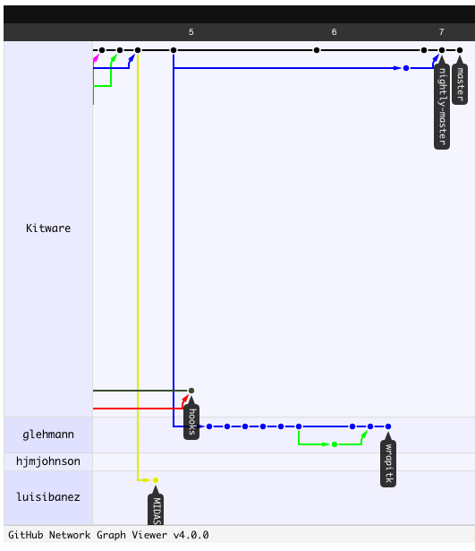
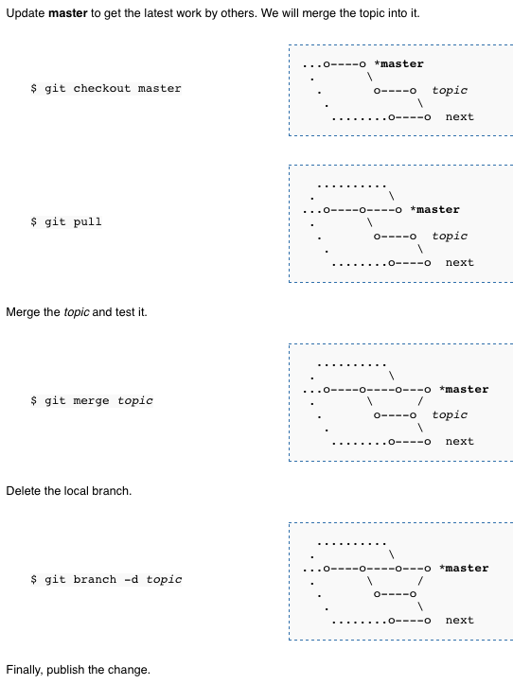

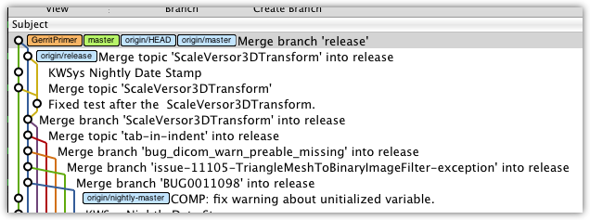
How? Git

Slide 6
What?
Organization
  Modernization (Third Party)
  Modularization
  Simplification
    Compile time Behavior
    Code duplication
  Consistency

Slide 7
Modernization
Many third party dependencies have been updated
  GDCM 2 (DICOM IO)
  NIFTI
  VNL
  OpenJPEG
  HDF5 (Addition, still being flushed out)

Slide 8
Modularization
Created an ontological hierarchy
  Encapsulate conceptual units
  Decouple functional units from rest of toolkit
Fine grained inclusion of functions
  Improve code coverage
  ${ITK_LIBRARIES}

Slide 9
Simplification
Compile time Behavior
  ITK_USE_DEPRECATED_LEVELSET_INTERPOLATION, ITK_USE_DEPRECATED_FAST_MARCHING, ITK_USE_CENTERED_PIXEL_COORDINATES_CONSISTENTLY, USE_REVIEW_STATISTICS, ITKIO_DEPRECATED_METADATA_ORIENTATION, ITK_IMAGE_BEHAVES_AS_ORIENTED_IMAGE, USE_OPTIMIZED_REGISTRATION
  Removed SGI, MSVS 6, Old SUN, cygwin #ifdef code
  Removed all “Legacy” code
Decouple Test Data from source

Slide 10
Consistency
Code API and execution
  Mask processing in filters
  Renaming for consistency
Code Reuse
  Create abstract base classes for common functionality

Slide 11
Major Changes
Wrapping of ITK Proper
  Improve end-user experience
  Improve long term maintenance
  Improve Documentation
FEM
  Improve ITK compatibility
  Improve coverage
Registration
  Conceptual consistency
  Expanded functionality
DICOM
  Improved Support

Slide 12
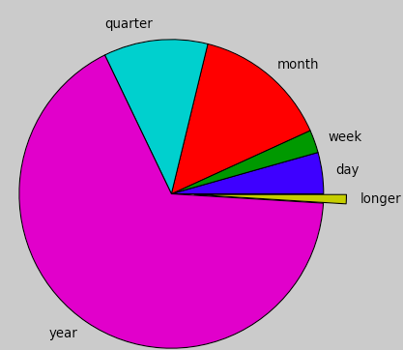
Days Inactive Report
: : mean
Who : How : days
:many : inactive
==========================================
Arnaud Gelas : 2 : 9
kentwilliams : 11 : 16
Hans Johnson : 7 : 65
Nick Tustison : 2 : 94
Jim Miller : 11 : 97
Brad King : 2 : 121
Tom Vercauteren : 1 : 138
Marcus D. Hanwell : 1 : 139
Vince Magnotta : 6 : 155
Gaetan Lehmann : 12 : 157
Ziv Yaniv : 2 : 169
Luis Ibanez : 51 : 174
Bill Lorensen : 6 : 177
Gabe Hart : 13 : 178
xiaoxiao : 17 : 179
Bradley Lowekamp : 13 : 185
Stephen Aylward : 7 : 189
Bill Hoffman : 1 : 202
alexandre gouaillard : 8 : 207
Ivan Macia : 2 : 211
brian avants : 19 : 211
Mathieu Malaterre : 13 : 215
Danielle Pace : 1 : 217

Slide 13
Discussion Points
Unified logins and Integrated systems
  Git
  Gerrit
  Wiki
  Mantis
  ?Midas?
These tools need to be less distinct
  GitHub
  NITRC
  NAMIC (Sandbox)
  NAMIC (Wiki)
  Slicer3/4 (Wiki)
  Slicer3/4 (svn)

