Slide 1



In-Situ Visualization with Catalyst
November 11, 2011
Andrew Bauer, Utkarsh Ayachit
Kitware Inc.
Norbert Podhorszki
Oak Ridge National Laboratory
Nathan Fabian, Ron Oldfield
Sandia National Laboratories
SAND 2012-7723 C
Sandia National Laboratories is a multi-program laboratory managed and operated by Sandia Corporation, a wholly owned subsidiary of Lockheed Martin Corporation, for the U.S. Department of Energy's National Nuclear Security Administration under contract DE-AC04-94AL85000.
Notes:
As we progress, please feel free to interrupt with questions.

Slide 2
Agenda
Introduction
Coprocessing API
  Establishing a pipeline
  Specifying and Querying input data
  Compiling
Data Staging
Notes:
What is Coprocessing
Uses and Examples
Coprocessing ParaView Plugin

Slide 3
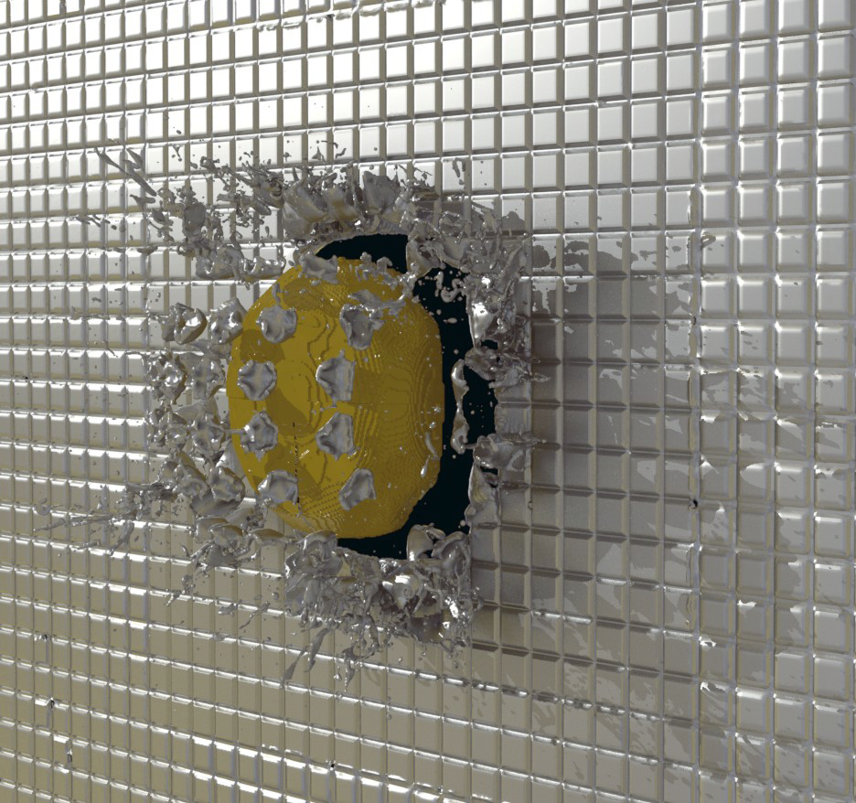
What is Catalyst
Notes:
High fidelity access to data
Directly couple with a simulation and pull from data not normally available, possibly every frame.

Slide 4

Access to More Data
Post Processing
In situ Processing
Roughly equal data stored at simulation time
Reflections and Shadows added in post-processing

Slide 5
Why In Situ?
 | 2010 | 2018 | Factor Change
System peak | 2 Pf/s | 1 Ef/s | 500
Power | 6 MW | 20 MW | 3
System Memory | 0.3 PB | 10 PB | 33
Node Performance | 0.125 Gf/s | 10 Tf/s | 80
Node Memory BW | 25 GB/s | 400 GB/s | 16
Node Concurrency | 12 cpus | 1,000 cpus | 83
Interconnect BW | 1.5 GB/s | 50 GB/s | 33
System size (nodes) | 20 K nodes | 1 M nodes | 50
Total Concurrency | 225 K | 1 B | 4,444
Storage | 15 PB | 300 PB | 20
Input/Output Bandwidth | 0.2 TB/s | 20 TB/s | 100
DOE Exascale Initiative Roadmap, Architecture and Technology Workshop, San Diego, December, 2009.

Slide 6
Two ways to run
What is In Transit
Simulation
Simulation
Separate MPI
Catalyst
Catalyst
Disk
Storage
Disk
Storage
Visualization
Visualization
Notes:
arbitrarily throwing out data, throw it out smart

Slide 7
Catalyst Architecture
Catalyst
Python Wrappings
ParaView Server
Parallel Abstractions and Controls
VTK
Core Visualization Algorithms

Slide 8
High Level View
Simulation Developers
Pass necessary simulation data to ParaView
Need sufficient knowledge of both codes
  VTK for grids and field data
  ParaView coprocessing library
Transparent to simulation users
Extensible
Simulation Users
Knowledge of ParaView as a post-processing/analysis tool
  Basic interaction with GUI coprocessing script generator plugin
  Incremental knowledge increase to use the coprocessing tools from basic ParaView use
Programming knowledge can be useful to extend the tools
Notes:
Most of the day is focused on the Developer perspective
How do you implement these technologies into a simulation

Slide 9
Developer Perspective
Solver
Catalyst
function
calls
function
calls
CoprocessingAPI
Adaptor
Initialize()
AddPipeline(in pipeline)
RequestDataDescription(in time, out fields)
CoProcess(in vtkDataSet)
Finalize()
Notes:
To add coprocessing to a simulation solver, one writes an adaptor.
The adaptor is the only thing that has to be created to use coprocessing in a new piece of code.
The amount of code required for the adaptor is very small.
A significant portion of this tutorial is in creating adaptors.

Slide 10
Developer Perspective
Notes:
If you are going to add these capabilities, you don’t want them to make the simulation fail to scale

Slide 11
User Perspective
Simulation
Catalyst
Notes:
The intension of the ParaView Coprocessing Library is to more directly couple analysis with the solver during simulation.
The ParaView Coprocessing Library is subservient to a running simulation that can make calls to do analysis while it runs.

Slide 12
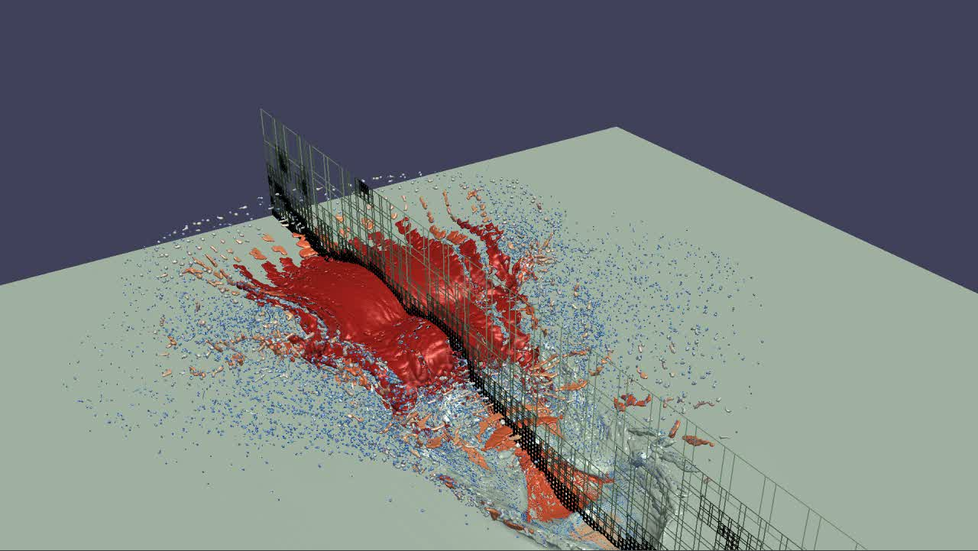
User Perspective
Simulation
Catalyst
Output Processed Data
Rendered Images
Notes:
The ParaView Coprocessing library outputs the results of its analysis.
A common desire is to render images of prepackaged visualizations.
Known as in-situ visualization.

Slide 13

User Perspective
Simulation
Catalyst
Output Processed Data
Polygonal Output
with Field Data
Rendered Images
Notes:
But there are many more options when using the coprocessing library.
You can extract information in other ways that preserve the most relevant information but keep in a form that can still be interacted with.
For example, you could extract relevant polygonal surfaces. They are a fraction the size of the full mesh.

Slide 14
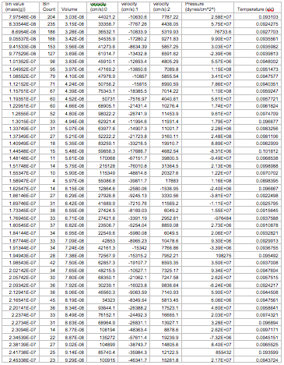
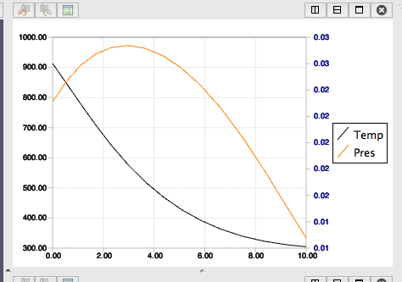
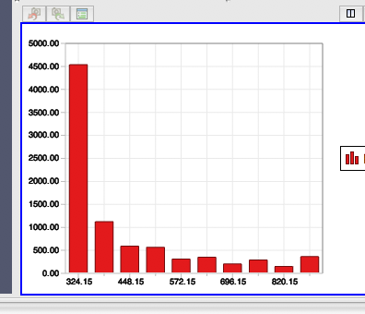
User Perspective
Simulation
Catalyst
Output Processed Data
Polygonal Output
with Field Data
Statistics
Series Data
Rendered Images
Notes:
You could also generate more statistical information for later charting.
One of the main advantages of the ParaView Coprocessing Library is that the algorithms available in the ParaView application are also available while coprocessing.

Slide 15
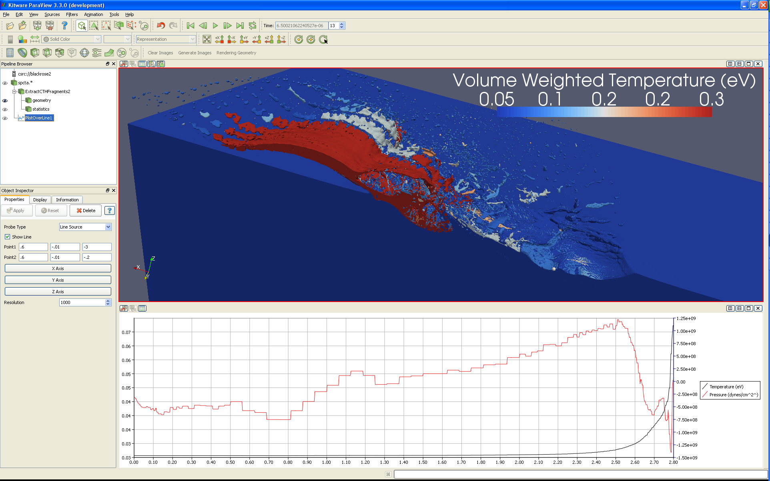
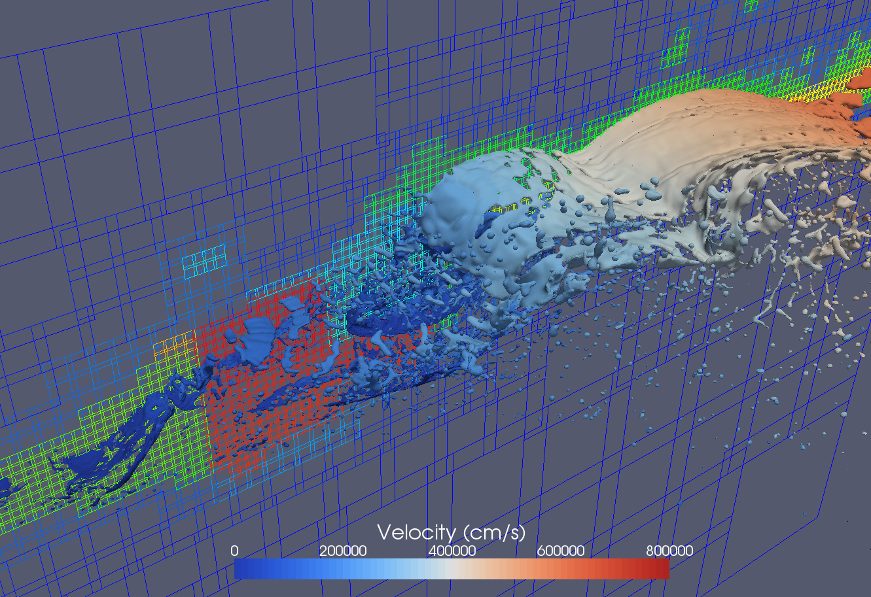
User Perspective
# Create the reader and set the filename.
reader = servermanager.sources.Reader(FileNames=path)
view = servermanager.CreateRenderView()
repr = servermanager.CreateRepresentation(reader, view)
reader.UpdatePipeline()
dataInfo = reader.GetDataInformation()
pDinfo = dataInfo.GetPointDataInformation()
arrayInfo = pDInfo.GetArrayInformation("displacement9")
if arrayInfo:
# get the range for the magnitude of displacement9
range = arrayInfo.GetComponentRange(-1)
lut = servermanager.rendering.PVLookupTable()
lut.RGBPoints = [range[0], 0.0, 0.0, 1.0,
range[1], 1.0, 0.0, 0.0]
lut.VectorMode = "Magnitude"
repr.LookupTable = lut
repr.ColorArrayName = "displacement9"
repr.ColorAttributeType = "POINT_DATA"
Simulation
Augmented script in input deck.
Script Export
Catalyst
Output Processed Data
Polygonal Output
with Field Data
Statistics
Series Data
Rendered Images
Notes:
Another advantage is that you can use the ParaView application to guide the coprocessing analysis.
From the ParaView application you can load a proxy geometry, define a desired analysis, and automatically generate a script understood by the ParaView Coprocessing Library.

Slide 16
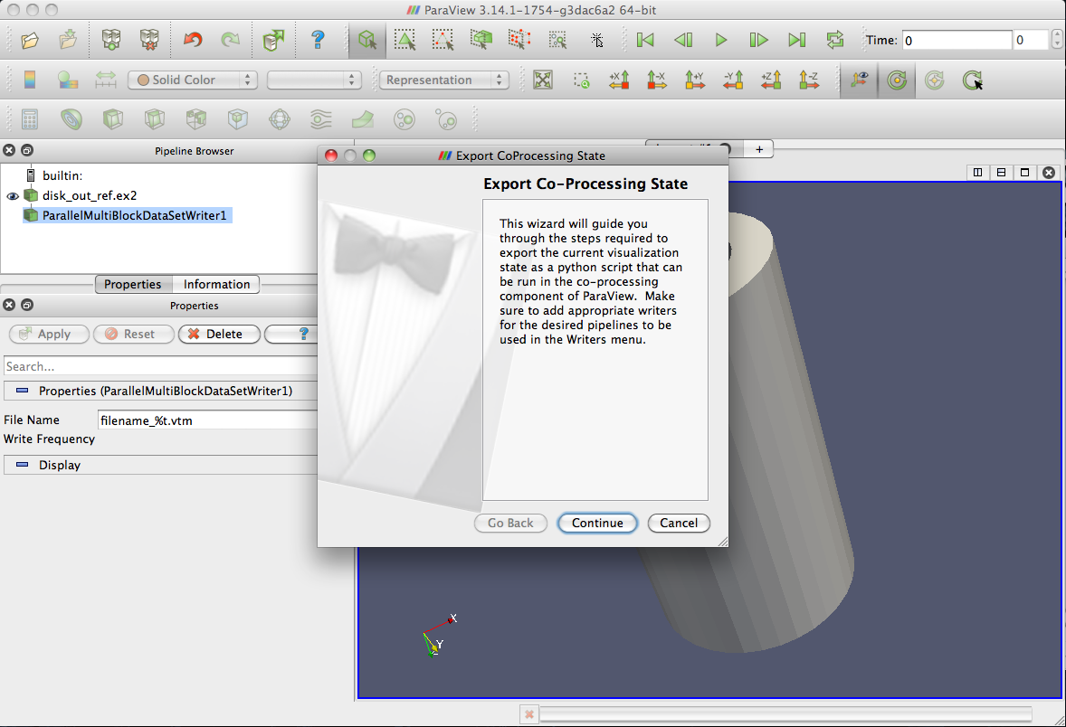
Exporting from ParaView
Interact with ParaView normally
Export a script that mimics that interaction
Runs during each coprocessing step
  (one frame at a time)

Slide 17
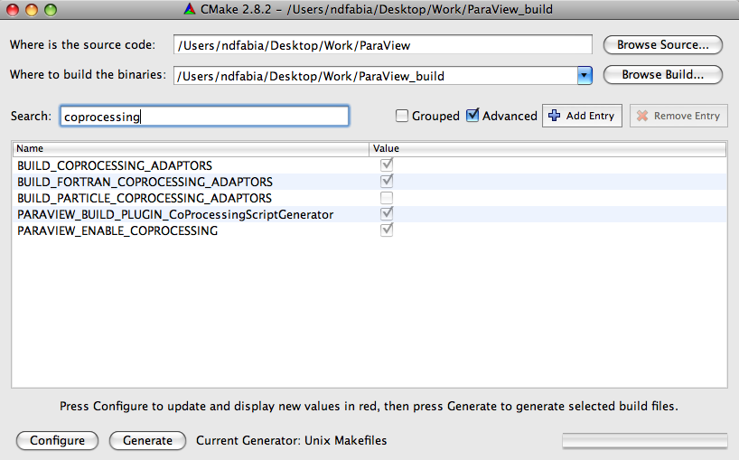
Setting up the Plugin

Slide 18
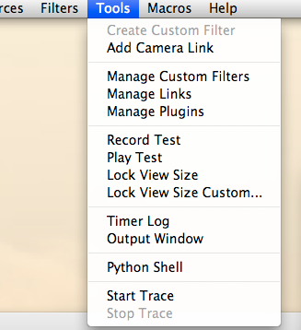
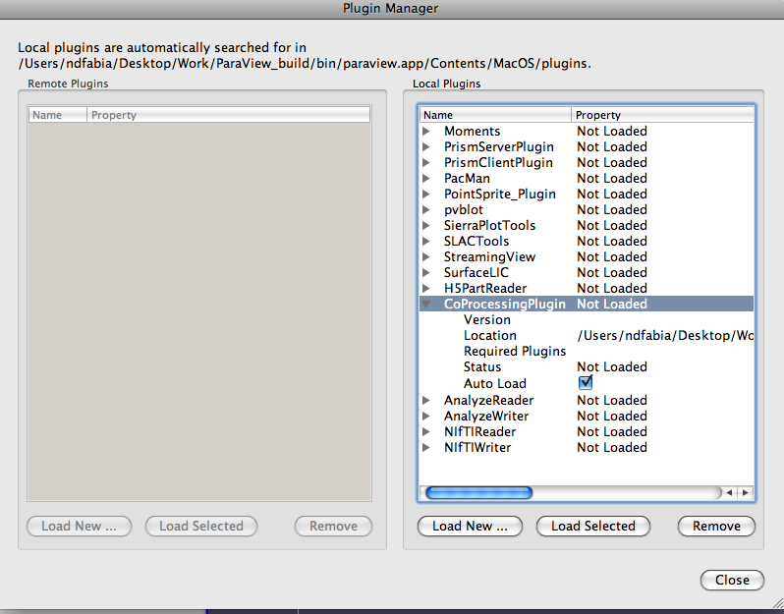
Setting up the Plugin

Slide 19
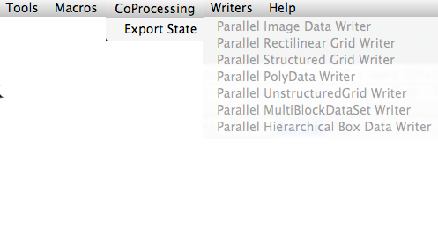
Setting up the Plugin

Slide 20
Bootstrapping a New Simulation
Why?
  Don’t have a writer available in the simulation
  Don’t have it in a file format readable by ParaView
  Only need to write the adaptor
    Writers come for free
    All ParaView writers work with all ParaView readers
  All ParaView formats now available to the simulation
  Very simple example to start with

Slide 21
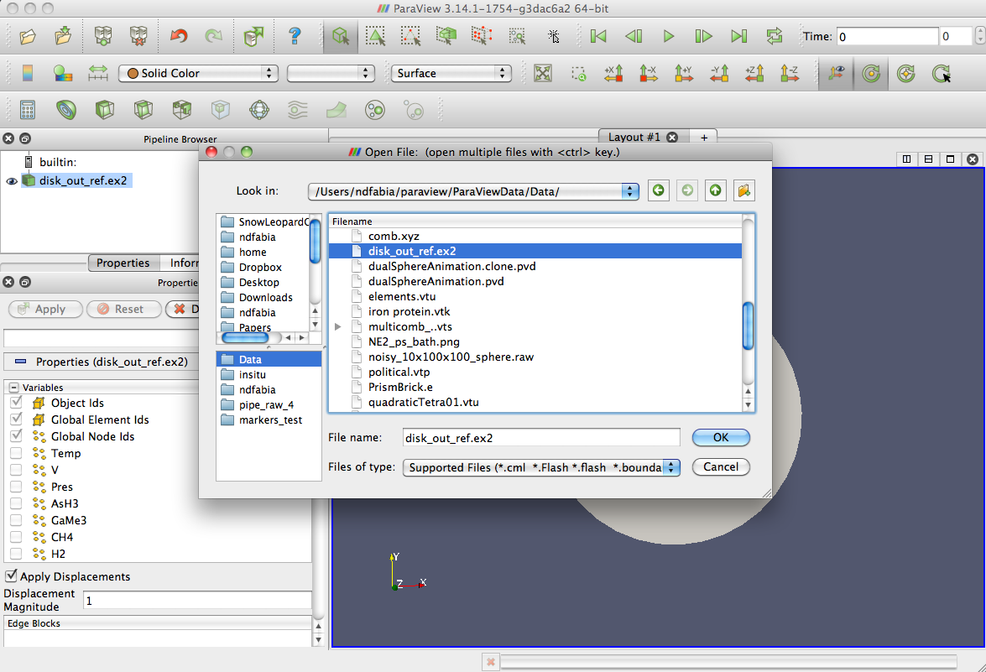
Example Bootstrap
(In this example, we want a multiblock data set)

Slide 22
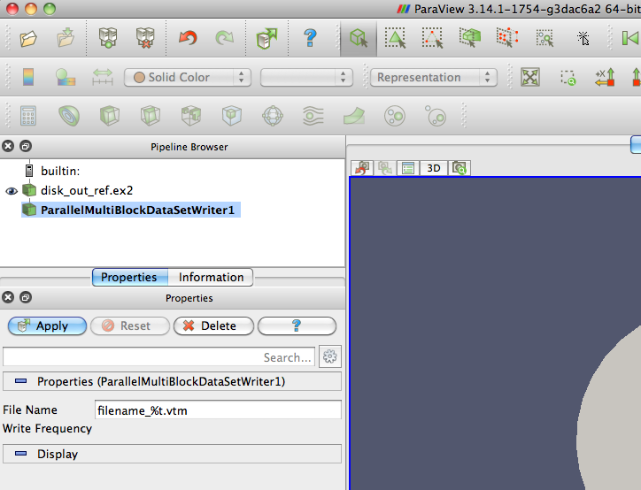
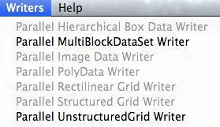
Example Bootstrap

Slide 23

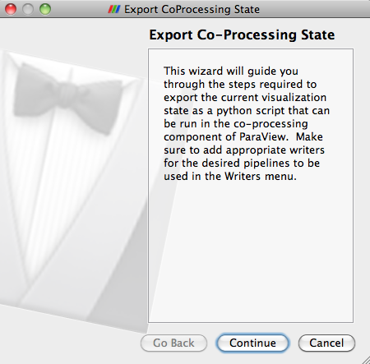
Creating the Script

Slide 24
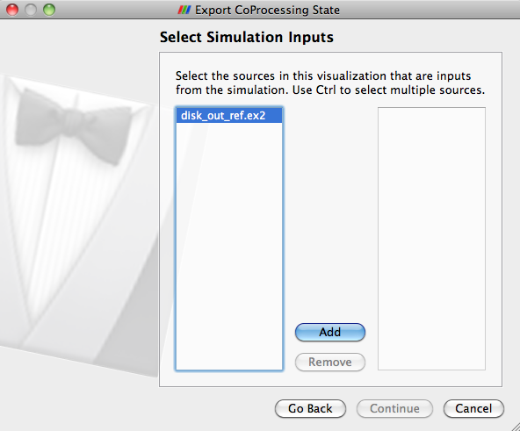
Pick the input reference

Slide 25
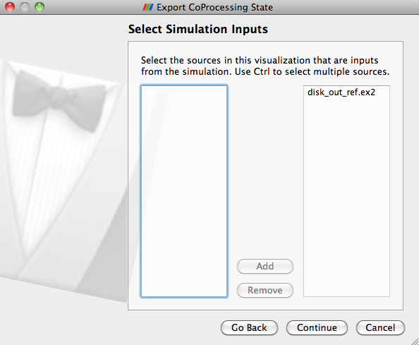
Pick the input reference

Slide 26
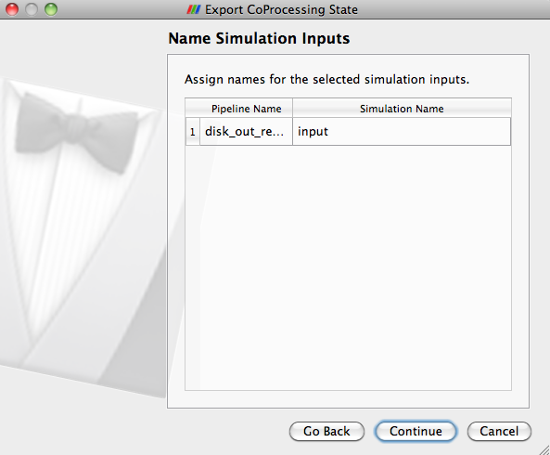
The Input reference

Slide 27
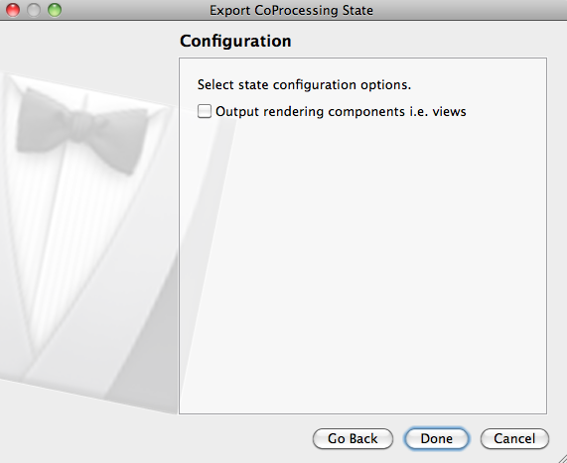
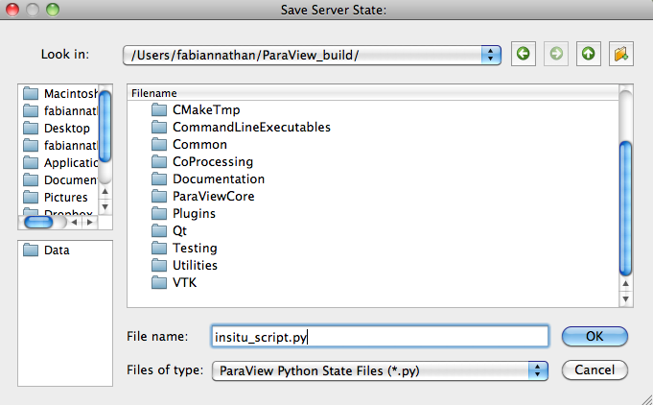
Generate the script

Slide 28
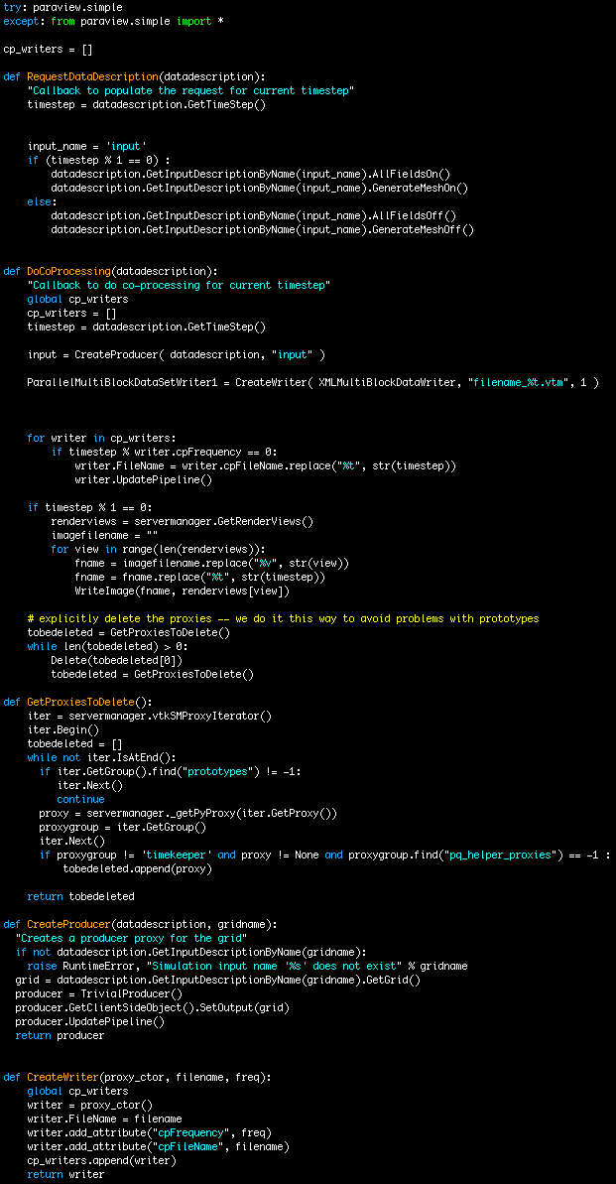
Generated Script
def DoCoProcessing(datadescription):
…
input = CreateProducer( datadescription, "input" )
ParallelMultiBlockDataSetWriter1 = CreateWriter( XMLMultiBlockDataWriter, "filename_%t.vtm", 1)

Slide 29
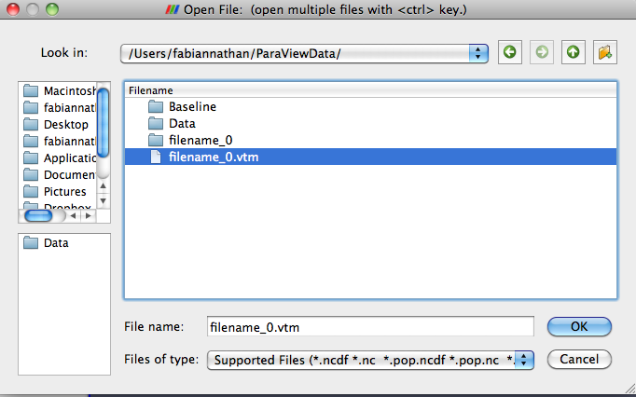
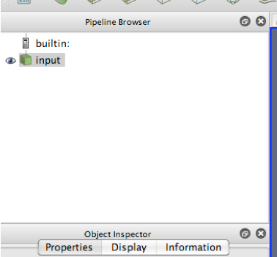
Loading the Bootstrapped Data

Slide 30
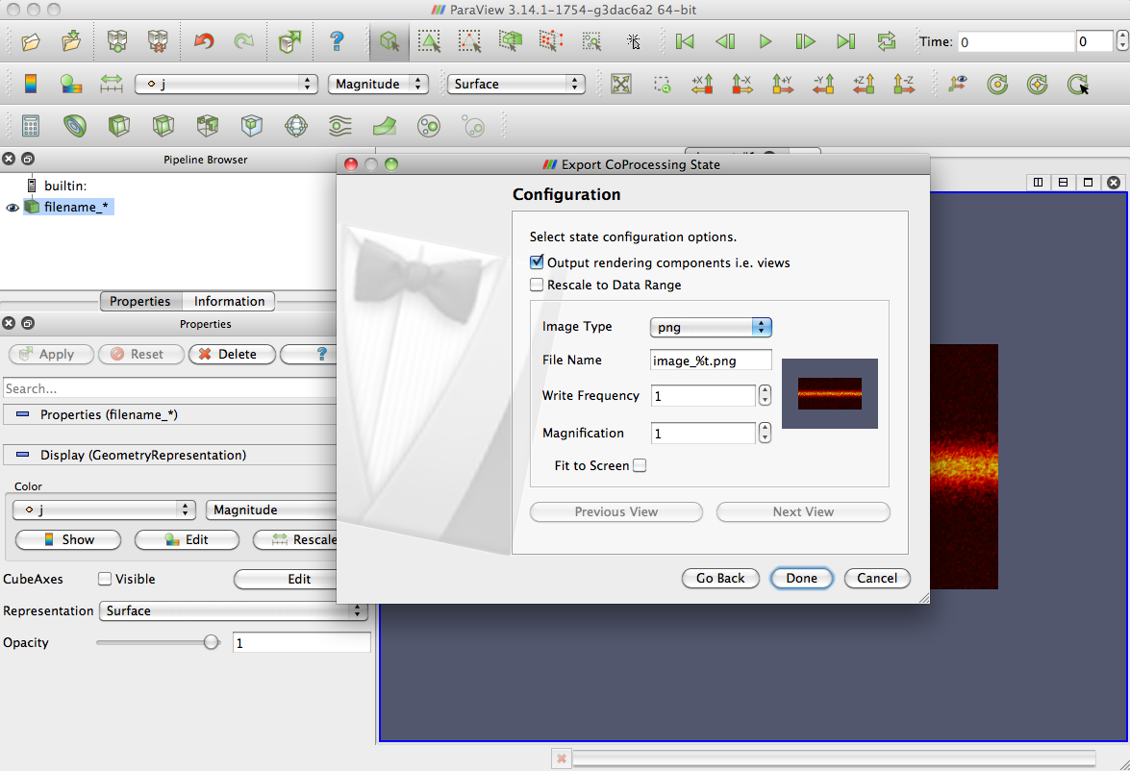
Generating an Image

Slide 31
First Useful Image
RenderView1.CameraPosition = [18.6328125, 37.3828125, 134.3787411685681]
…
RenderView1.CameraFocalPoint = [18.6328125, 37.3828125, 0.0]
…
RenderView1.Background = [0.31999694819562063, 0.34000152590218968, 0.42999923704890519]
a3_j_PVLookupTable = GetLookupTableForArray( "j", 3, Discretize=1, RGBPoints=[0.00029873965903074048, 0.0, 0.0, 0.0, 0.077298959436258918, 0.90196078431372551, 0.0, 0.0, 0.1542991792134871, 0.90196078431372551, 0.90196078431372551, 0.0, 0.19279928910210117, 1.0, 1.0, 1.0], UseLogScale=0, VectorComponent=0, NumberOfTableValues=256, ColorSpace='RGB', VectorMode='Magnitude', HSVWrap=0, ScalarRangeInitialized=1.0, LockScalarRange=0 )

Slide 32
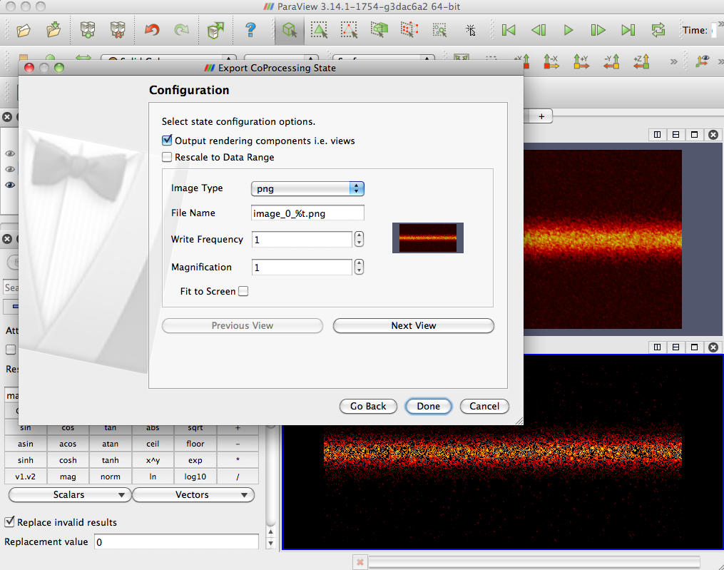
Two Images

Slide 33
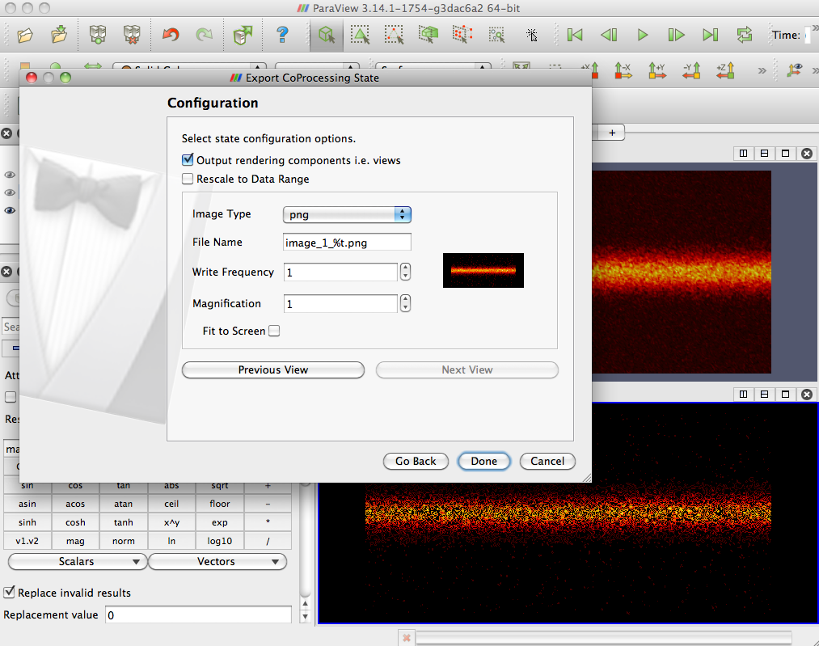
Two Images

Slide 34

The Catalyst API

Slide 35
Online Help
Email list: paraview@paraview.org
Doxygen:
  http://www.vtk.org/doc/nightly/html/classes.html
  http://www.paraview.org/ParaView3/Doc/Nightly/html/classes.html
Wiki: http://paraview.org/Wiki/CoProcessing
  C++ example: http://paraview.org/Wiki/Coprocessing_example
  Python example: http://paraview.org/Wiki/Python_coprocessing_example
Notes:
Many of the paraview classes derive from VTK – can follow the inheritance hierarchy to get to VTK doxygen
http://paraview.org//Wiki for the main wiki page – also a paraview users guide there in pdf format

Slide 36
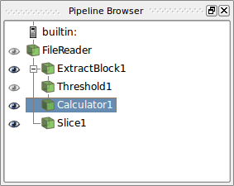
ParaView Pipeline Concept
Fundamental concept in ParaView
Directed acyclic graph specifying how to process information
Filters are nodes in the graph
  Perform a certain action on a data set (grid and fields)
    Contours, streamlines, file IO, etc.
  Do not modify input data set
Coprocessing executes user pipelines at specified times
Notes:
Can have multiple pipelines
Normally writers are not part of the pipeline shown in ParaView.

Slide 37
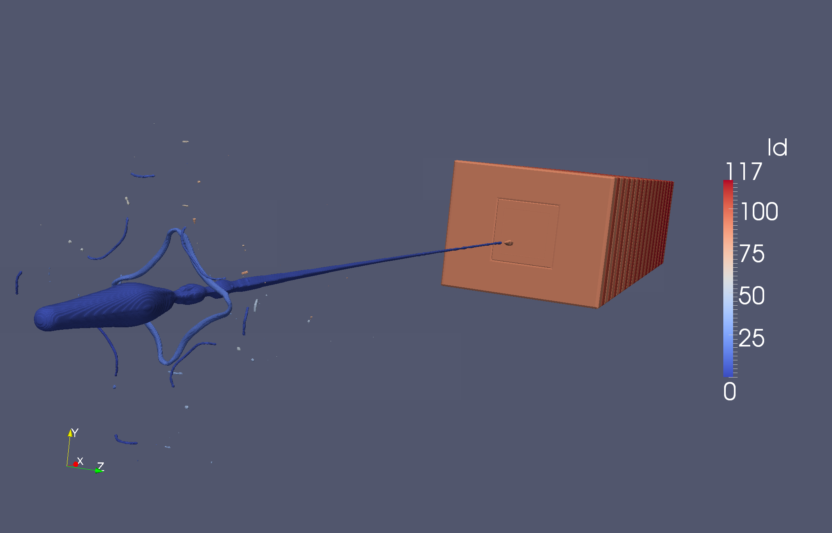
Catalyst Pipelines
User generated Python scripts from the ParaView plugin
Hard-coded pipelines

Slide 38
vtkCPPythonScriptPipeline
Typically from ParaView script generator plugin
Initialize from a path to a ParaView Python coprocessing script
  vtkCPPythonScriptPipeline::Initialize(const char* fileName)
http://www.paraview.org/ParaView3/Doc/Nightly/html/classvtkCPPythonScriptPipeline.html

Slide 39
vtkCPPythonScriptPipeline (2)
Advantages
  Easily created through ParaView plugin
    Output should be moderately readable
  Encourage advanced users to modify
    Can use ParaView’s Python trace utility to see options
  View/screenshot settings can be difficult to set
    Camera angle, zoom, lighting, data representations, etc.
  Takes care of parallel image compositing
  Can modify without recompiling

Slide 40
vtkCPPythonScriptPipeline (3)
Disadvantages
  Slight overhead compared to C++ hard-coded pipeline
    Roughly 10⁻⁵ seconds per time step
  Simulation code must be linked with Python
    Static build issues
    More complex to minimize executable size

Slide 41
Hard-coded Pipelines
Derives from vtkCPPipeline
Generally C++ but could be Python code
Most are done directly creating VTK filters and connecting them together
  Creating screen shots from rendering pipeline with compositing can be daunting
Possible to do using ParaView C++ proxies
  Poor documentation for proxies
  Simpler set up for rendering pipeline
Less dependencies for compiling and linking
http://www.paraview.org/ParaView3/Doc/Nightly/html/classvtkCPPipeline.html

Slide 42
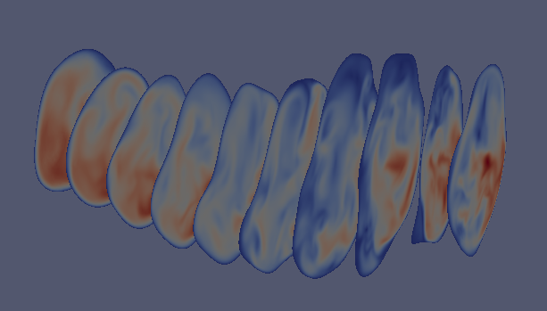
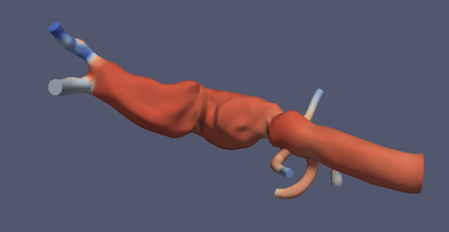
Catalyst
Catalyst’s job is to create and execute pipelines
Notes:
Start mentioning adaptors as bridge between simulation and catalyst

Slide 43
Information Flow
Solver
Adaptor
Initialization
  Information for creating pipelines

Slide 44
Information Flow
Pipeline
Solver
Pipeline
T,TS,FO
Adaptor
Pipeline
After simulation completes time step update
  Time, time step, force output flag
  Information for creating grid and field information

Slide 45
Information Flow
Pipeline
Solver
T,TS,FO
Pipeline
Adaptor
T,TS,FO
Pipeline
T,TS,FO
After simulation completes time step update
  Time, time step, force output flag passed to each pipeline

Slide 46
Information Flow
Pipeline
Solver
Y
Pipeline
Adaptor
N
Pipeline
Y
After simulation completes time step update
  Flag indicating which pipelines need to be executed/updated

Slide 47

Information Flow
Pipeline
Solver
Pipeline
Adaptor
Pipeline
After simulation completes time step update
  If any pipeline needs to be executed
    Adaptor creates VTK objects to represent grids and fields
Notes:
Will discuss later how to make VTK grid and field objects

Slide 48
Information Flow
Pipeline
Solver
G,F
Pipeline
Adaptor
Pipeline
G,F
After simulation completes time step update
  Pass VTK data object representing grids and fields to pipelines that need to execute/update

Slide 49
Information Flow
Pipeline
Solver
Pipeline
Adaptor
Pipeline
After simulation completes time step update
  Pipelines execute and output desired information

Slide 50
What is Catalyst?
Pipeline
Pipeline
Pipeline
Communication/synchronization routines
Pipeline mechanics
Data processing through filters
Writers
Rendering and compositing

Slide 51
Interfacing with Catalyst
Adaptor
Catalyst calls should have minimal footprint in simulation code
  Initialization call
  CoProcessing call
  Finalize call
VTK data structures usually not appropriate for simulation code data structures
Adaptor’s job is to provide interface between simulation code and Catalyst

Slide 52
Adaptor Architectural View
Adaptor:
vtkCPProcessor* Processor;
vtkDataObject* CreateGrid();
vtkCPPipeline* CreatePipeline();
Initialization
  Creates vtkCPProcessor and initializes it
    vtkCPProcessor::Initialize()
  Creates vtkCPPipeline objects and adds them to vtkCPProcessor
    vtkCPProcessor::AddPipeline(vtkCPPipeline*)

Slide 53
Adaptor Architectural View
Adaptor:
vtkCPProcessor* Processor;
vtkDataObject* CreateGrid();
vtkCPPipeline* CreatePipeline();
When called after update time step is completed
  Creates a vtkCPDataDescription
    Information needed by Catalyst to determine what pipelines need to execute
    vtkCPDataDescription::SetTimeData(double time, vtkIdType timeStep)
    vtkCPDataDescription::SetForceOutput(bool) optional
  Queries pipelines to determine if coprocessing is necessary
    Processor->RequestDataDescription(vtkCPDataDescription*)
    Returns 0 if no coprocessing is needed that time step

Slide 54
Adaptor Architectural View
Adaptor:
vtkCPProcessor* Processor;
vtkDataObject* CreateGrid();
vtkCPPipeline* CreatePipeline();
If Processor->RequestDataDescription() != 0
  CreateGrid()
    Creates grids and fields
    Biggest part of the adaptor
  vtkCPDataDescription::AddInput(const char* name)
    Convention is that name := “input” for a single input
  vtkCPDataDescription::GetInputDataDescriptionByName(
  const char* name)->SetGrid( CreateGrid() )
  Processor->CoProcess(vtkCPDataDescription*)

Slide 55
Adaptor Architectural View
Adaptor:
vtkCPProcessor* Processor;
vtkDataObject* CreateGrid();
vtkCPPipeline* CreatePipeline();
Finalize
  Processor->Finalize()

Slide 56
Main CoProcessing Parts
Initialize
Check with each coprocessing pipeline if execution is necessary
  Input is simulation time and time step
  Output is if coprocessing is needed along with needed grids and fields
If coprocessing is needed at specified time and time step:
  Input the grid and field information
  Execute the proper coprocessing pipelines
Finalize
Notes:
Will go further into details in the following slides

Slide 57
C++ Example
http://paraview.org/Wiki/Coprocessing_example
Tutorial files: CxxExample/CoProcessingExample.cxx
Notes:
Reference counting of the pipeline – Delete is ok here

Slide 58
C++ Example (2)
Notes:
For 3.12 we should add in ForceOutputOn() for the last time step.

Slide 59
Python Example
http://paraview.org/Wiki/Python_coprocessing_example
Tutorial files
  PythonExample/example.py
PYTHONPATH
  <PARAVIEW BUILD DIR>/lib
  <PARAVIEW BUILD DIR>/lib/site-packages
  <PARAVIEW BUILD DIR>/VTK/Wrapping/Python
LD_LIBRARY_PATH
  <PARAVIEW BUILD DIR>/lib
  Depending on ParaView build options
    Qt libraries
    Mesa libraries

Slide 60
Python Example Code

Slide 61
Python Example Code (2)
Adaptor efficiency suggestions:
Use numpy
Create a class derived from vtkObject with static member functions
Notes:
Static member functions to iterate over points, cells, etc.

Slide 62
Creating VTK Objects

Slide 63
Getting Data Into Catalyst
Main object will derive from vtkDataObject
  Grids that derive from vtkDataSet
  Multiblock grids that contain multiple vtkDataSets
Field information
  Point data – information specified for each point in a grid
  Cell data – information specified for each cell in a grid
  Field data – meta-data not associated with either points or cells
All object groups are 0-based/C/C++ indexing

Slide 64
vtkDataSet Subclasses
vtkImageData
vtkUniformGrid
vtkPolyData
vtkRectilinearGrid
vtkUnstructuredGrid
vtkStructuredGrid
http://www.vtk.org/doc/nightly/html/classvtkDataSet.html
Notes:
Slides may be out of order here!!!
Will go into more details in the following slides

Slide 65
vtkImageData/vtkUniformGrid
vtkCPInputDataDescription::SetWholeExtent() – total number of points in each direction
SetExtent() – a process’s part of the whole extent
SetSpacing() – cell lengths in each direction
SetOrigin() – location of point 0 (i=0, j=0, k=0)
Ordering for points and cells
  Fastest in x-direction
  Next in y-direction
  Slowest in z-direction
vtkUniformGrid
  Supports cell blanking
  Currently written to file as vtkImageData
http://www.vtk.org/doc/nightly/html/classvtkUniformGrid.html
Notes:
Required to call both SetWholeExtents() – this and the one mentioned earlier vtkCPInputDescription::SetWholeExtent()

Slide 66
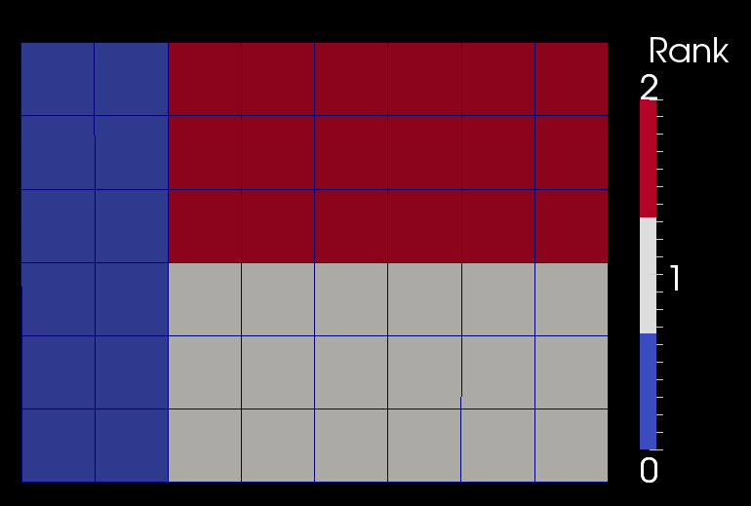
Extents
Whole extent for all processes (0, 8, 0, 6, 0, 0)
Extents different for each process
  Rank 0: (0, 3, 0, 6, 0, 0), 21 points, 18 cells
  Rank 1: (3, 8, 0, 3, 0, 0), 28 points, 18 cells
  Rank 2: (3, 8, 3, 6, 0, 0), 28 points, 18 cells
Notes:
User sets partitioning by specifying the extents on each process

Slide 67
vtkRectilinearGrid
vtkCPInputDataDescription::SetWholeExtent() – total number of points in each direction
SetExtents() – a process’s part of the whole extent
Set<X,Y,Z>Coordinates() – point coordinates in each direction
  Only values for process’s extents
  Index starting at 0
Ordering for points and cells
  Fastest in x-direction
  Next in y-direction
  Slowest in z-direction
http://www.vtk.org/doc/nightly/html/classvtkRectilinearGrid.html
Notes:
SetDimensions() – should not be used but if it is it must be before SetExtent() is called

Slide 68
vtkPointSet
Abstract class for grids with arbitrary point locations
  Derived classes: vtkStructuredGrid, vtkPolyData, vtkUnstructuredGrid
SetPoints(vtkPoints*) – set the number and coordinates of a process’s points
vtkPoints
  Class used to store actual point location
  array
  C/C++ indexing
  SetDataTypeTo<Int,Float,Double>()
  SetNumberOfPoints() – allocation
  SetPoint() – fast but doesn’t do bounds checking
  InsertPoint()/InsertNextPoint() – safe but does bounds checking and reallocation as needed
http://www.vtk.org/doc/nightly/html/classvtkPointSet.html

Slide 69
vtkStructuredGrid
vtkCPInputDataDescription::SetWholeExtent() – total number of points in each direction
SetExtents() – a process’s part of the whole extent
Ordering for points and cells
  Fastest in x-direction
  Next in y-direction
  Slowest in z-direction
  vtkPoints must be ordered in same manner
http://www.vtk.org/doc/nightly/html/classvtkStructuredGrid.html
Notes:
SetDimensions() – should not be used but if it is it must be before SetExtent() is called

Slide 70
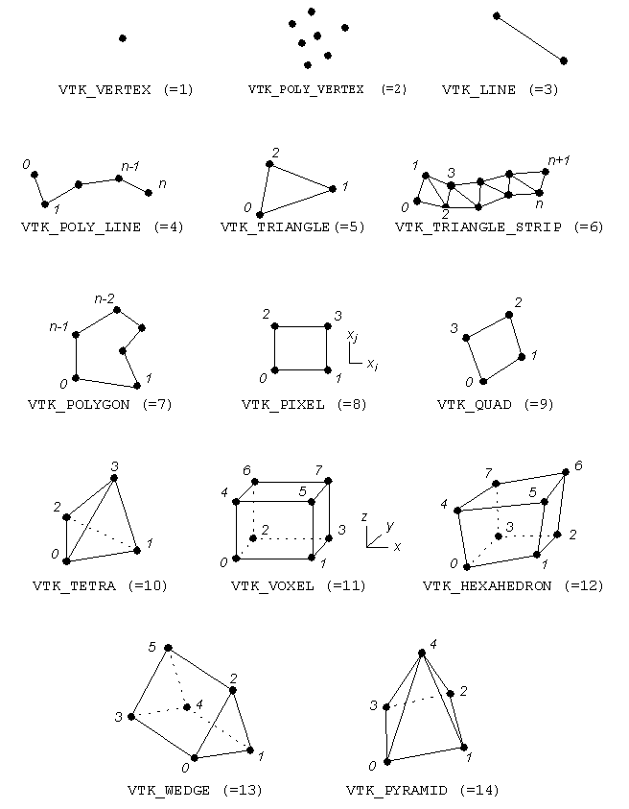
vtkCell Straight-Edged Types
http://www.vtk.org/doc/nightly/html/classvtkCell.html

Slide 71
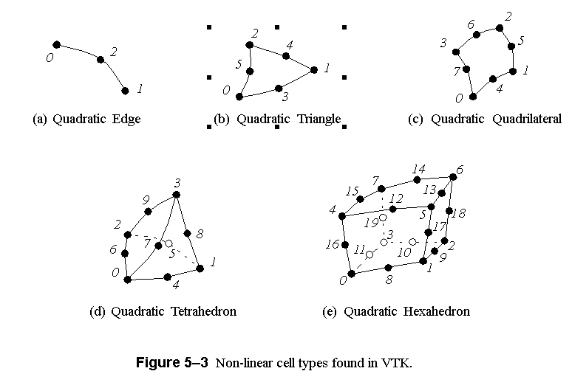
vtkCell Curvilinear-Edged Types

Slide 72
vtkPolyData Cells
Efficient way – build through vtkCellArray
  vtkCellArray::SetNumberOfCells()
  Done for verts, lines, polys, triangle strips
Simple way – build through poly data API
  Allocate()
  InsertNextCell()
  Squeeze() – reclaim unused memory
WARNING – Order that cells are added may be different than they are accessed
  Ordered by verts, lines, polys, triangle strips
  Need to match with cell data
http://www.vtk.org/doc/nightly/html/classvtkPolyData.html

Slide 73
vtkUnstructuredGrid Cells
Order of cells is order of insertion
  0-based indexing
Allocate()
InsertNextCell()
SetCells()
Squeeze()
Inserted points of cells are 0-based indexing
http://www.vtk.org/doc/nightly/html/classvtkUnstructuredGrid.html

Slide 74
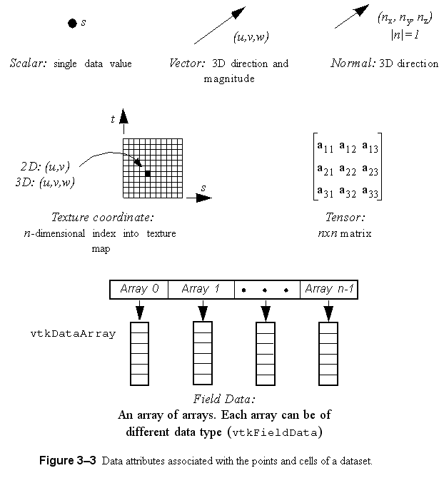
Field Information
Store information defined over grids
Stored in concrete classes that derive from vtkDataArray
  vtkFloatArray
  vtkIntArray
  vtkDoubleArray
  vtkUnsignedCharArray
  …

Slide 75
vtkDataArray : Basis for vtkDataObject Contents
tuple 0
An array of n tuples
Each tuple has
m components
Internal implementation is a pointer to an n x m block of memory
Data type determined by class
Two APIs : generic and data type specific
tuple n-1
http://www.vtk.org/doc/nightly/html/classvtkDataArray.html

Slide 76
vtkDataArray
SetNumberOfComponents() – call first
SetNumberOfTuples()
  For point data must be set to number of points
  For cell data must be set to number of cells
SetArray()
  If flat array has proper component & tuple ordering use existing memory – most efficient
  Can specify who should delete
  VTK uses pipeline architecture so coprocessing library will NOT modify array values
SetTupleValue() – uses native data type
SetValue() – uses native data type
SetName() – array descriptor, e.g. velocity, density
http://www.vtk.org/doc/nightly/html/classvtkDataArray.html

Slide 77
vtkFieldData
Object for storing vtkDataArrays
vtkDataSet::GetFieldData() – non-grid associated arrays
Derived classes
  vtkPointData – vtkDataSet::GetPointData()
  vtkCellData – vtkDataSet::GetCellData()
vtkFieldData::AddArray()
Specific arrays are normally retrieved by name from vtkFieldData
  Uniqueness is not required but can cause unexpected results
http://www.vtk.org/doc/nightly/html/classvtkFieldData.html

Slide 78
vtkCompositeDataSet
Way to combine multiple vtkDataSets into a single VTK structure
vtkMultiBlockDataSet
  Block structure must be the same on each process
  Block is null if data set is on a different process
  SetNumberOfBlocks()
  SetBlock()
vtkHierarchicalBoxDataSet
  AMR data sets using vtkUniformGrids
  SetNumberOfLevels()
  SetNumberOfDataSets()
  SetDataSet()
http://www.vtk.org/doc/nightly/html/classvtkCompositeDataSet.html

Slide 79
Grid Partitioning
For unstructured grids and polydatas
  Single data set per process – use as is
  Multiple data sets per process – choice of combining or not depends on memory layout
For topologically structured grids
  Must be partitioned into logical blocks
  SetExtent()
    Index of first and last point in each direction
    Will be different on each process
  vtkCPInputDataDescription::SetWholeExtent() – same on each process

Slide 80
vtkUnstructuredGrid Example
void CreateGrid(vtkCPDataDescription* dataDescription, int numPoints, double* coordsArray, int numCells, int* cellConnectivity, double* dofArray)
{
vtkUnstructuredGrid* grid = vtkUnstructuredGrid::New();
vtkPoints* nodePoints = vtkPoints::New();
vtkDoubleArray* coords = vtkDoubleArray::New();
coords->SetNumberOfComponents(3);
coords->SetNumberOfTuples(numPoints);
for(int i=0;i<*numPoints;i++)
{
double tuple[3] = {coordsArray[i],
coordsArray[i+numPoints],
coordsArray[i+numPoints*2]};
coords->SetTupleValue(i, tuple);
}
nodePoints->SetData(coords);
coords->Delete();
grid->SetPoints(nodePoints);
nodePoints->Delete();
…

Slide 81
vtkUnstructuredGrid Example (2)
Only tetrahedra in this example
Canonical ordering of tetrahedra is same in simulation data structures and VTK
…
vtkIdType pts[4];
for(int iCell=0;iCell<numCells;iCell++)
{
for(int i=0;i<4;i++)
{
pts[i] = cellConnectivity[iCell+i*numCells];
}
grid->InsertNextCell(VTK_TETRA, 4, pts);
}
dataDescription->GetInputDescriptionByName("input")
->SetGrid(grid);
grid->Delete();
…

Slide 82
vtkUnstructuredGrid Example (3)
…
vtkCPInputDataDescription* idd =
dataDescription->GetInputDescriptionByName("input");
if(idd->IsFieldNeeded("velocity")) {
vtkDoubleArray* velocity = vtkDoubleArray::New();
velocity->SetName("velocity");
velocity->SetNumberOfComponents(3);
velocity->SetNumberOfTuples(numPoints);
for (vtkIdType idx=0; idx<numPoints; idx++) {
velocity->SetTuple3(idx, dofArray[idx],
dofArray[idx+ numPoints], dofArray[idx+ 2*numPoints]);
}
grid->GetPointData()->AddArray(velocity);
velocity->Delete();
}
if(idd->IsFieldNeeded("pressure")) {
vtkDoubleArray* pressure = vtkDoubleArray::New();
pressure->SetName("pressure");
pressure->SetArray(dofArray+3*numPoints, numPoints, 1);
grid->GetPointData()->AddArray(pressure);
pressure->Delete();
}
}

Slide 83
Binding to Fortran and C

Slide 84
Adaptor Strategy
Use existing/create flat arrays in C/Fortran code
Create VTK data objects in C++ code
  vtkDataArrays can use existing memory without coprocessing library modifying it
API at ParaView/CoProcessing/Adaptors/FortranAdaptors/FortranAdaptorAPI.h
Use CMake to simplify the build process
  BUILD_COPROCESSING_ADAPTORS →ON

Slide 85
FortranAdaptorAPI.h
Fortran to C/C++ bindings – call xyz()
  Lower case C/C++ function names
    Add underscore to end of function name – void xyz_()
    Unchanged – void xyz()
  Upper case C/C++ function name – void XYZ()
extern "C" void coprocessorinitialize_(char* pythonFileName, int* pythonFileNameLength);
  Creates a static vtkCPProcessor object and sets the python script file name
  Creates a vtkCPDataDescription object and adds in an input with name “input”
extern "C" void coprocessorfinalize_();
  Deletes vtkCPProcessor and vtkCPDataDescription objects
Notes:
Next release of ParaView will use Cmake’s Fortran/C module to help with this.

Slide 86
FortranAdaptorAPI.h (2)
extern "C" void requestdatadescription_(int* timeStep, double* time, int* coprocessThisTimeStep);
  Checks with the python coprocessing script whether or not to process for input timeStep and time
  Sets coprocessThisTimeStep
    1 – do coprocessing
    0 – skip coprocessing

Slide 87
FortranAdaptorAPI.h (3)
extern "C" void needtocreategrid_(int* needGrid);
  Checks whether or not a grid has been created and added to the vtkCPDataDescription object
    Assumes the grid is static
    Sets needGrid
      1 – need to create the grid
      0 – a grid exists
  Clears field data from the created grid
extern "C" void coprocess_();
  Only need to call if coprocessing is requested
  Must create grid and set field information first
  Executes the proper coprocessing pipelines

Slide 88
FortranAdaptorAPI.h (4)
Helper functions:
vtkCPDataDescription* GetCoProcessorData();
  Access to a static vtkCPDataDescription object
void ClearFieldDataFromGrid(vtkDataSet* grid);
  Assumes grid is static but field information is changing
bool ConvertFortranStringToCString(char* fortranString, int fortranStringLength, char* cString, int cStringMaxLength);
  C/C++ code doesn’t know when Fortran strings end

Slide 89
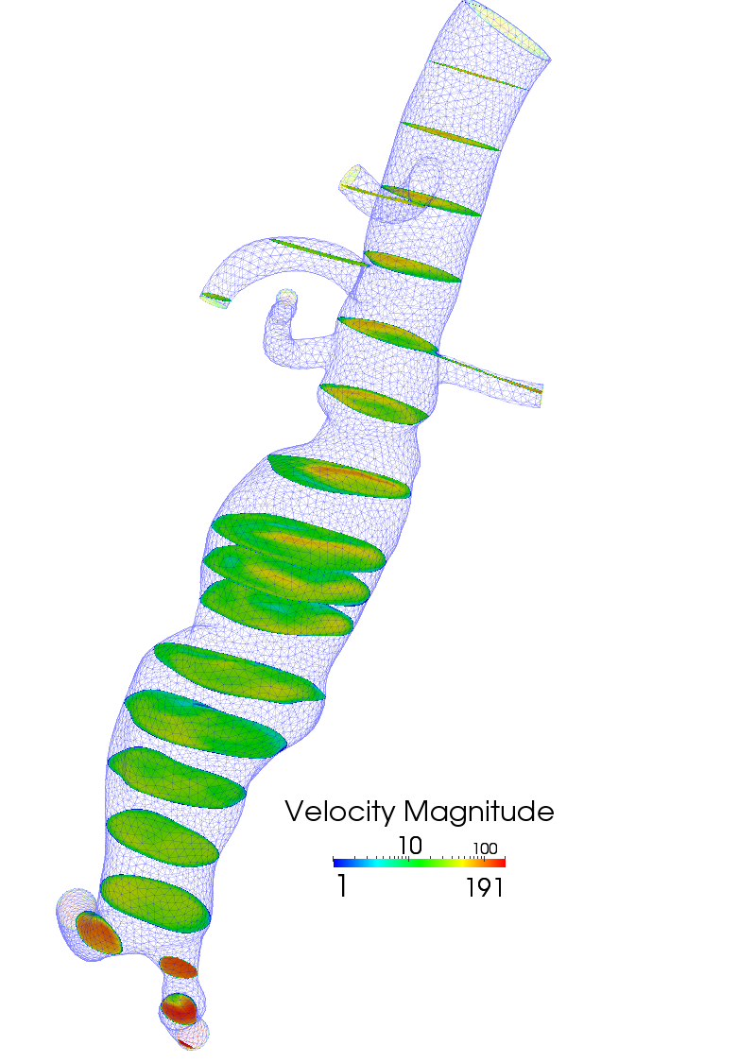
PHASTA Example
ParaView/CoProcessing/Adaptors/FortranAdaptors/PhastaAdaptor
phastaadaptor.f
  Creates the flat arrays from PHASTA data structures
  PHASTA blocks some information for cache efficiency
PhastaAdaptor.cxx
  Similar to the vtkUnstructured example shown earlier
  Single unstructured grid per block
  Scalar temperature and pressure arrays just reference PHASTA memory

Slide 90
Compiling Fun

Slide 91
Cross Compiling
Why / when should we cross compile?
- When target platform does not support a compiler environment
- Mobile devices, embedded systems
- Supercomputers
Native, or build platform vs. target, or host platform

Slide 92
Cross Compiling
Need headers and libraries for target platform
Need to restrict search paths when configuring build

Slide 93
Cross Compiling
Configure time tests
- Try compile
- Example: check if symbol exists
- No problem
- Try run
- Example: check if char is signed
- Can’t do it! Test must run on target platform

Slide 94
Cross Compiling
Problem: compile time code execution
Example, python wrapping:
- Compile a helper executable
- Helper writes generated source files
- Generated source files are compiled
Solution:
- Compile helper executables natively
- Invoke native executables while cross compiling

Slide 95
Cross Compiling with CMake
CMake is a configure tool, writes Makefiles
To cross compile, specify a toolchain file:
cmake –D CMAKE_TOOLCHAIN_FILE=/path/to/toolchain.cmake
Toolchain file specifies target platform, compilers, search paths, default flags

Slide 96
Cross Compiling with CMake
Handling Try Run tests:
  CMake generates a file with the command line of the Try Run test it wants to execute
  User executes Try Run tests by hand, types result into generated file for CMake to read
ParaView is distributed with TryRunResults files for popular target platforms

Slide 97
Cross Compiling with CMake
Handling compile time code execution in CMake
  Configure the project twice: native and cross compile
  For native build, compile only the helper executables
  During cross compile, use native executables

Slide 98
Cross Compiling with CMake
# Invoke a python wrapper executable to generate a new source file
# and then create a library with the generated source file
add_custom_command(
OUTPUT myClassPython.cpp
DEPENDS pythonWrapper myClass.cpp
COMMAND pythonWrapper
ARGS myClass.cpp)
add_library(mymodule myClassPython.cpp)

Slide 99
Cross Compiling with CMake
# Create the python wrapper executable
if(NOT CMAKE_CROSSCOMPILING)
add_executable(pythonWrapper pythonWrapper.c)
else()
add_executable(pythonWrapper IMPORTED)
set_target_properties(pythonWrapper
PROPERTIES IMPORTED_LOCATION "/path/to/pythonWrapper")
endif()

Slide 100
Cross Compiling with CMake
if(CMAKE_CROSSCOMPILING)
find_package(HostTools REQUIRED)
else()
add_custom_target(HostTools)
endif()
if(NOT CMAKE_CROSSCOMPILING)
add_executable(pythonWrapper pythonWrapper.c)
export(TARGETS pythonWrapper FILE HostTools.cmake APPEND)
add_dependencies(HostTools pythonWrapper)
endif()
make HostTools

Slide 101
Cross Compiling with CMake
CMake discovers MPI headers and libraries
CMake invokes mpi compiler wrapper to determine required paths and libraries
mpicxx –show

Slide 102
Static Python Linking
A simple python module example
import mymodule
mymodule.say_hello()
Pure python module: mymodule.py
Extension module: mymodule.so
  mymodule.so is dynamically loaded
  Contains C function: void initmymodule()

Slide 103
Static Python Linking
#include <Python.h>
int main() {
Py_Initialize();
const char* code = "import mymodule \n"
"mymodule.say_hello() \n";
PyRun_SimpleString((char*)code);
Py_Finalize();
}

Slide 104
Static Python Linking
#include <Python.h>
extern void initmymodule();
int main() {
PyImport_AppendInittab(" mymodule ", initmymodule);
Py_Initialize();
const char* code = "import mymodule \n"
"mymodule.say_hello() \n";
PyRun_SimpleString((char*)code);
Py_Finalize();
}
Executable now has a dependency on mymodule.so

Slide 105
Static Python Linking
Use static linking to avoid shared library dependencies
Must compile python statically
  configure –disable-shared
  libpython2.6.a instead of libpython2.6.so
Python standard library includes many extension modules
  Want to compile math.c into libpython2.6.a, instead of producing math.so

Slide 106
Static Python Linking
After configuring python, edit file Modules/Setup to indicate which modules should be included as part of libpython2.6.
Or, use CMake! CMake handles static extension modules and cross compiling
CMakified version of python 2.5 is available

Slide 107
Minimizing Executable Size
pvbatch is a paraview server and python batch client
  includes python, mesa rendering, mpi
pvbatch static executable is 130 MB using ibm xlC cross compiler
Coprocessor library therefore adds 130 MB

Slide 108
Minimizing Executable Size
Leverage static linking to determine minimal set of object code required
Linker will copy relevant sections of archive libraries into final executable based on symbols referenced

Slide 109
Minimizing Executable Size
Problem: wrapper layers reference almost all the code in a library
Paraview wrappers:
  python
  client server
  instantiator

Slide 110
Minimizing Executable Size
If we knew which functions would be invoked by the wrappers then we could use just a subset of the wrappers
Compile with full wrappers, run coprocessing routine, debugging printf’s write all wrapper invocations to a file
Tool parsers the debug file and generates a header file that references the minimal set of wrappers required

Slide 111
Minimizing Executable Size
Recompile using minimal required wrappers
130 MB → 25 MB
Issue: if you change your coprocessing routine you may require wrappers that are not available

Slide 112
Minimizing Executable Size
Compromise solution- vtkmodular
vtkmodular is a re-organization of the VTK libraries into smaller modules
vtkmodular is a future solution, paraview does not yet build against modularized vtk libraries.

Slide 113
Minimizing Startup Time
On very large jobs, startup time can be a major concern
Must avoid all-process disk operations
Without taking special precautions, python can be very detrimental to startup time
We can write our code to avoid long startup times without relying on tricks that are specific to the OS or filesystem

Slide 114
Minimizing Startup Time
Python inspects the filesystem in order to build a module search path when the PYTHONPATH environment variable is not set
export PYTHONPATH=/foo

Slide 115
Minimizing Startup Time
Watch out for the PYTHONSTARTUP environment variable, some environments set this to an rc file
unset PYTHONSTARTUP

Slide 116
Minimizing Startup Time
All processes will attempt to read the .py files when python extension modules are imported
For example: ‘import os’ will read os.py from disk
Solution- use the python freeze tool to embed the .py file contents into the executable
python freeze.py myscript.py

Slide 117
Minimizing Startup Time
Compiling frozen modules:
#include "Python.h"
extern unsigned char M_paraview__simple[];
static struct _frozen my_frozen_modules[] = {
{"paraview.simple", M_paraview__simple, 36946},
{0, 0, 0}
};
void init_frozen_modules()
{
PyImport_FrozenModules = my_frozen_modules;
}

Slide 118
Minimizing Startup Time
What about .py files we want to change between runs?
Read .py files on process zero, broadcast file contents to all processes
On all processes, use python imp.new_module to create a new, empty module, then execute the file contents in the new module

Slide 119
Live catylst demo

Slide 120

Coprocessing as an I/O Service
Using ADIOS
to deliver and transform data
from application to ParaView
through a processing pipeline

Slide 121
Agenda
Introduction
ADIOS Adaptable I/O Framework
  Available I/O interfaces.
  File based examples
Staging I/O method using DataSpaces
A code coupling example
Demo
Future directions to the exascale

Slide 122
Service Oriented Architecture philosophy
The overarching design philosophy of our framework is based on the Service-Oriented Architecture for software
  Successfully used by enterprise software systems to deal with system/application complexity, rapidly changing requirements, rapidly evolving target platforms, and diverse development teams
Applications is constructed by assembling services based on a universal view of their functionality using a well-defined API
Service implementations can be changed easily, and workflows can be customized to fit application requirements
Integrated simulation systems can be assembled using these codes as well as coupling and data-movement services

Slide 123
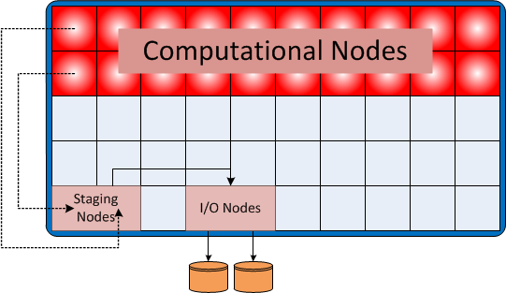
Data Staging
Why staging?
  Reduces performance linkage
  between I/O subsystem and
  application
  Decouple file system perfor-
  mance variations and limitations
  from application run time
Enables optimizations based on dynamic number of writers
High bandwidth data extraction from application
Scalable data movement with shared resources requires us to manage the transfers
Scheduling properly can greatly reduce the impact of I/O

Slide 124
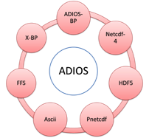
ADIOS: Adaptable I/O System
Provides portable, fast, scalable,
easy-to-use,metadata rich output
with a simple API
Change I/O method by changing XML
Layered software architecture:
  Allows plug-ins for different I/O
  implementations
  Abstracts the API from the method
  used for I/O
Open source:
  http://www.nccs.gov/user-support/center-projects/adios/
Research methods from many groups
S3D: 32 GB/s with 96K cores, 1.9MB/core:
  0.6% I/O overhead with ADIOS
XGC1 code: 40 GB/s, SCEC code: 30 GB/s
GTC code: 40 GB/s, GTS code: 35 GB/s

Slide 125
BP File Format
Why a new file format?
  Flexible data storage not restricted to a particular decomposition
    netcdf – totally linear, hdf5 – linear per variable
  Resilience to failures
    no rewriting of file to change header (netcdf)
    failure of any process will not corrupt the output
  Metadata collection for faster analysis
    replicated data characteristics to aid in data selection/identification
    no unique data stored in the index
Initially developed to gain writing performance over legacy file formats.
  No “messy” rearrangement of the data when writing from multiple processors.
Self-describing format and hierarchical view of the data (like HDF5).
Tested at scale (220K processors for XGC-1 on Jaguar).
Easy conversion to legacy file formats: HDF5, netcdf

Slide 126
Output file is self-describing
$ bpls -lav writer.bp
File info:
of groups: 1
of variables: 10
of attributes: 6
time steps: 0 - 4
file size: 34 KB
bp version: 513
endianness: Little Endian
statistics: Min / Max / Avg / Std_dev
integer /info/nproc 5*scalar = 4 / 4
integer /info/npx 5*scalar = 2 / 2
integer /info/npy 5*scalar = 2 / 2
integer /gdx 5*scalar = 8 / 8
integer /gdy 5*scalar = 10 / 10
integer /aux/ox 5*scalar = 0 / 0
integer /aux/oy 5*scalar = 0 / 0
integer /aux/ldx 5*scalar = 4 / 4
integer /aux/ldy 5*scalar = 5 / 5
double /xy 5*{10, 8} = 0.01 / 3.05 / 1.53 / 1.11812
string /info/nproc/description attr = "Number of writers"
string /info/npx/description attr = "Number of processors in x dimension"
string /info/npy/description attr = "Number of processors in y dimension"
string /gdx/description attr = "Global array size in x dimension"
string /gdy/description attr = "Global array size in y dimension"
string /xy/description attr = "2D array with 2D decomposition"
Notes:
gdx, gdy describe the size of a global array ‘xy’ written by 2x2 processes with 2D decomposition of ldx x ldy blocks.
Metadata includes Min/Max/Avg/Std.dev for each array.

Slide 127
ADIOS API
XML for mapping C/F90 variables
Code which writes data
<adios-group name="writer2D" >
<global-bounds dimensions=“gdx,gdy”
offsets=”ox,oy">
<var name="xy" type=“real“
dimensions=”ldx,ldy"/>
</global-bounds>
</adios-group>
<transport group=“writer2D”
method = “MPI” />
call adios_open (adios_handle,
"writer2D", filename, “a”,
group_comm, adios_err)
#include "gwrite_writer2D.fh"
call adios_close (adios_handle,
adios_err)
<adios-group name="writer2D" >
<global-bounds dimensions=“gdx,gdy”
offsets=”ox,oy">
<var name="xy" type=“real“
dimensions=”ldx,ldy"/>
</global-bounds>
</adios-group>
<transport group=“writer2D”
method = “DATASPACES” />
Change the method for
memory to memory coupling
Notes:
XML defines the variables to be written, and how global arrays are to be composed/viewed from the pieces that individual processes write.
A header automatically is generated and is included in the writing code. But adios_write() Is available to state what variables to write in the source itself.
Each process can read in an arbitrary slice of ‘xy’.
A non-XML API is also available for full control from within the source if you prefer (e.g. variable names depend on code configuration)

Slide 128
ADIOS API
Code which reads file data
call adios_read_init_method (ADIOS_READ_METHOD_BP, group_comm,“”,ierr);
call adios_read_open_stream (inh, infn, 0, group_comm,
ADIOS_LOCKMODE_CURRENT, 60.0, ierr)
do while (ierr != err_stream_terminated)
call adios_selection_boundingbox (sel, 0, offset, readsize)
call adios_schedule_read (inh, sel, "gdx", 1, 1, gdx, ierr)
call adios_schedule_read (inh, sel, "gdy", 1, 1, gdy, ierr)
call adios_perform_reads (inh, ierr)
! … calculate offsets and sizes of xy to read in…
call adios_selection_boundingbox (sel, 2, offset, readsize)
call adios_schedule_read (inh, sel, "xy", 1, 1, xy, ierr)
call adios_perform_reads (inh, ierr)
call adios_advance_step(inh, 0, 60.0, ierr)
enddo
call adios_read_close (inh, ierr)
Notes:
XML defines the variables to be written, and how global arrays are to be composed/viewed from the pieces that individual processes write.
A header automatically is generated and is included in the writing code. But adios_write() Is available to state what variables to write in the source itself.
Each process can read in an arbitrary slice of ‘xy’.
A non-XML API is also available for full control from within the source if you prefer (e.g. variable names depend on code configuration)

Slide 129
ADIOS API
Code which reads stream data
call adios_read_init_method (ADIOS_READ_METHOD_DATASPACES, group_comm,“”,ierr);
call adios_read_open_stream (inh, infn, 0, group_comm,
ADIOS_LOCKMODE_CURRENT, 60.0, ierr)
do while (ierr != err_stream_terminated)
call adios_selection_boundingbox (sel, 0, offset, readsize)
call adios_schedule_read (inh, sel, "gdx", 1, 1, gdx, ierr)
call adios_schedule_read (inh, sel, "gdy", 1, 1, gdy, ierr)
call adios_perform_reads (inh, ierr)
! … calculate offsets and sizes of xy to read in…
call adios_selection_boundingbox (sel, 2, offset, readsize)
call adios_schedule_read (inh, sel, "xy", 1, 1, xy, ierr)
call adios_perform_reads (inh, ierr)
call adios_advance_step(inh, 0, 60.0, ierr)
enddo
call adios_read_close (inh, ierr)
Now we have memory to memory coupling

Slide 130
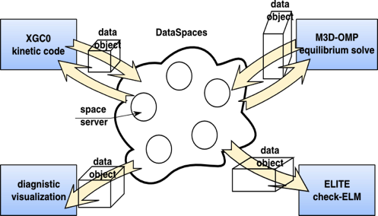

DataSpaces
Semantically-specialized virtual shared space
  3D space, put/get functions
  Put arrays with local sizes and offsets in space
  Get an arbitrary slice
Constructed on-the-fly on the cloud of staging nodes
  Indexes data for quick access and retrieval
Complements existing interaction/coordination mechanisms
  In-memory code coupling becomes part of the I/O pipeline
courtesy of Manish Parashar, Rutgers University
http://nsfcac.rutgers.edu/spaces/dataspaces.php

Slide 131
Demonstration

Slide 132
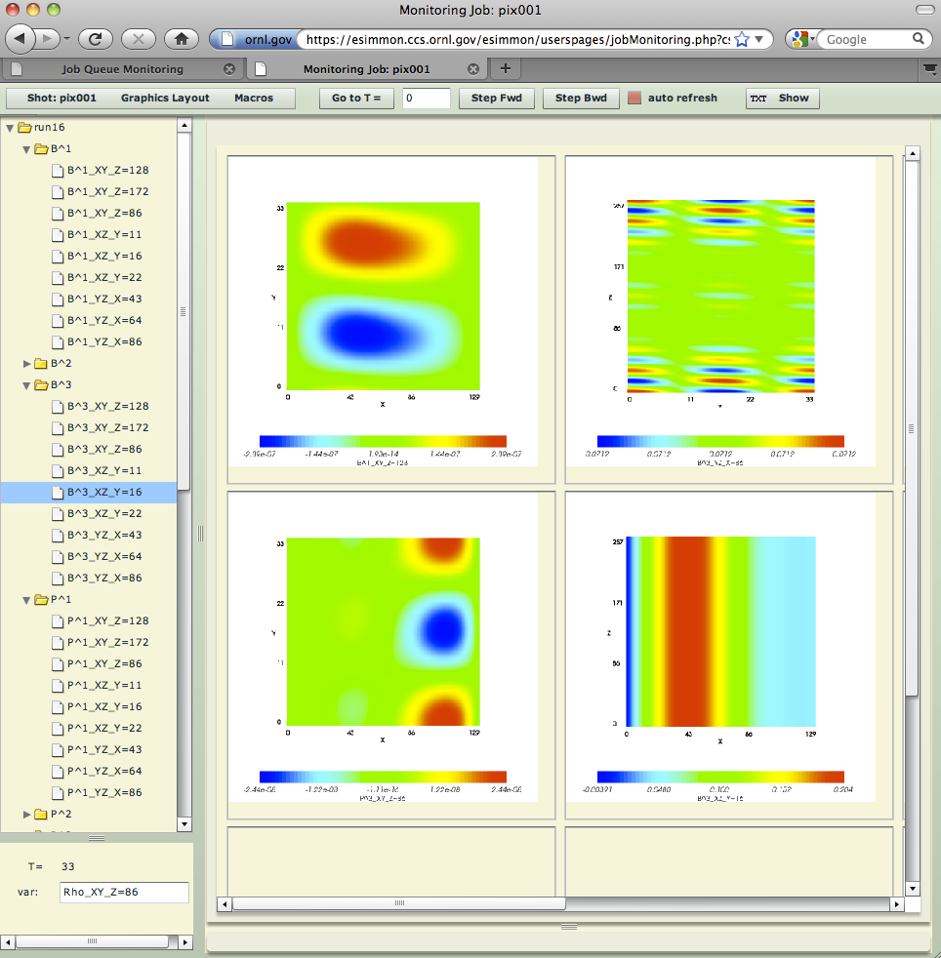
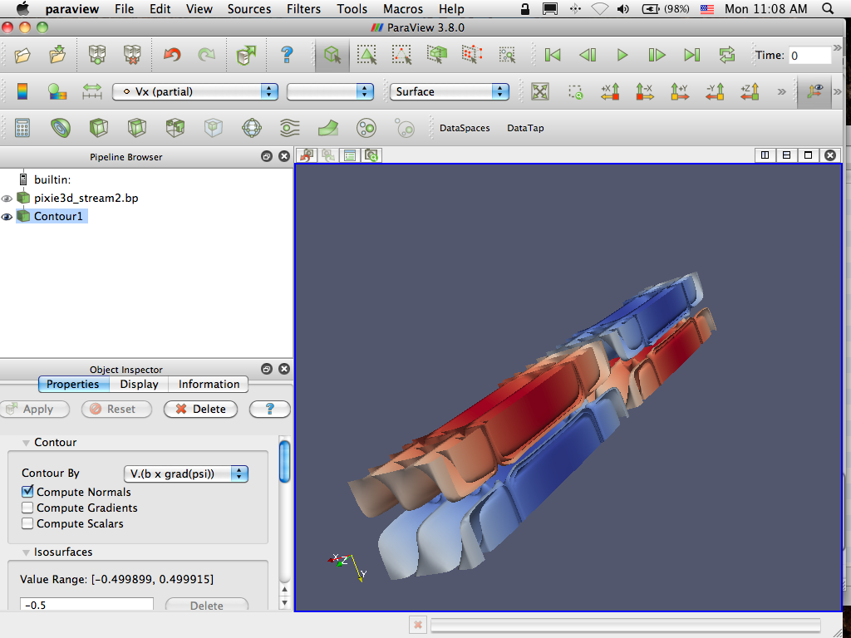


In-situ viz. and monitoring with staging
Pixie3D
1024 cores
Pixplot
8 cores
record.bp
Pixmon
1 core
(login node)
record.bp
record.bp
pixie3d.bp
pixie3d.bp
pixie3d.bp
ParaView Server
4 cores
DataSpaces

Slide 133
Towards the Exascale
Reduce IO overhead for all platforms.
Create a robust I/O staging framework for in situ analysis and reduction of extreme-scaled application data.
Create a toolkit of I/O services such as FastBit indexing that scientists can easily utilize.
Create and extend programming models for end scientists to utilize in situ I/O stream processing
Reduction of data movement for I/O pipelines.
Easy to Use.
Portable and scalable performance with low variability.

Slide 134
In Situ Workflows
Raw data
Definition of pipelines
Separate codes
(in-situ services)
Dependency defined by ADIOS variables
Data exchange =
ADIOS read/write
Kmeans
FastBit Indexing
Data Reduc-tion
Write
Write
Write
GTC in situ pipeline with ADIOS/DataTap

Slide 135
Selected References
ADIOS
J. Logan, S. Klasky, H. Abbasi, Q. Liu, G. Ostrouchov, M. Parashar, N. Podhorszki, Y. Tian, M. Wolf: "Understanding I/O Performance using I/O Skeletal Applications", EuroPar'12, Rhodos, Greece, 2012
J. Lofstead, F. Zheng, Q. Liu, S. Klasky, R. Oldfield, T. Kordenbrock, K. Schwan, M. Wolf, “Managing Variability in the IO Performance of Petascale Storage Sytems”, ACM/IEEE SC 2010 Conference (SC’10), 2010.
J. Lofstead, F. Zheng, S. Klasky, K. Schwan, “Adaptable Metadata Rich IO Methods for Portable High Performance IO”, IPDPS 2009, IEEE Computer Society Press 2009.
Reading with ADIOS
Y. Tian, S. Klasky, H. Abbasi, J. Lofstead, R. Grout, N. Podhorszki, Q. Liu, Y. Wang, W. Yu. "EDO: Improving Read Performance for Scientific Applications Through Elastic Data Organization", Cluster 2011
J. Lofstead, M. Polte, G. Gibson, S. Klasky, K. Schwan, R, Oldfield, M. Wolf, “Six Degrees of Scientific Data: Reading Patterns for Extreme Scale Science IO”, HPDC 2011.
Milo Polte, Jay Lofstead, et al. “…And eat it too: High read performance in write-optimized HPC I/O middleware file formats., 4th Petascale Data Storage Workshop, November 15, 2009. Portland, Oregon.
Staging
F. Zhang, C. Docan, M. Parashar, S. Klasky, N. Podhorszki, H. Abbasi: "Enabling In-situ Execution of Coupled Scientific Workflow on Multi-core Platform", (IPDPS 2012), Shanghai, China, May 2012.
F. Zhang, C. Docan, M. Parashar, S. Klasky, “Enabling Multi-Physics Coupled Simulations within the PGAS Programming Framework”, CCGrid 2011 .
H. Abbasi, G. Eisenhauer, S. Klasky, K. Schwan, M. Wolf., “Just In Time: Adding Value to IO Pipelines of High Performance Appications with JITStaging, HPDC 2011.
C. Docan, J. Cummings, S. Klasky, M. Parashar, “Moving the Code to the Data – Dynamic Code Deplyment using ActiveSpaces”, IPDPS 2011.
F. Zheng, H. Abbasi, C. Docan, J. Lofstead, Q. Liu, S. Klasky, M. Parashar, N. Podhorszki, K. Schwan, M. Wolf, “PreDatA - Preparatory Data Analytics on Peta-Scale Machines”, IPDPS 2010
C. Docan, M. Parashar, J. Lofstead, K. Schwan, S. Klasky “DART: An Infrastructure for High Speed Asynchronous Data Transfers”, IPDPS 08.
Code coupling
C. Docan, J. Cummings , S. Klasky , M. Parashar, N. Podhorszki, F. Zhang, “Experiments with Memory-to-Memory Coupling for End-to-End fusion Simulation Workflows”, CCGrid2010
J. Cummings et al., “EFFIS: and End-to-end Framework for Fusion Integrated Simulation”, PDP 2010, 18th Euromicro International Conference on Parallel, Distributed and Network-Based Computing, Pisa, Italy, 2010.

Slide 136
ADIOS Online
http://www.olcf.ornl.gov/center-projects/adios
  download adios source
  see examples/ directory in source
Email: help@nccs.gov
Movie of demonstration
  http://users.nccs.gov/~pnorbert/Paraview_insituviz_Adios_DataSpaces_smallcase.mov
    movie shows real time, so be patient…
Example code used for here to show write/read
  http://users.nccs.gov/~pnorbert/SC12_insitu_ADIOS_example.tgz

Slide 137
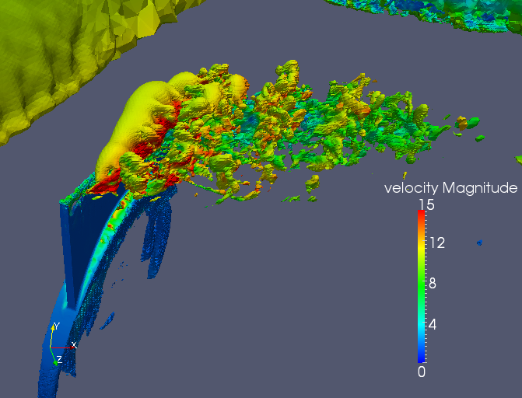
Use the Software!
http://www.paraview.org
Email: paraview@paraview.org
BSD style license
http://www.olcf.ornl.gov/center-projects/adios
Email: help@nccs.gov
BSD license
Rasquin, Jansen, et. al.
Notes:
Isosurface of vertical velocity colored by speed and cut plane through the synthetic jet (on 22 Million element mesh)
Kitware will be part of the NASA booth on Tuesday and part of Thursday
The Poster Session will be held Tuesday, November 15 2011 from 5:15-7:00PM in the lobby in the 2nd/3rd floors of the North Galleria of the Seattle Convention Center.
Could you also let me know when the coprocessing tutorial will take place so that I can make some advertisement if the poster session takes place earlier?
Please find below the title, the authors list and the abstract of the poster:
"Co-visualization of full data and in situ data extracts from unstructured grid CFD at 160k cores"
M. Rasquin, P. Marion, V. Vishwanath, R. Loy, A. Bauer, B. Matthews, M. Zhou, O. Sahni, J. Fu, N. Lu, C. Carothers, M. Shephard, M. Hereld, M. Papka, K. Kumaran, B. Geveci, K. Jansen
Scalability and time-to-solution studies have historically been focused on the size of the problem and run time. We consider a more strict definition of “solution” whereby a live data analysis provides continuous and reconfigurable insight into massively parallel simulations.
Specifically, we used the Argonne ALCF's BlueGene/P machine with 163,840 cores tightly linked through a high-speed network to 100 visualization nodes that share 200 GPUs.
Two meshes with 416M and 3.3B elements discretize the flow over a full swept wing with an unsteady synthetic jet. The 416M element mesh takes about 2 seconds per flow solve step including the extraction and rendering of a slice or a contour, slowing currently the simulation by only 10 and 15% respectively. The 3.3B element case proved scalable at about 15 seconds per time step.
This work will be presented with informational slides combined with a looping video and live demonstrations of our software.

Slide 138
The Network Scalable Service Interface (Nessie)
A Framework for Supporting Integrated Data Services
Ron A. Oldfield
Sandia National Laboratories
raoldfi@sandia.gov
SC2012 Tutorial: In-Situ Visualization with Catalyst
November 2012
Approved for Public Release: SAND2012-XXXXP

Slide 139
Some I/O Issues for Exascale
Storage systems are the slowest, most fragile, part of an HPC system
  Scaling to extreme client counts is challenging
  POSIX semantics gets in the way, …
Current usage models not appropriate for Petascale, much less Exascale
  Checkpoints are a HUGE concern for I/O…currently primary focus of FS
  App workflow uses storage as a communication conduit
    Simulate, store, analyze, store, refine, store, … most of the data is transient
  High-level I/O libraries (e.g., HDF5, netCDF) have high overheads
One way to reduce pressure on the FS is to inject processing nodes
  Reduce the “effective” I/O cost through data staging
  Reduce amount of data written to storage (integrated analysis, data services)
  Present FS with fewer clients (IO forwarding)
We call this “Integrated Data Services”

Slide 140
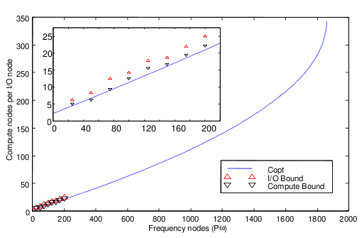
I/O Processing for Seismic Imaging
Our First Data Service (1996)
Salvo’s I/O Partition
  Partition of application processors (used separate MPI Communicator for I/O)
  Used for FFT, I/O cache, and interpolation
  Async I/O allowed overlap of I/O and computation (pre-process next step)
Results
  +10% nodes led to +30% in performance
  Modeling I/O and compute costs helped find the right balance of compute and I/O nodes
Contacts: Ron Oldfield, Curtis Ober
  {raoldfi,ccober}@sandia.gov
Client Application
(compute nodes)
I/O Partition
(compute nodes)
Frequency
Data
Processed Data
Storage
System
FFT
Oldfield, et al. Efficient parallel I/O in seismic imaging. The International Journal of High Performance Computing Applications, 12(3), Fall 1998

Slide 141
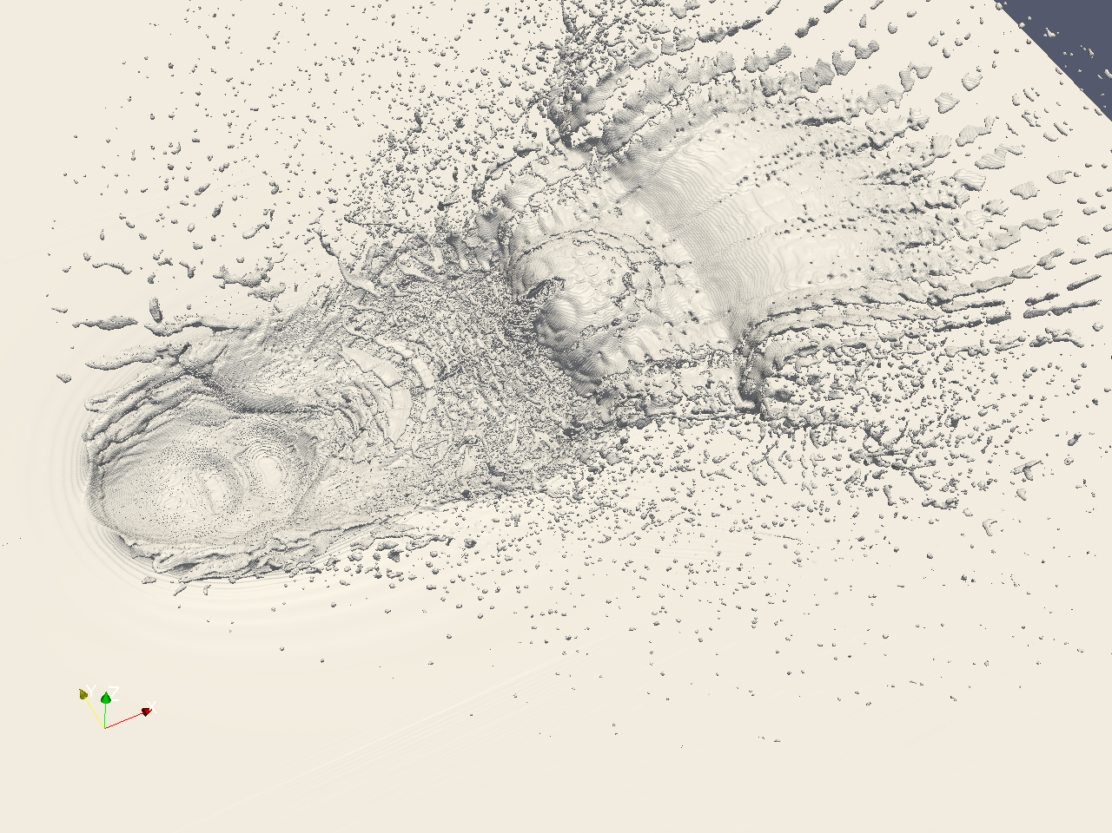

Network Scalable Service Interface (Nessie)
Purpose and Approach
  Reduce I/O impact on applications
  Leverage available compute/service nodes resources for staging and data processing
Nessie (now part of Trilinos)
  Framework for developing data services
  Abstract RDMA transport layer (NNTI)
  Client and server libs, cmake macros, utilities for deployment
I/O Services
  PnetCDF staging service
  Real-time analysis of shock physics code
  Interactive sparse-matrix visualization
  SQL Proxy
Client Application
(compute nodes)
I/O Service
(compute/service nodes)
Lustre File System
Raw Data
Processed Data
Visualization Client
Cache/aggregate/process

Slide 142
Nessie Network Transport Layer (NNTP)
An abstract API for RDMA-based interconnects
Provides portable methods for inter-application RDMA-based communication
Basic functionality
  Initialize/close the interface
  Connect/disconnect to a peer
  Register/deregister memory
  Transport data (put, get, wait)
Supported Interconnects
  Seastar (via Portals3)
  InfiniBand
  Gemini
  IBM BG/P
  Portals4 (coming…)
Clients
Application
NSSI Client API
NTTI
Ptls
uGNI
IB
Network
Ptls
uGNI
IB
NTTI
NSSI Service
Servers

Slide 143
Example: A Simple Transfer Service
Trilinos/packages/trios/examples/xfer-service
Client Application
Used to test Nessie API
  xfer_write_rdma: server pulls raw data using RDMA get
  xfer_read_rdma: server transfers data to client using RDMA put
Used for performance evaluation
  Test low-level network protocols
  Test overhead of XDR encoding
  Tests async and sync performance
Creating the Transfer Service
  Define the XDR data structs and API arguments
  Implement the client stubs
  Implement the server
Xfer-Service

Slide 144
Transfer Service
Implementing the Client Stubs
Interface between scientific app and service
Steps for client stub
  Initialize the remote method arguments, in this case, it’s just the length of the array
  Call the rpc function. The RPC function includes method arguments (args), and a pointer to the data available for RDMA (buf)
The RPC is asynchronous
  The client checks for completion by calling nssi_wait(&req);

Slide 145
Transfer Service
Implementing the Server
Implement server stubs
  Using standard stub args
  For xfer_write_rdma_srvr, the server pulls data from client
Implement server executable
  Initialize Nessie
  Register server stubs/callbacks
  Start the server thread(s)

Slide 146
Transfer Service Evaluation
Overhead of XDR Encoding on RedStorm
Lesson: Use one-sided API for bulk data transport

Slide 147
Transfer Service Evaluation
Read/Write performance
client-initiated
server-initiated
Client
Server
read
request
write
request
request
A
request
queue
B
PUT
GET
A
C
C
B
D
D
complete
data
buffers
data
xfer-write
xfer-read

Slide 148
Transfer Service Evaluation uGNI compared to MPI

Slide 149
Transfer Service Evaluation uGNI Compared to SeaStar
32 1KiB 32KiB 1MiB 32MiB

Slide 150
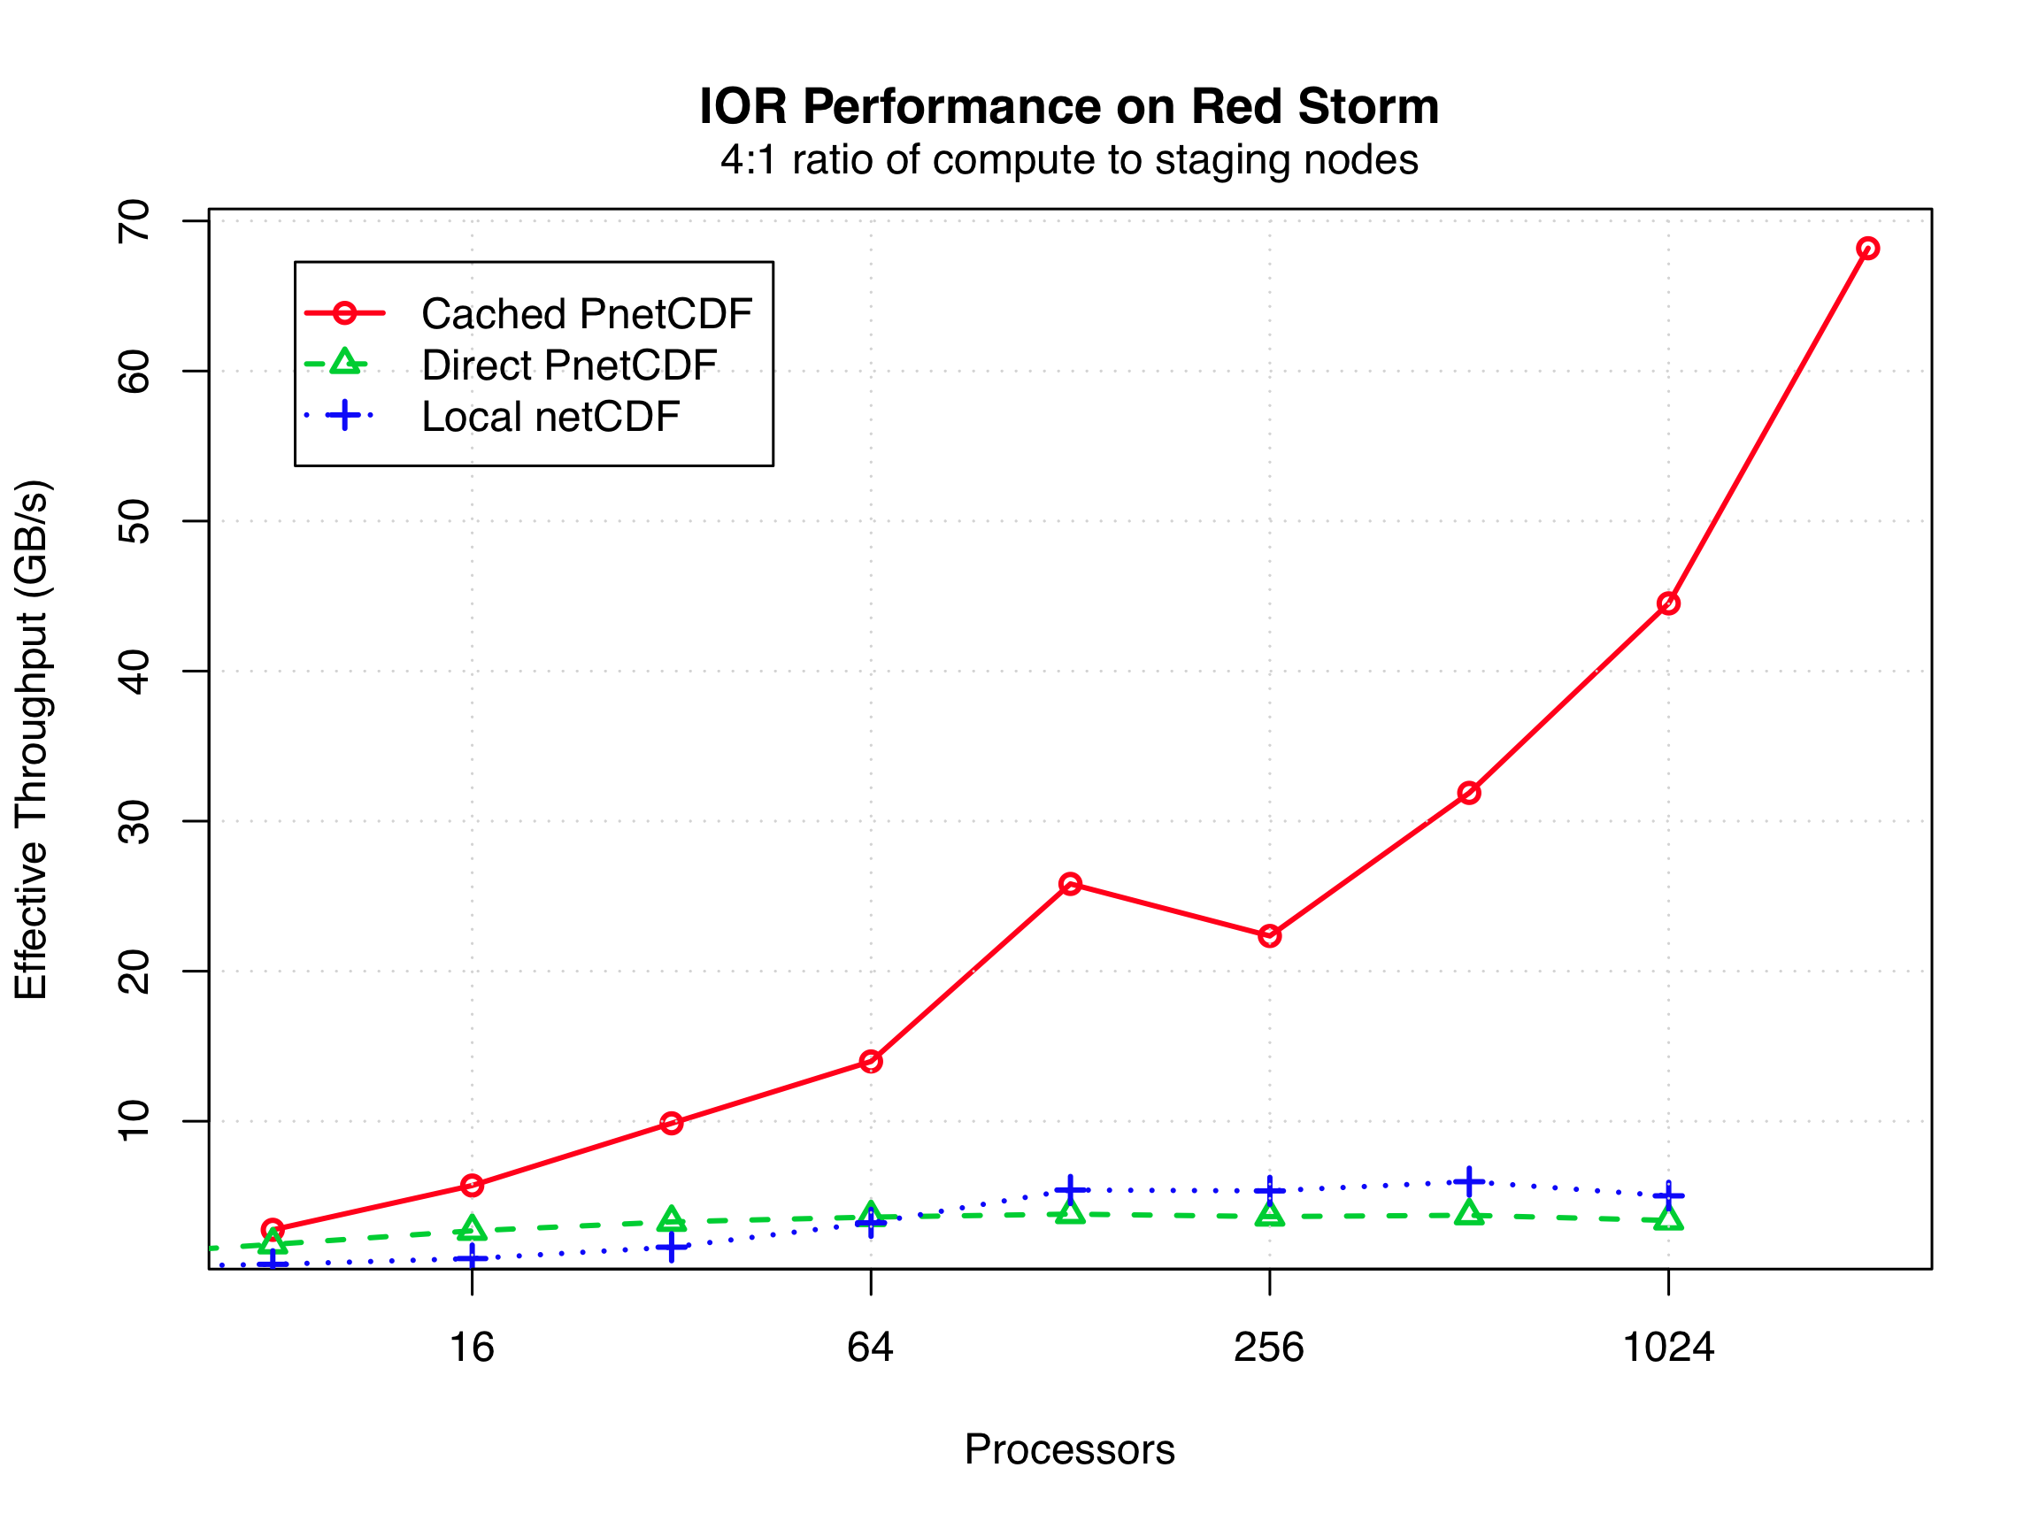
Scalable I/O Services
PnetCDF Data Staging
Motivation
  Synchronous I/O libraries require app to wait until data is on storage device
  Not enough cache on compute nodes to handle “I/O bursts”
  NetCDF is basis of important I/O libs at Sandia (Exodus)
Client Application
(compute nodes)
NetCDF Service
(compute nodes)
NetCDF requests
Processed Data
Cache/aggregate
Lustre File System
PnetCDF Caching Service
  Service aggregates/caches data and pushes data to storage
  Async I/O allows overlap of I/O and computation
Status
  First discussed at MSST 2006
  Implemented in 2007
  Presented at PDSW’11

Slide 151
Data Service Applications
CTH Fragment Detection
Motivation
  Fragment detection process can take up to 30% of time-step calculation
  Fragment tracking requires data from every time step (too data intensive for post processing)
  Integrating detection software with CTH is intrusive on developer
CTH fragment detection service
  Extra compute nodes provide in-line processing (overlap fragment detection with time step calculation)
  Only output fragments to storage (reduce I/O)
  Non-intrusive
    Looks like normal I/O (pvspy interface)
    Can be configured out-of-band
Status and Ongoing Work
  Porting to Cielo and RedSky
  Comparison of in-situ and in-transit
In-Situ Fragment Detection
In-Transit Fragment Detection

Slide 152
Data-Service Applications
SQL Service: Remote Access to Data Warehouse Appliances
Analyst
HPC System (Red Storm)
DWA
SQL Service*
  Provides “bridge” between parallel apps and external DWA
  Runs on Red Storm network nodes
  Titan applications communicate with service through Portals
  External resources (Netezza) communicate through standard interfaces (e.g. ODBC over TCP/IP)
TCP/IP
Service Nodes
(GUI and Database Services)
SQL
Netezza
High-Speed Network
(NNTI/Portals)
LexisNexis
Compute Nodes
(Titan Analysis Code)
Other
ODBC DWA
Anywhere
Tech Area 1
CSRI
The SQL service enables an HPC application to access a remote DWA
Additional Modifications for Multilingual
  Tokenization support on Netezza (goal is to count unique words)
  Developed a custom UTF-8 words splitter for SPU (snippet processing unit)
  Allows parallel tokenization and counting at storage device
* Results of SQL access from parallel statistics code presented at CUG’2009.
Notes:
Not

Slide 153
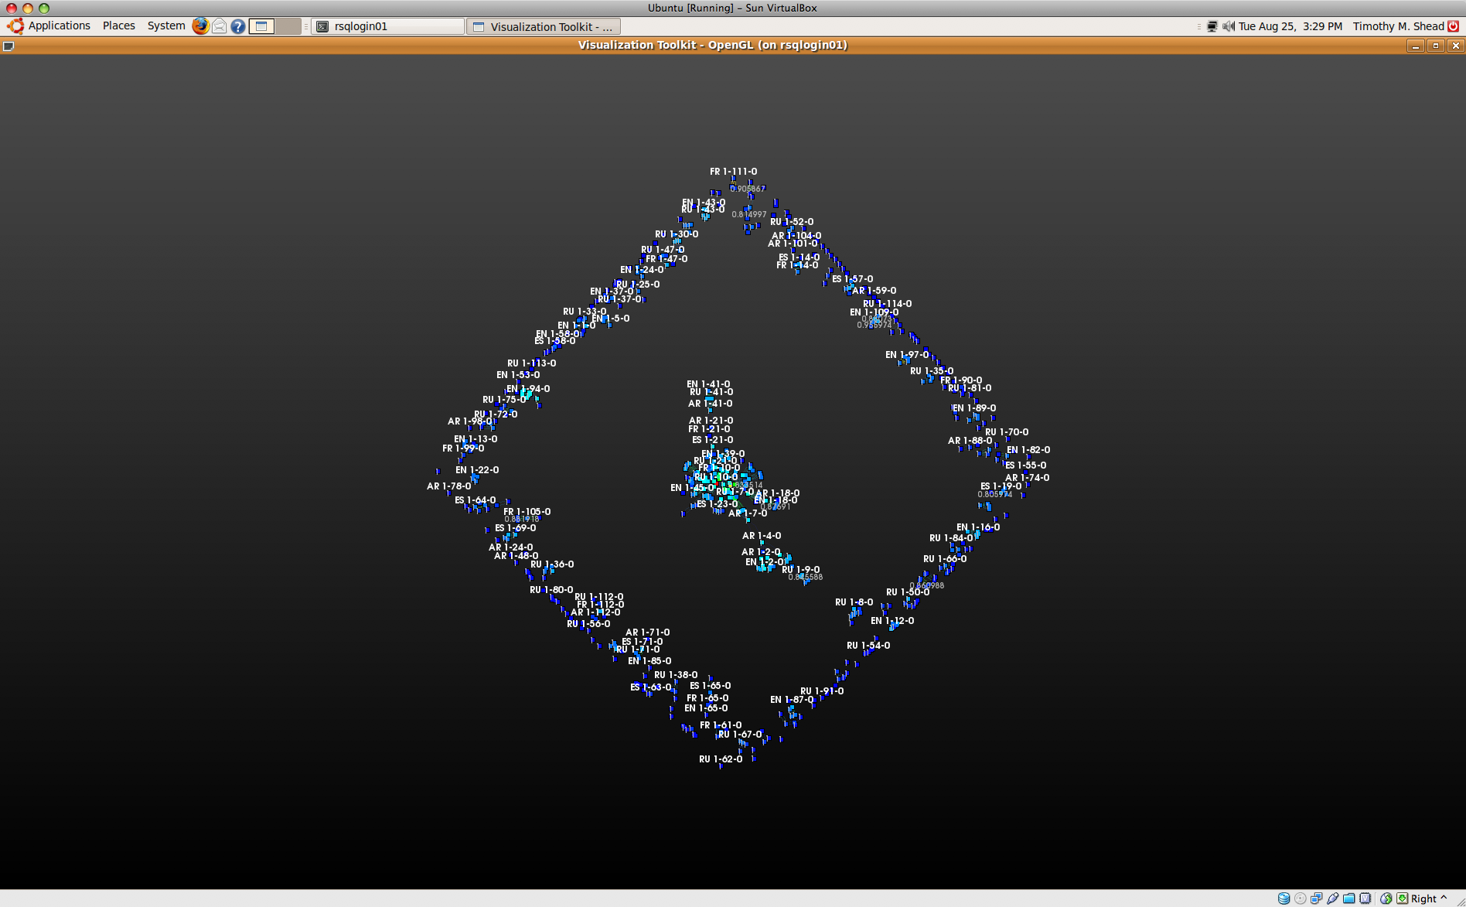
Data-Services Application
Interactive Visualization for Multilingual Document Clustering
Compute Nodes
(Trilinos Code)
Service Nodes
(VTK Service)
Titan Visualization
Similarity Matrix

Slide 154
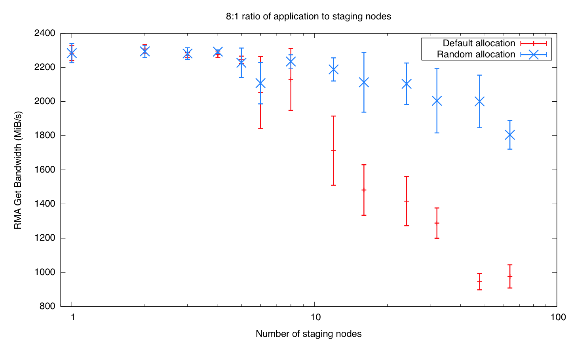
So What’s Missing?
Two types of data services: application-level and system-level
  Some system-level services already exist (e.g., file services)
  The challenge is providing support for application-level services
Scheduling: dynamic allocation, reconfiguration, and placement
  Balance workflow, reduce data movement, on-demand services
  The ability to control placement is important

Slide 155
So What’s Missing?
Programming models
  Standard API for inter-application communication (RDMA)
    Portals, InfiniBand, Gemini, …
    MPI-2 has this… kind of. Not many implementations.
  Programming models for integrating analysis (co-processing)
  High-level libraries for developing/integrating services (CPU, GPU, FPGA)
Security models that support shared services
  Cray XE6 doesn’t even support private services

Slide 156
So What’s Missing?
Resilience
  Storage-efficient app resilience is still a problem after 20+ years of research
  Data services use memory for transient data, how do we ensure resilience in such a model?
  We are exploring transaction-based methods
    Goal is to provide assurances in multiple protection domains (e.g., the application, service 1, service 2,…)
    Collaboration between SNL and GA Tech

Slide 157
Summary
Data Services are here!
  Nearly every Lab has their own approach (Nessie, Gleam, ADIOS, …)
  Scheduling, programming models, security, and resilience need to better support data services. Lots of work to do!
Nessie provides an effective framework for developing services
  Client and server API, macros for XDR processing, utils for managing svcs
  Supports all major HPC interconnects (Seastar, Gemini, InfiniBand, IBM)
Trilinos as a research vehicle
  Common repository, testing support, broad distribution
Trios Data Services Development Team (and current assignment)
  Ron Oldfield: PI, CTH data service, Nessie development
  Todd Kordenbrock: Nessie development, performance analysis
  Gerald Lofstead: PnetCDF/Exodus service, transaction-based resilience
  Craig Ulmer: Data-service APIs for accelerators (GPU, FPGA)
  Shyamali Mukherjee: Protocol performance evaluations, Nessie BG/P support

