Slide 1
ITKv4 Software Process
Bill Hoffman
bill.hoffman@kitware.com

Slide 2
Tools
Git
Gerrit
CMake/CTest/CPack/Cdash
Mailing list - no change
Wiki - no change
Mantis – no change

Slide 3
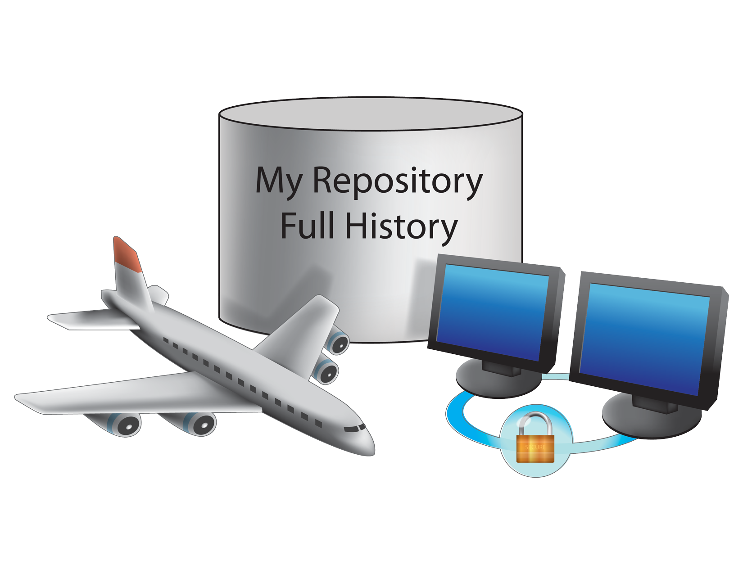
Access to all information at all times

Slide 4
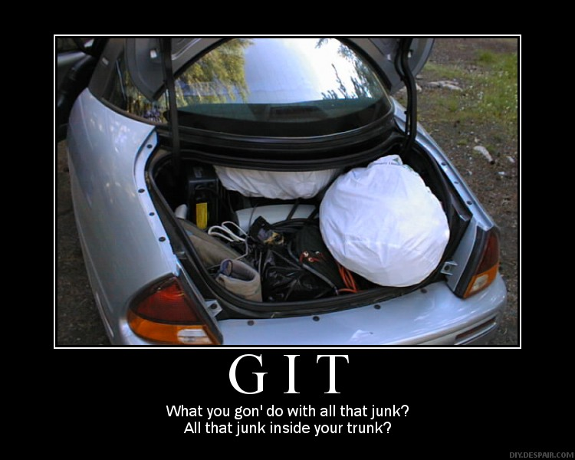
‘Git “Branchy” workflow for CMake
Three integration branches on server
maint = release bug fixes (Release Manager)
master = release preparation (Topic lead/Developer)
next = bleeding edge (Developers)
Fork topics from master, merge to next
Distributed Release Managment
master
Merge by Topic Lead/Developer
some-topic
next
Merge by Developer

Slide 5
Adding Support for “branchy” Workflow to Gerrit
Shawn Pearce from google is working with Marcus Hanwell to add topic branch support to Gerrit.

Slide 6
git
http://www.kitware.com/products/html/DistributedVersionControlTheFutureOfHistory.html

Slide 7
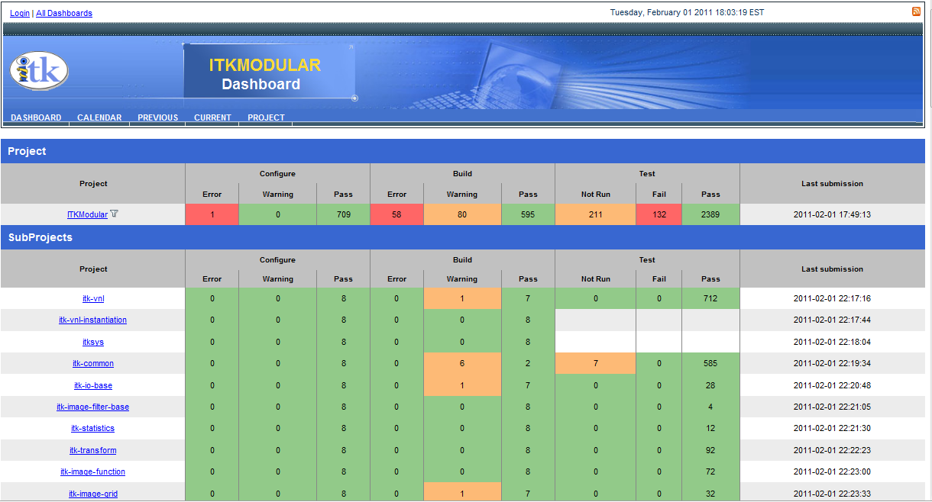
Modular Dashboard

Slide 8
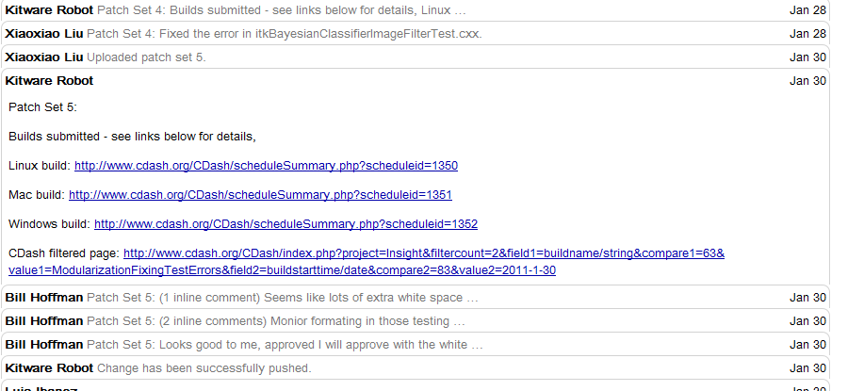
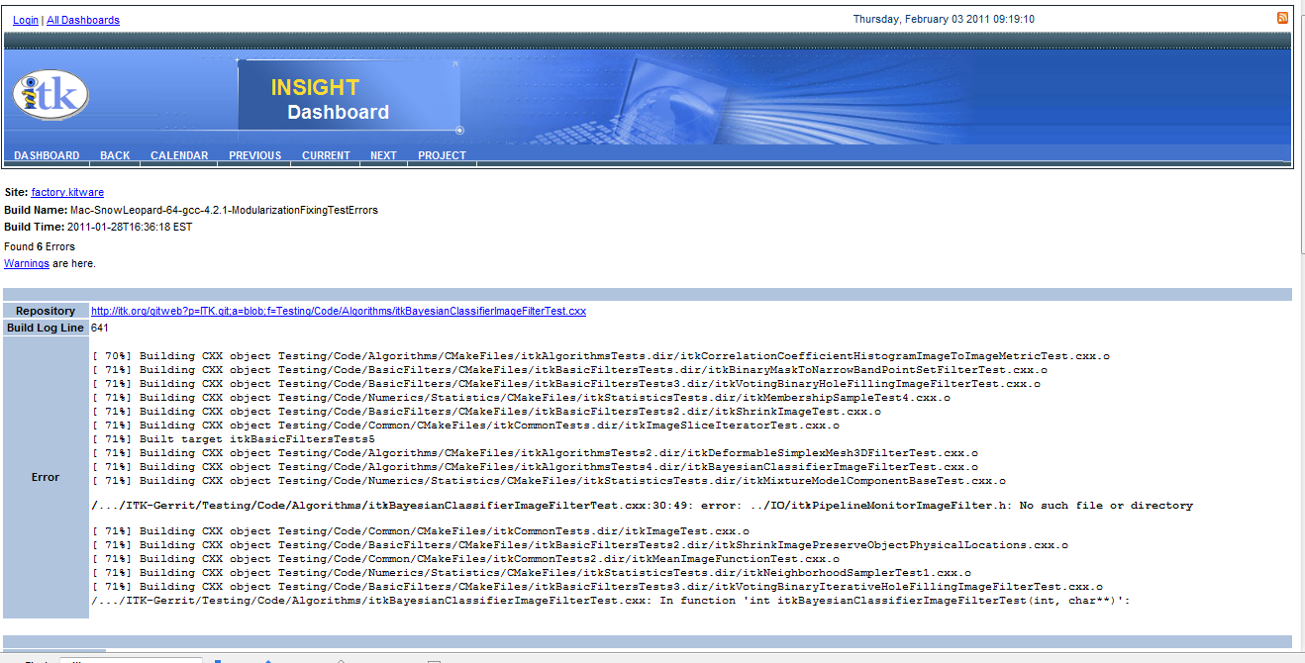
Gerrit and CDash@home

Slide 9
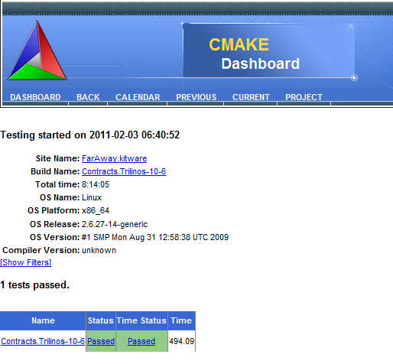
Contract with ITK

