Slide 1

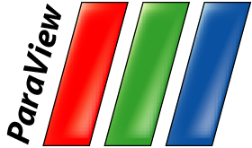



Large Scale Visualization with ParaView
Supercomputing 2016 Tutorial
November 14, 2016
Kenneth Moreland
W. Alan Scott
Sandia National Laboratories
David DeMarle
Kitware, Inc.
Joseph Insley
Argonne National Laboratory
Jonathan Woodring
John Patchett
Los Alamos National Laboratory
Sandia National Laboratories is a multi-program laboratory managed and operated by Sandia Corporation, a wholly owned subsidiary of Lockheed Martin Corporation, for the U.S. Department of Energy’s National Nuclear Security Administration under contract DE-AC04-94AL85000.
SAND 2015-7814 PE

Slide 2
Outline
Introduction
Basic Usage
Batch Scripting
Visualizing Large Models

Slide 3
To Follow Along…
Install ParaView 5.1.
  http://www.paraview.org → Download
Get example material.
  http://www.paraview.org/Wiki/The_ParaView_Tutorial
Data also available on thumb drives.
  Please don’t steal the thumb drives.
  They are personal property volunteered by presenters.
  They have never touched a Sandia computer.

Slide 4
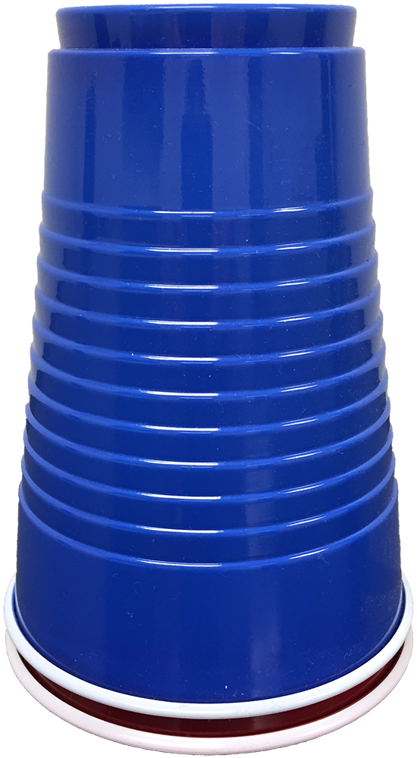
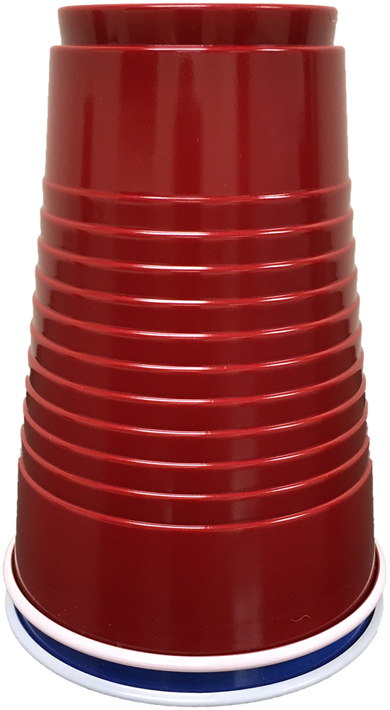
If You Need Help
I am fine.
Please help.

Slide 5
Introduction

Slide 6
What is ParaView?
An open-source, scalable, multi-platform visualization application.
Support for distributed computation models to process large data sets.
An open, flexible, and intuitive user interface.
An extensible, modular architecture based on open standards.
A flexible BSD 3 Clause license
Commercial maintenance and support.

Slide 7
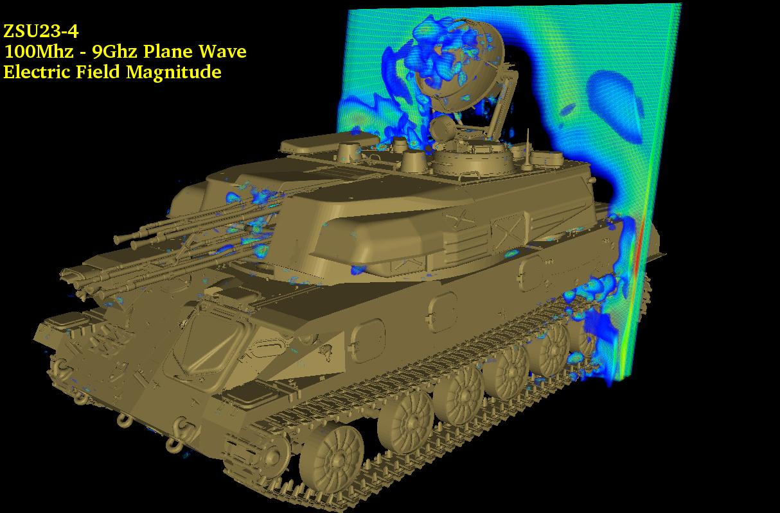
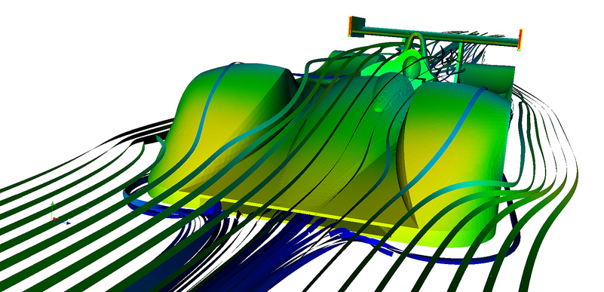
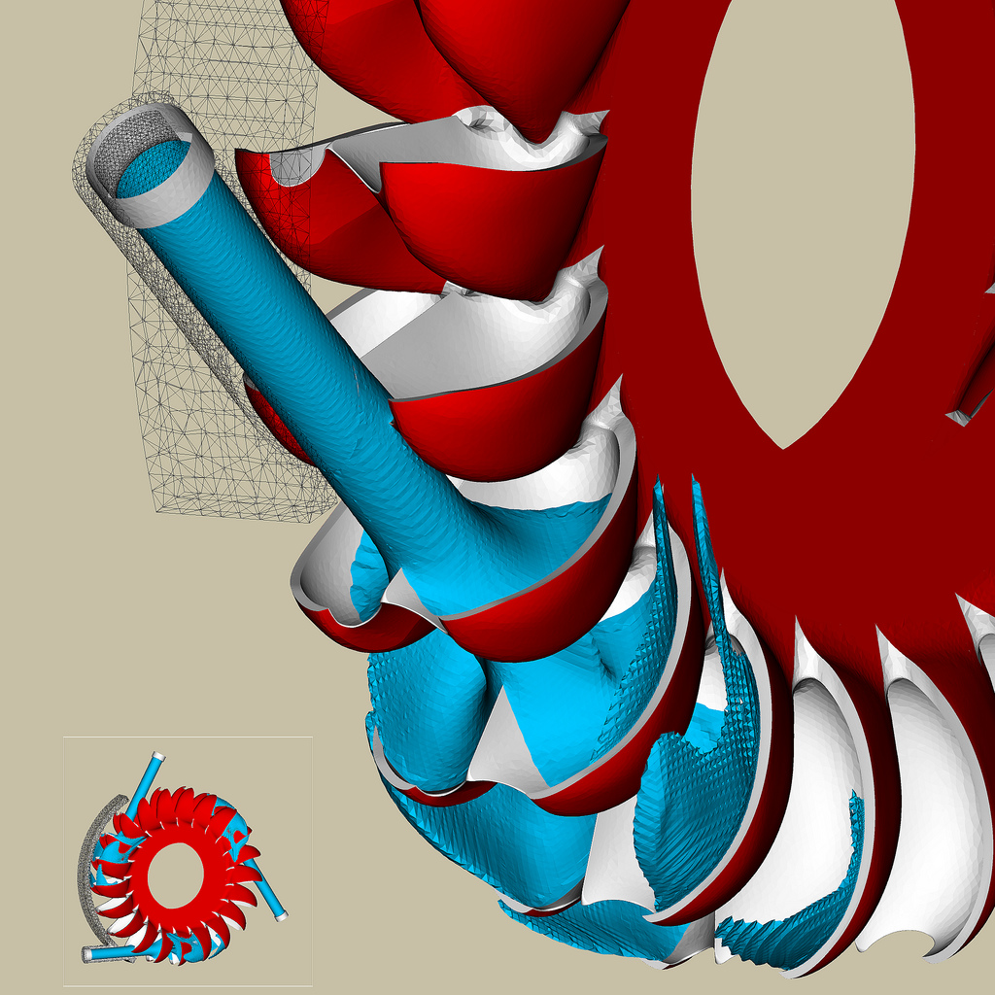
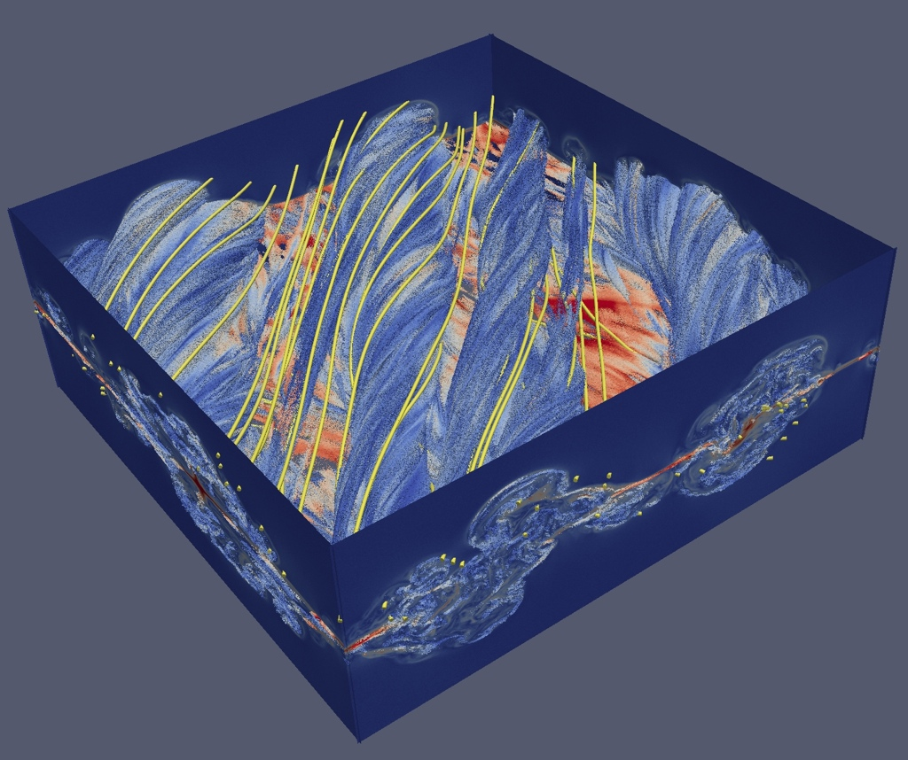
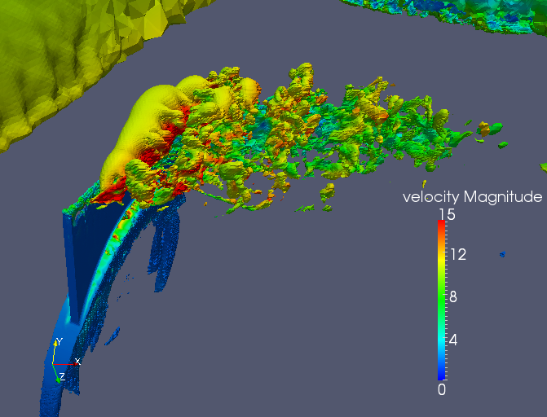
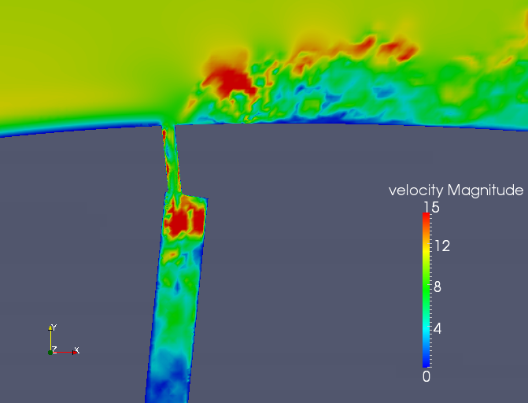
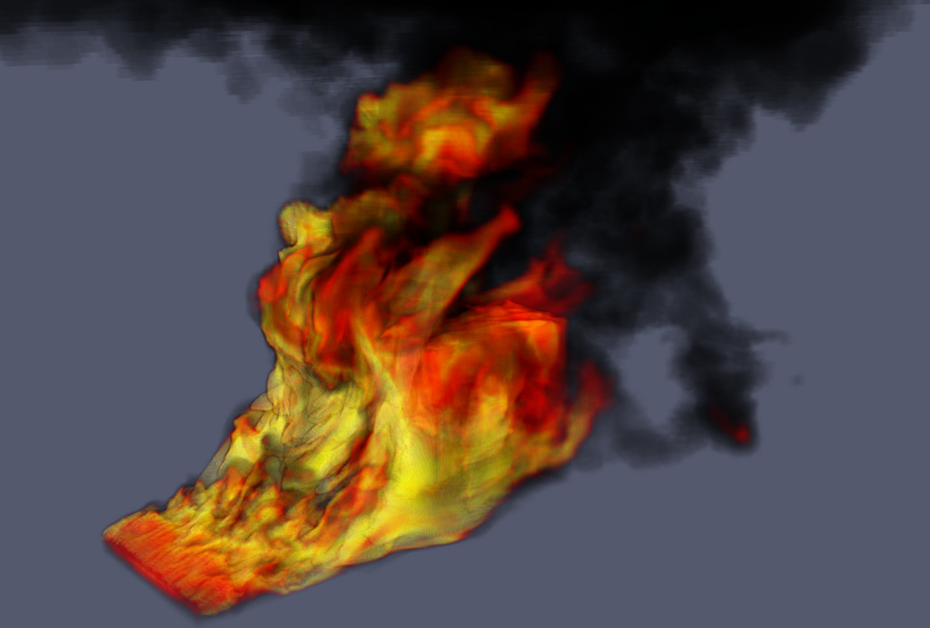
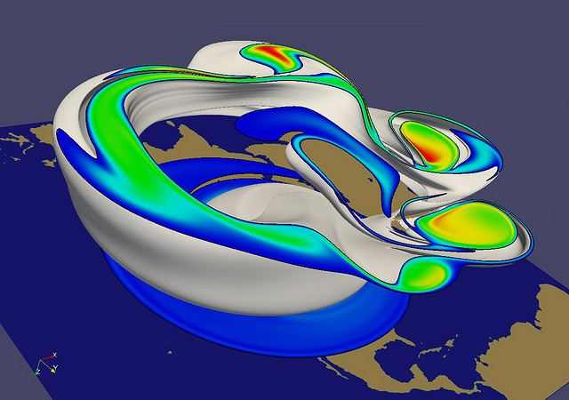
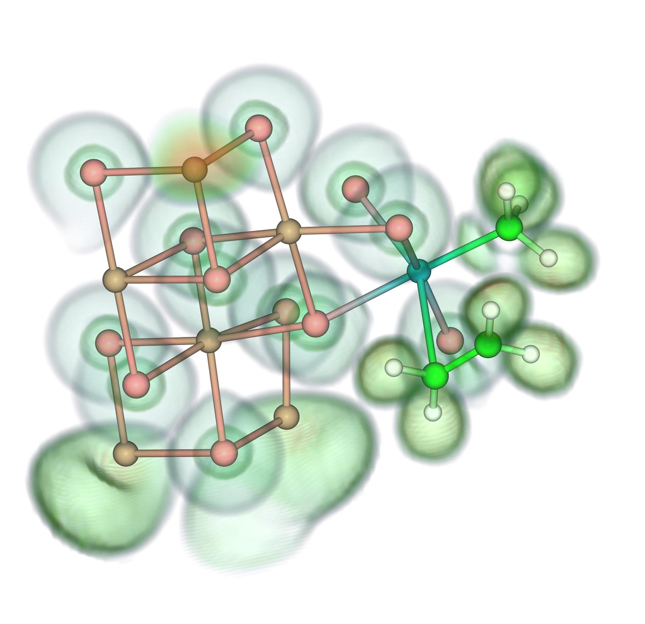
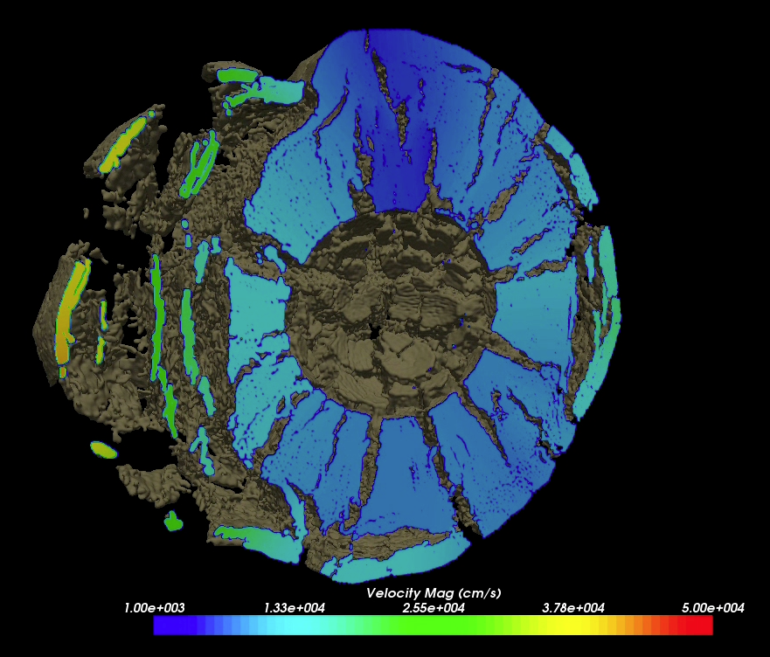
Renato N. Elias, NACAD/COPPE/UFRJ, Rio de Janerio, Brazil
Jerry Clarke, US Army Research Laboratory
Swiss National Supercomputing Centre
Bill Daughton, LANL
Swiss National Supercomputing Centre
Notes:
Small montage of projects using ParaView.
Demonstrates the breadth of utility ParaView has.

Slide 8



Current ParaView Usage
Used by academic, government, and commercial institutions worldwide.
Downloaded ~100K times per year.
HPCwire Editors’ Choice 2010 and HPCwire Readers’ Choice 2010/2012 Awards for Best Visualization Product or Technology.

Slide 9
Data Ranges
Used for all ranges of data size.
Landmarks of SNL usage:
  6 billion structured cells (2005).
  250 million unstructured cells (2005).
  Billions of AMR cells (2008).
  Scaling test over 1 Trillion cells (2010).

Slide 10
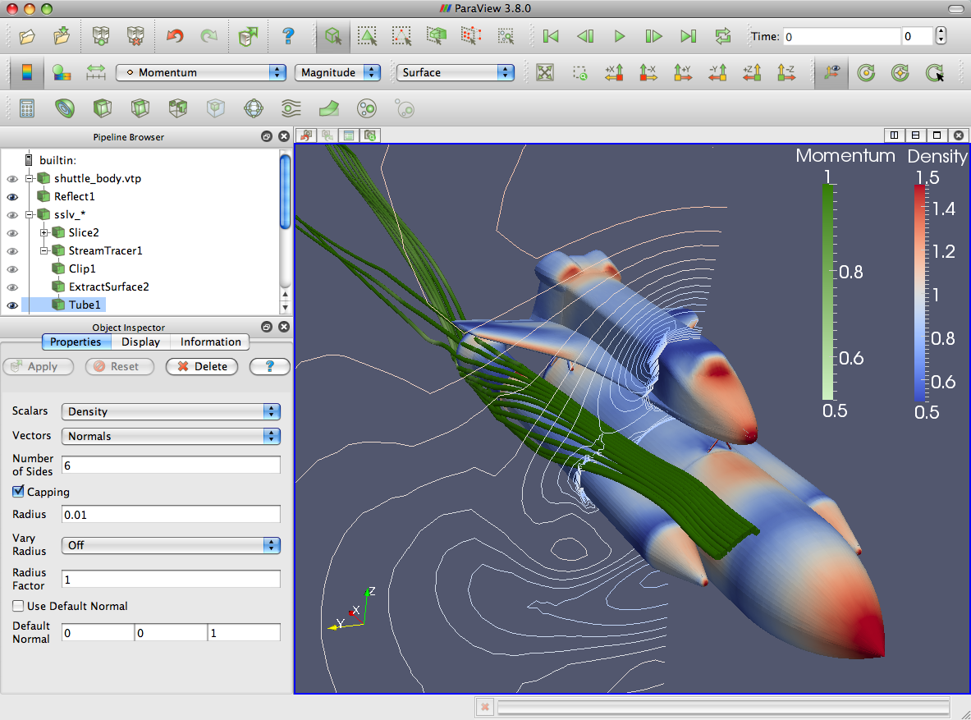
ParaView Application Architecture
ParaView Client
pvpython
ParaWeb
Catalyst
Custom App
UI (Qt Widgets, Python Wrappings)
ParaView Server
VTK
OpenGL
MPI
IceT
Etc.

Slide 11
ParaView Development
Started in 2000 as collaborative effort between Los Alamos National Laboratories and Kitware Inc. (lead by James Ahrens).
  ParaView 0.6 released October 2002.
September 2005: collaborative effort between Sandia National Laboratories, Kitware Inc. and CSimSoft to rewrite user interface to be more user friendly and develop quantitative analysis framework.
  ParaView 3.0 released in May 2007.
ParaView 4.0 released in June 2013.

Slide 12




Current Funding
ARL
ERDC
US Army (SBIR)
US Air Force (STTR)
ONR
Support Contracts
  Electricity de France
  Microsoft
Other contributors
  Swiss National Supercomputing Centre
  DOE SLAC
  Ohio State
  Mississippi State
  RPI

Slide 13
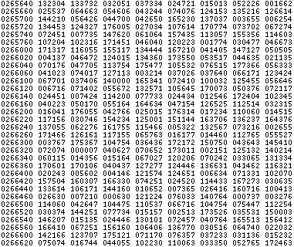
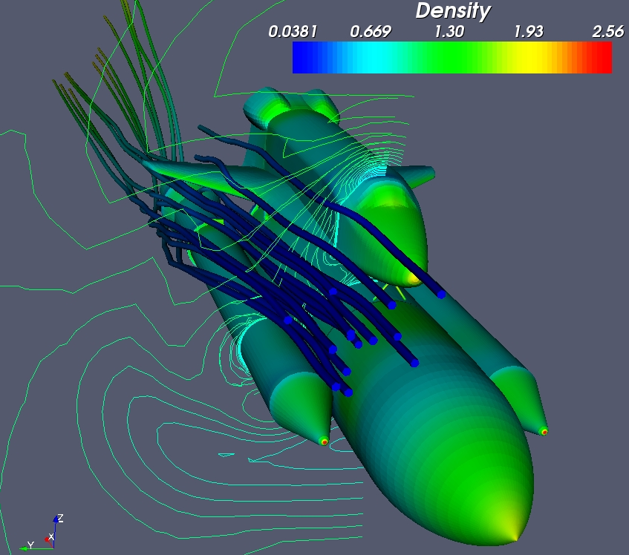
Basics of Visualization

Slide 14
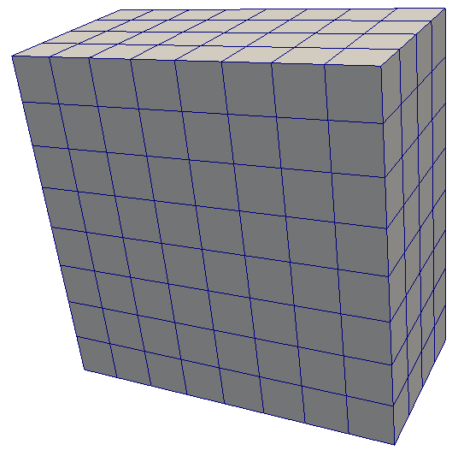
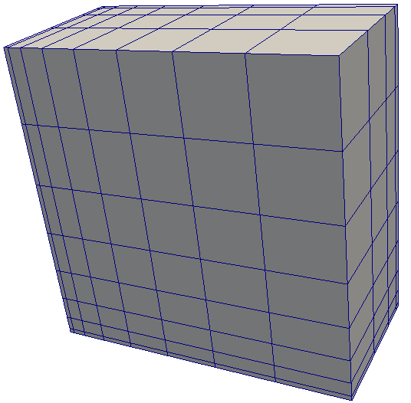
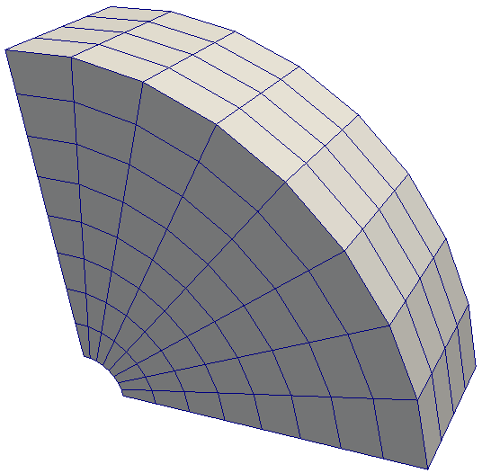
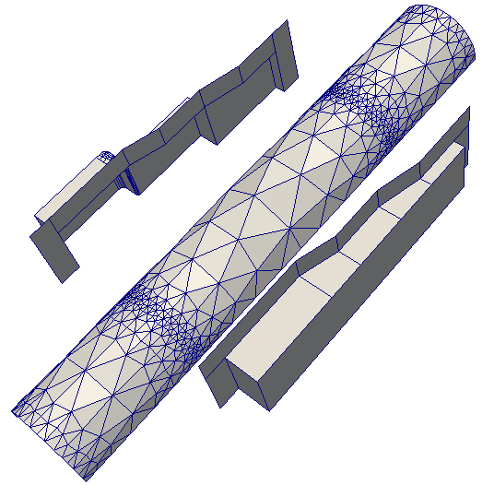
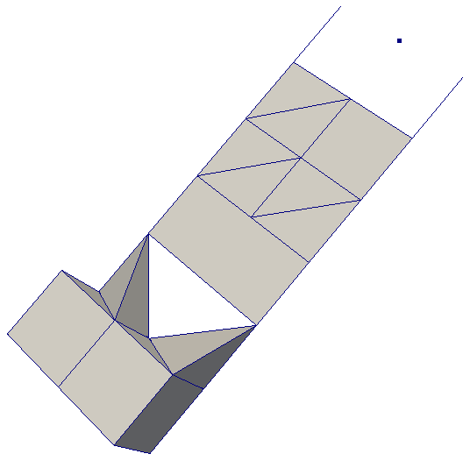
Data Types
Uniform Rectilinear
(vtkImageData)
Non-Uniform Rectilinear
(vtkRectilinearData)
Curvilinear
(vtkStructuredData)
Multi-block
Hierarchical Adaptive Mesh Refinement (AMR)
Hierarchical Uniform AMR
Octree
Polygonal
(vtkPolyData)
Unstructured Grid
(vtkUnstructuredGrid)

Slide 15
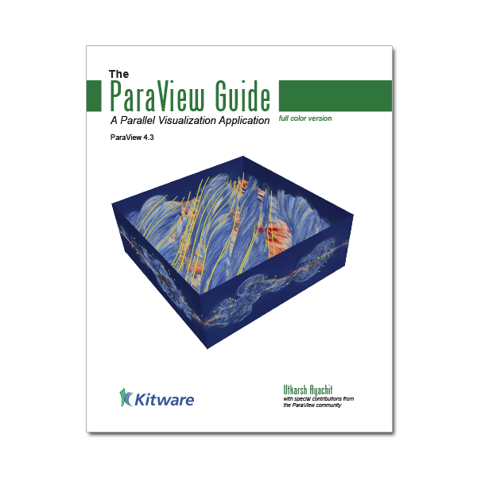

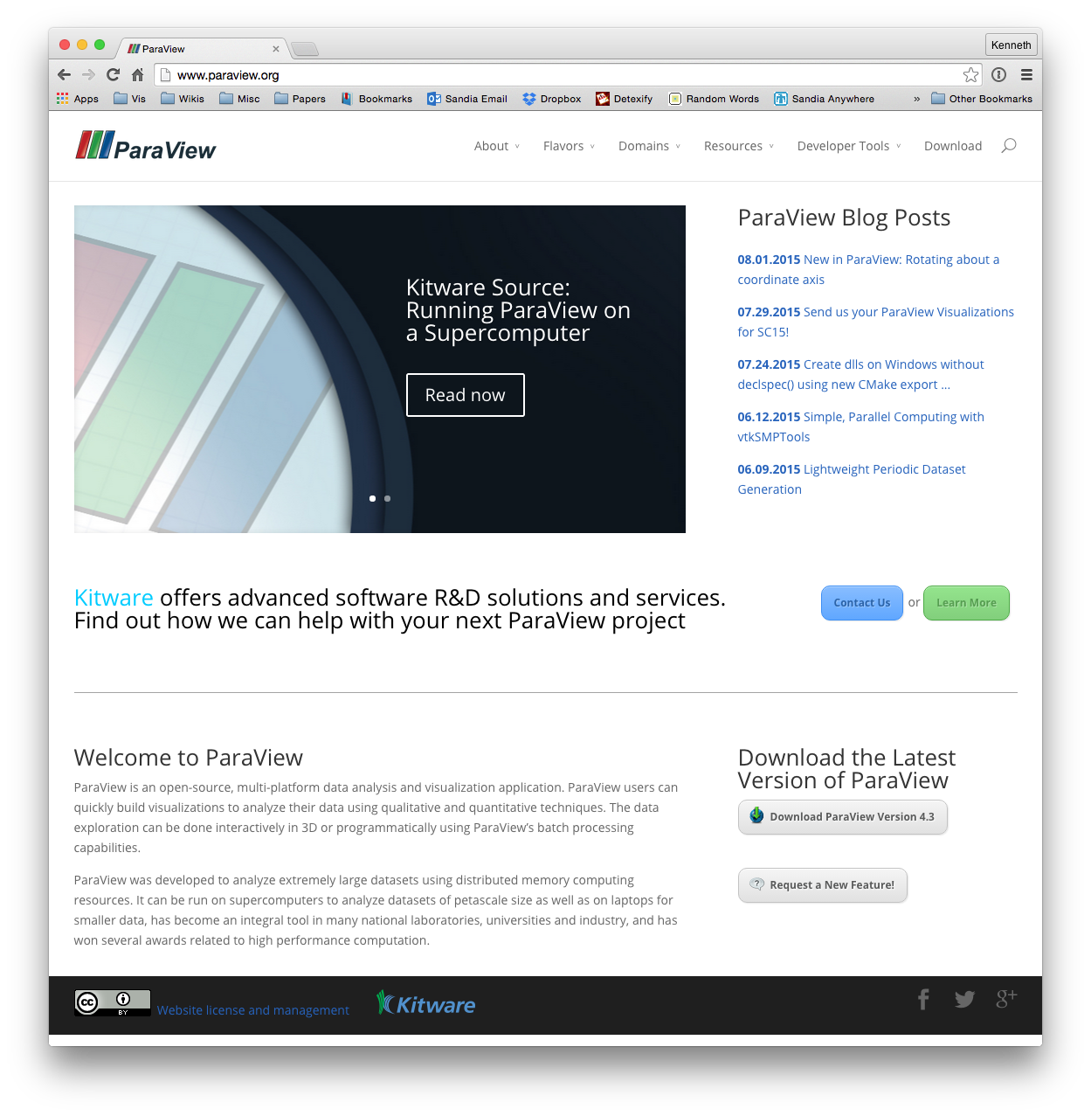
More Information
Online Help – F1
The ParaView User’s Guide
  http://www.paraview.org/paraview-guide/
The ParaView web page
  www.paraview.org
ParaView mailing list
  paraview@paraview.org

Slide 16
If You Need Help
I am fine.
Please help.

Slide 17
Basic Usage

Slide 18
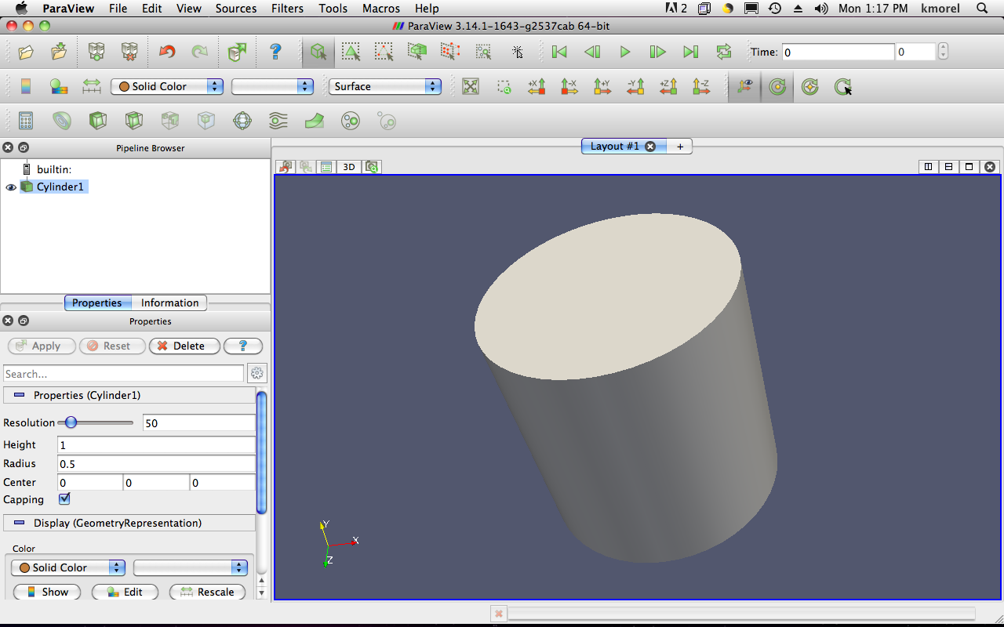
User Interface
Menu Bar
Toolbars
Pipeline Browser
Properties Panel
Advanced Toggle
3D View

Slide 19
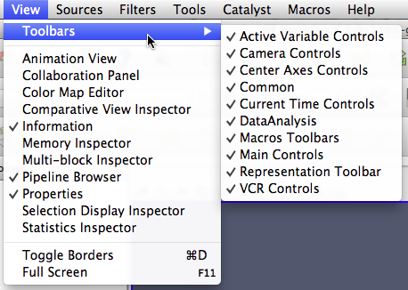
Getting Back GUI Components

Slide 20
Creating a Cylinder Source
Go to the Source menu and select Cylinder.
Click the Apply button to accept the default parameters.

Slide 21

Simple Camera Manipulation
Drag left, middle, right buttons for rotate, pan, zoom.
  Also use Shift, Ctrl, Alt modifiers.

Slide 22
Creating a Cylinder Source
Go to the Source menu and select Cylinder.
Click the Apply button to accept the default parameters.
Increase the Resolution parameter.
Click the button again.

Slide 23
Pipeline Object Controls

Slide 24

Using Auto Apply
Click Auto Apply.
Change the Resolution parameter again.
Note that the visualization automatically updates without having to hit Apply.

Slide 25
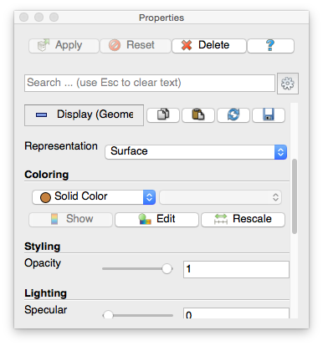
Display Properties

Slide 26

Change Render Properties
Scroll down to the Display group.
Click the Edit button. (This button is replicated in the toolbar.)
Select a new color for the cylinder.

Slide 27
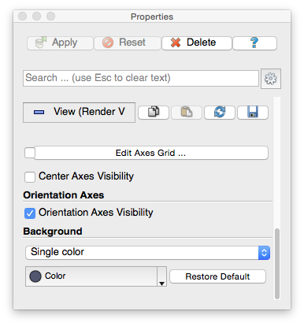
Render View Options

Slide 28
Change Render Properties
Scroll down to the Display group.
Click the Edit button. (This button is replicated in the toolbar.)
Select a new color for the cylinder.
Scroll down to the View group.
Change the background from Single color to Gradient.

Slide 29


Changing the Color Palette
Make sure the orientation axes are visible in the lower left corner.
Click the color palette button and change the colors.
Try several color palettes.

Slide 30
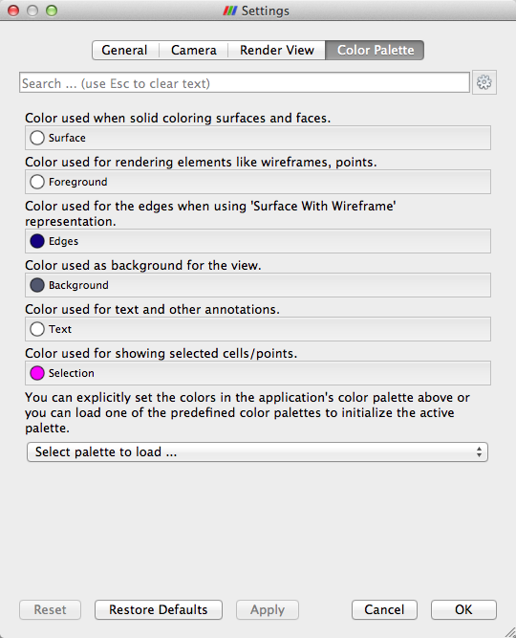
Color Palettes

Slide 31
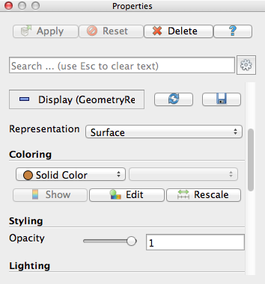
Advanced Properties
Toggle
Advanced
Properties
Search
Properties

Slide 32
Searching Properties
Type “specular” in the properties search box
Change Specular value to 1 (makes the cylinder shiny)

Slide 33
Searching Properties
Type “specular” in the properties search box
Change Specular value to 1 (makes the cylinder shiny)
Other interesting properties:
Cube Axes
Opacity
Lights

Slide 34




Undo Redo
Undo
Redo
Camera
Undo
Camera
Redo

Slide 35
Creating a Cylinder Source
Go to the Source menu and select Cylinder.
Click the Apply button to accept the default parameters.
Increase the Resolution parameter.
Click the button again.
Delete the Cylinder.

Slide 36
Supported Data Types
ParaView Data (.pvd)
VTK (.vtp, .vtu, .vti, .vts, .vtr)
VTK Legacy (.vtk)
VTK Multi Block (.vtm,.vtmb,.vtmg,.vthd,.vthb)
Partitioned VTK (.pvtu, .pvti, .pvts, .pvtr)
ADAPT (.nc, .cdf, .elev, .ncd)
ANALYZE (.img, .hdr)
ANSYS (.inp)
AVS UCD (.inp)
BOV (.bov)
BYU (.g)
CAM NetCDF (.nc, .ncdf)
CCSM MTSD (.nc, .cdf, .elev, .ncd)
CCSM STSD (.nc, .cdf, .elev, .ncd)
CEAucd (.ucd, .inp)
CMAT (.cmat)
CML (.cml)
CTRL (.ctrl)
Chombo (.hdf5, .h5)
Claw (.claw)
Comma Separated Values (.csv)
Cosmology Files (.cosmo, .gadget2)
Curve2D (.curve, .ultra, .ult, .u)
DDCMD (.ddcmd)
Digital Elevation Map (.dem)
Dyna3D(.dyn)
EnSight (.case, .sos)
Enzo boundary and hierarchy
ExodusII (.g, .e, .exe, .ex2, .ex2v.., etc)
ExtrudedVol (.exvol)
FVCOM (MTMD, MTSD, Particle, STSD)
Facet Polygonal Data
Flash multiblock files
Fluent Case Files (.cas)
GGCM (.3df, .mer)
GTC (.h5)
GULP (.trg)
Gadget (.gadget)
Gaussian Cube File (.cube)
JPEG Image (.jpg, .jpeg)
LAMPPS Dump (.dump)
LAMPPS Structure Files
LODI (.nc, .cdf, .elev, .ncd)
LODI Particle (.nc, .cdf, .elev, .ncd)
LS-DYNA (.k, .lsdyna, .d3plot, d3plot)
M3DCl (.h5)
MFIX Unstructred Grid (.RES)
MM5 (.mm5)
MPAS NetCDF (.nc, .ncdf)
Meta Image (.mhd, .mha)
Miranda (.mir, .raw)
Multilevel 3d Plasma (.m3d, .h5)
NASTRAN (.nas, .f06)
Nek5000 Files
Nrrd Raw Image (.nrrd, .nhdr)
OpenFOAM Files (.foam)
PATRAN (.neu)
PFLOTRAN (.h5)
PLOT2D (.p2d)
PLOT3D (.xyz, .q, .x, .vp3d)
PLY Polygonal File Format
PNG Image Files
POP Ocean Files
ParaDIS Files
Phasta Files (.pht)
Pixie Files (.h5)
ProSTAR (.cel, .vrt)
Protein Data Bank (.pdb, .ent, .pdb)
Raw Image Files
Raw NRRD image files (.nrrd)
SAMRAI (.samrai)
SAR (.SAR, .sar)
SAS (.sasgeom, .sas, .sasdata)
SESAME Tables
SLAC netCDF mesh and mode data
SLAC netCDF particle data
Silo (.silo, .pdb)
Spheral (.spheral, .sv)
SpyPlot CTH
SpyPlot (.case)
SpyPlot History (.hscth)
Stereo Lithography (.stl)
TFT Files
TIFF Image Files
TSurf Files
Tecplot ASCII (.tec, .tp)
Tecplot Binary (.plt)
Tetrad (.hdf5, .h5)
UNIC (.h5)
VASP CHGCA (.CHG)
VASP OUT (.OUT)
VASP POSTCAR (.POS)
VPIC (.vpc)
VRML (.wrl)
Velodyne (.vld, .rst)
VizSchema (.h5, .vsh5)
Wavefront Polygonal Data (.obj)
WindBlade (.wind)
XDMF and hdf5 (.xmf, .xdmf)
XMol Molecule

Slide 37
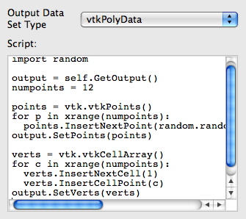
Custom Data Import:
Prototype with Python
A “programmable source” lets you program data readers right in the GUI.
Uses wrappings for the basic VTK classes.
Good for prototyping readers.

Slide 38
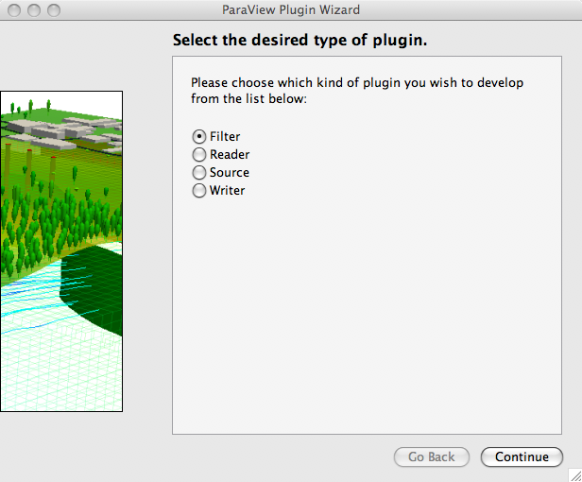
Custom Data Import:
Plugin Containing a Reader
Plugins: shared object libraries that can be dynamically loaded into ParaView.
Any VTK reader object can be added.
For help, try MIRARCO’s Plugin Wizard.
  http://pluginwizard.mirarco.org/

Slide 39
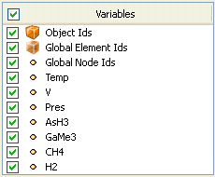
Load disk_out_ref.ex2
Open the file disk_out_ref.ex2.
Load all data variables.
Click

Slide 40
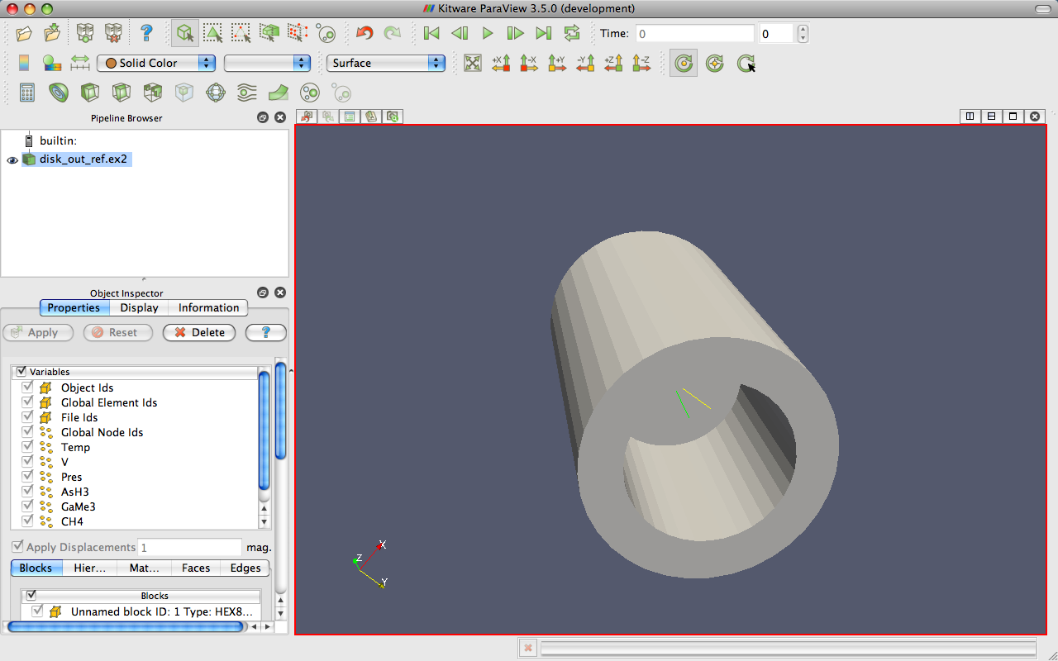
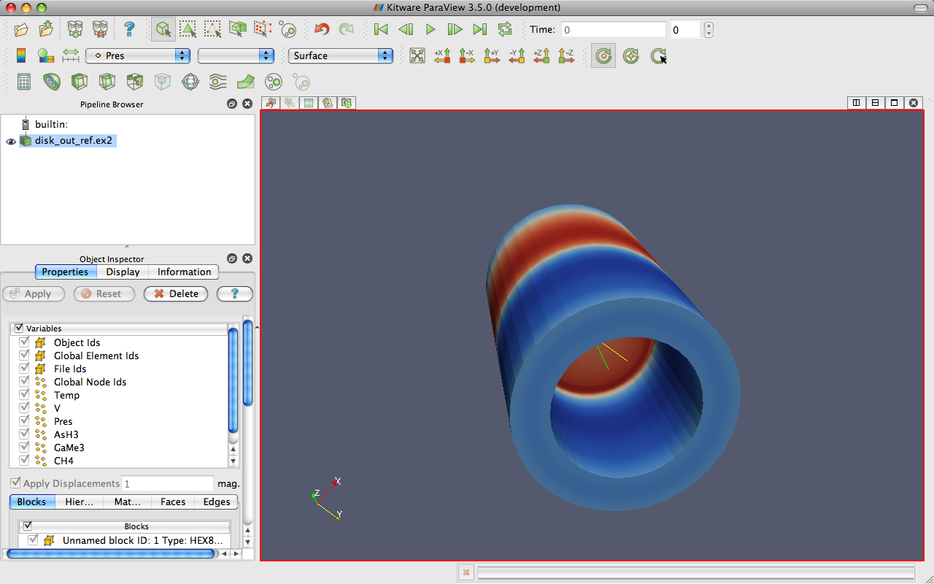
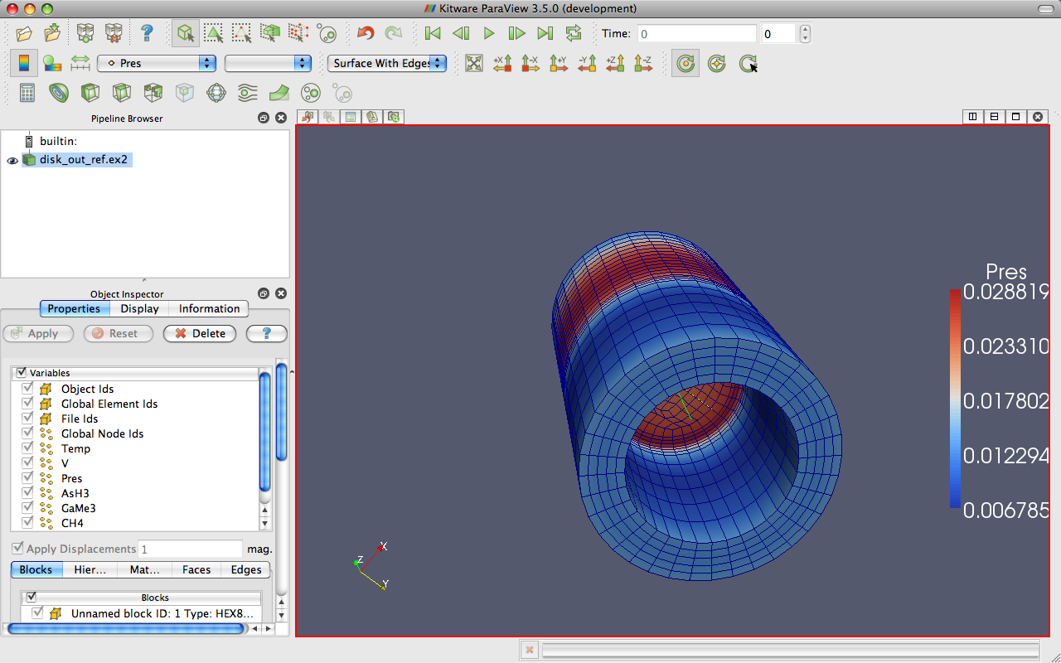
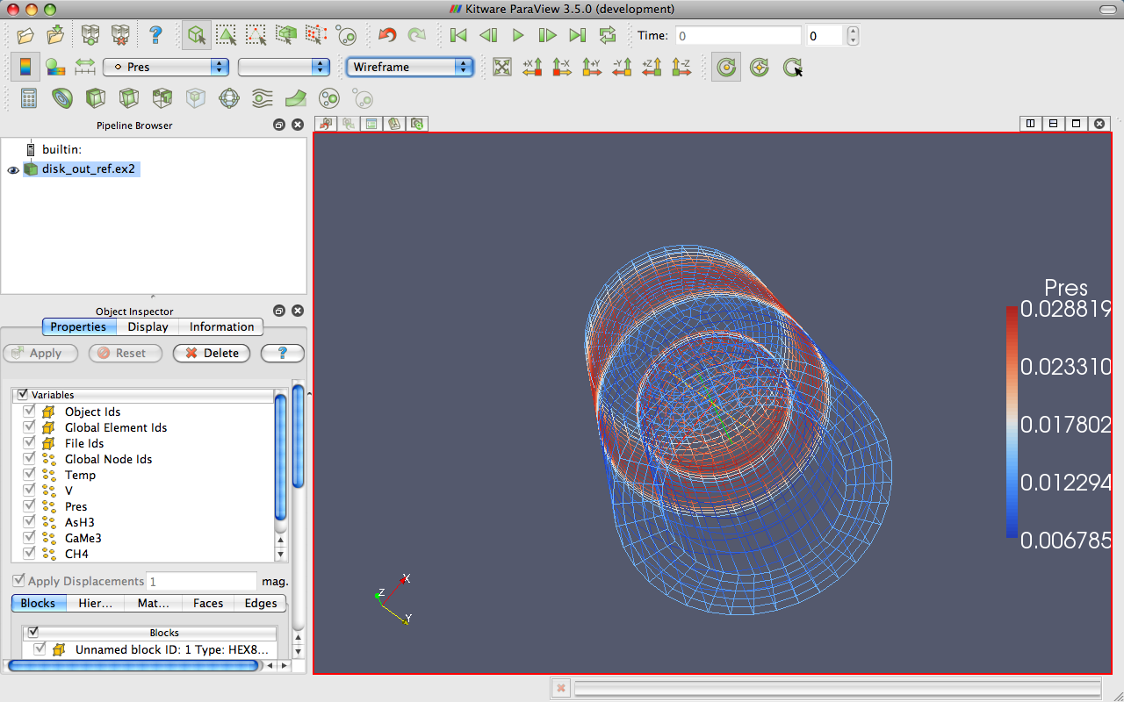
Data Representation
Notes:
Also do volume rendering.

Slide 41
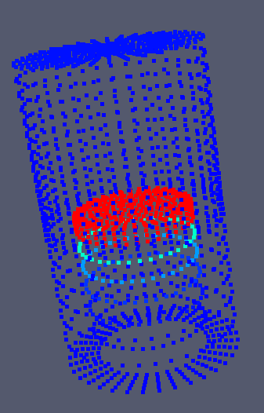
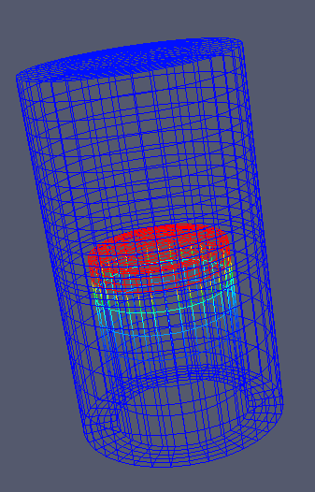
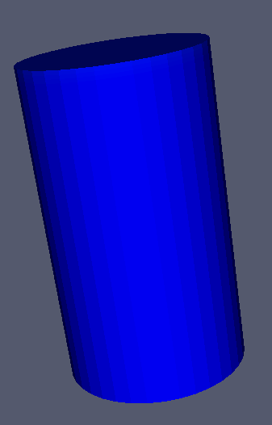
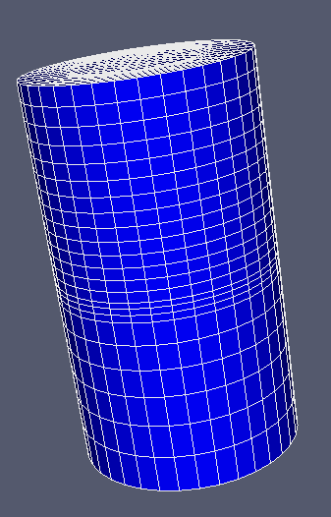
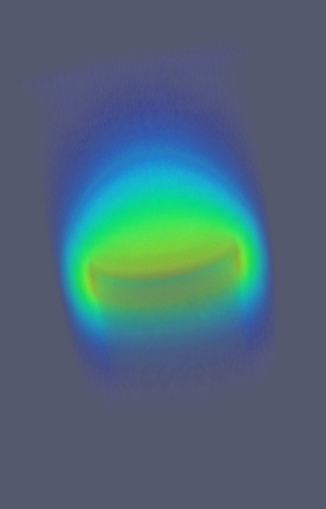
Geometry Representations
Points
Wireframe
Surface
Surface
with Edges
Volume

Slide 42











Common Filters
Calculator
Contour
Clip
Slice
Threshold
Extract Subset
Glyph
Stream Tracer
Warp (vector)
Group Datasets
Extract Level

Slide 43
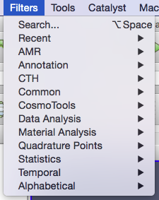
Filters Menu

Slide 44
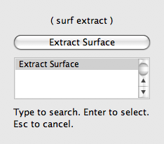
Quick Launch
Used for searching for filters by name
Keyboard shortcut
  Ctrl-space for Windows & Linux
  Alt-space for Mac
Notes:
ctrl-space: Win/Linux. alt-space: Mac

Slide 45
Apply a Filter
Make sure that disk_out_ref.ex2 is selected in the pipeline browser.
Select the contour filter.

Slide 46
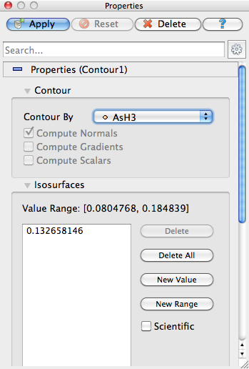
Apply a Filter
Change parameters to create an isosurface at Temp = 400K.
Change to Temp
Change to 400

Slide 47
Apply a Filter
Make sure that disk_out_ref.ex2 is selected in the pipeline browser.
Select the contour filter.
Change parameters to create an isosurface at Temp = 400K.

Slide 48
Create a Cutaway Surface
Select disk_out_ref.ex2 in the pipeline browser.
From the quick launch, select Extract Surface.

Slide 49
Create a Cutaway Surface
Select disk_out_ref.ex2 in the pipeline browser.
From the quick launch, select Extract Surface.
Create a clip filter.
Uncheck Show Plane.

Slide 50
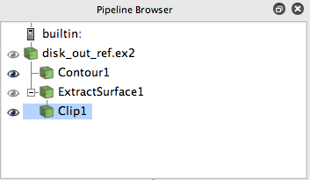
Pipeline Browser Structure
disk_out_ref.ex2
DataSetSurfaceFilter1
Contour1
Clip1
Notes:
Mention eyeballs

Slide 51
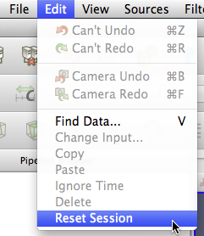
Reset ParaView
Edit → Reset Session

Slide 52

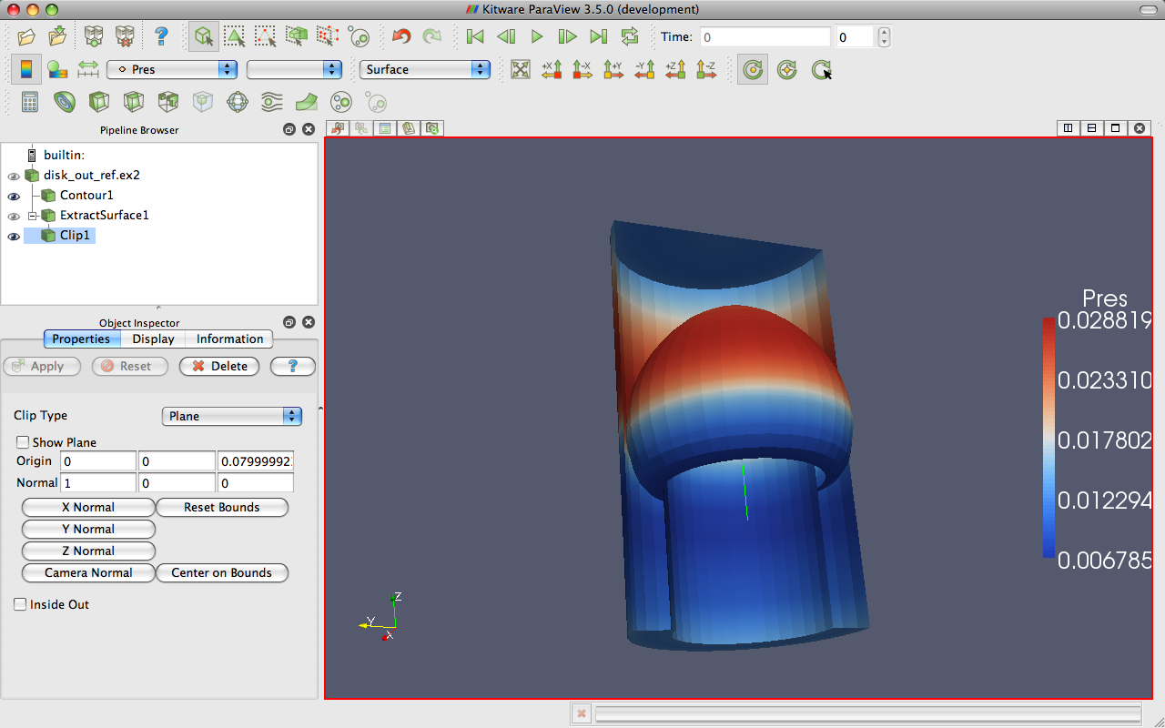
Multiview

Slide 53
Multiview
Open disk_out_ref.ex2. Load all variables.
Add Clip filter.
Uncheck Show Plane.
Color surface by Pres.

Slide 54
Multiview
Split the view horizontally.
Make Clip1 visible.
Color surface by Temp.
Notes:
Problem: camera position different in each view.

Slide 55
Multiview
Split the view horizontally.
Make Clip1 visible.
Color surface by Temp.
Right-click view, Link Camera…
Click other view.

Slide 56

Multiview
Split the view horizontally.
Make Clip1 visible.
Color surface by Temp.
Right-click view, Link Camera…
Click other view.
Click

Slide 57
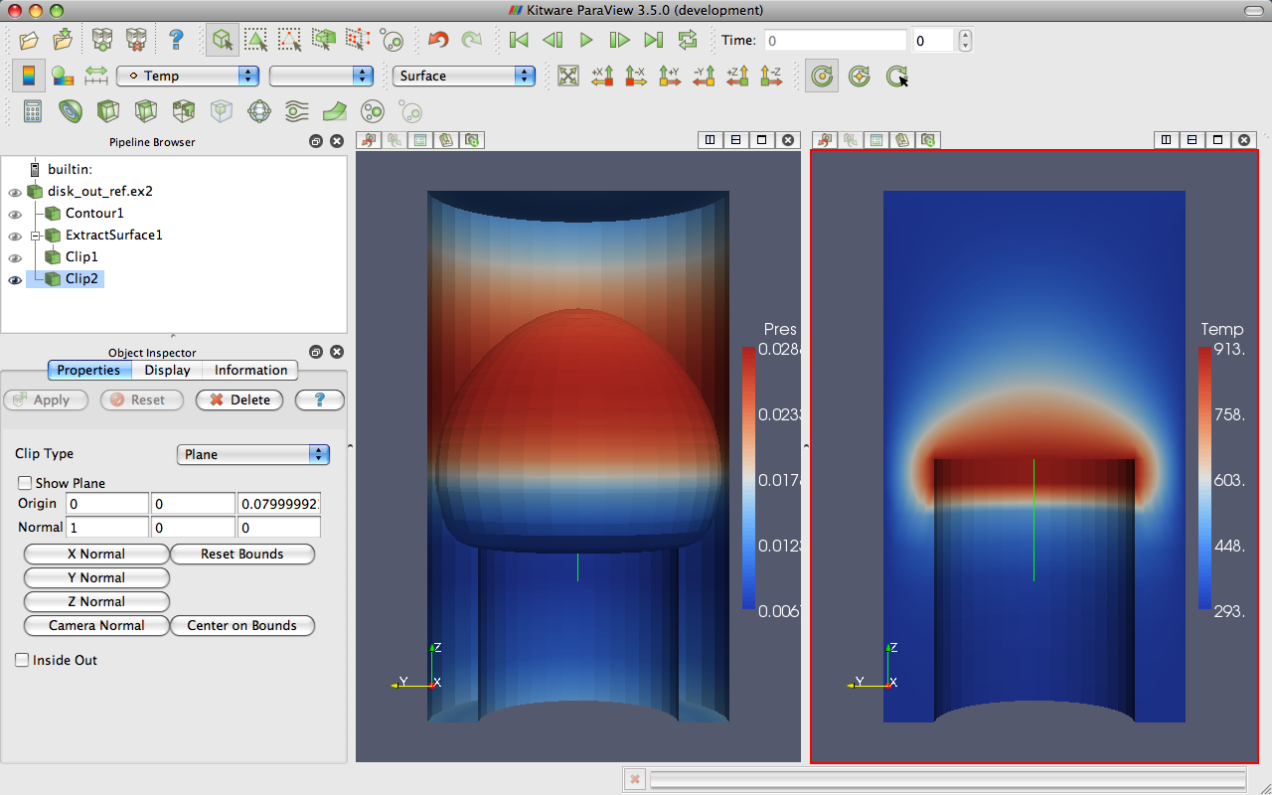
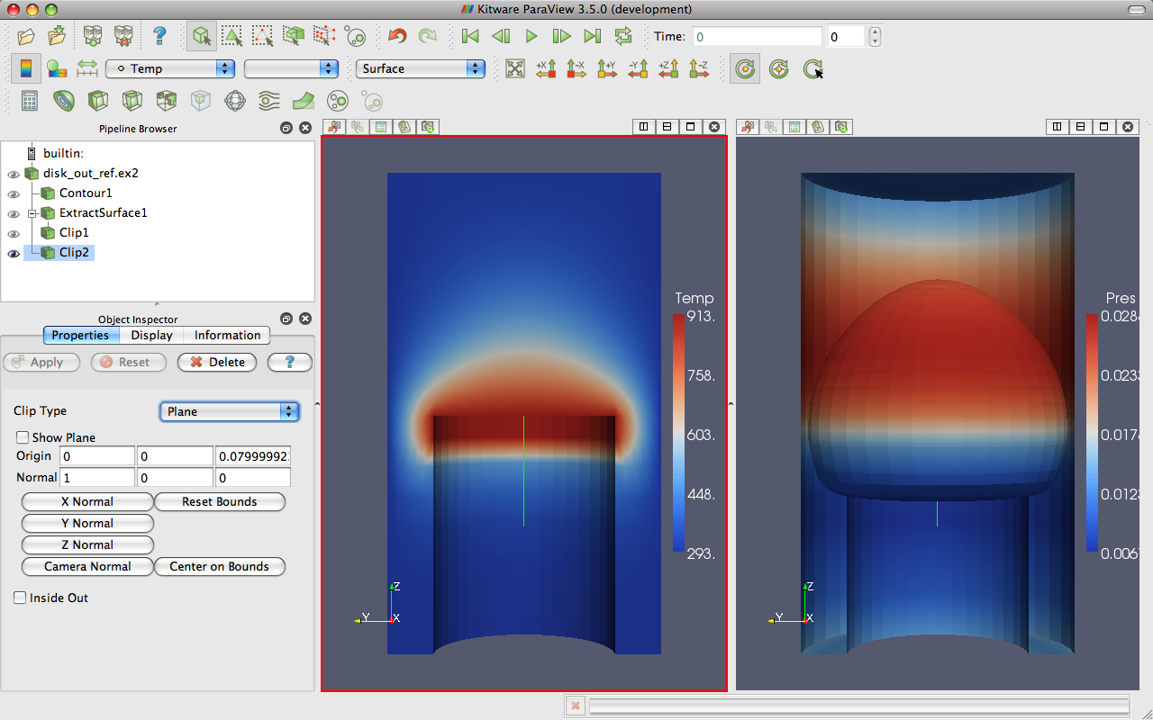
Modifying Views

Slide 58
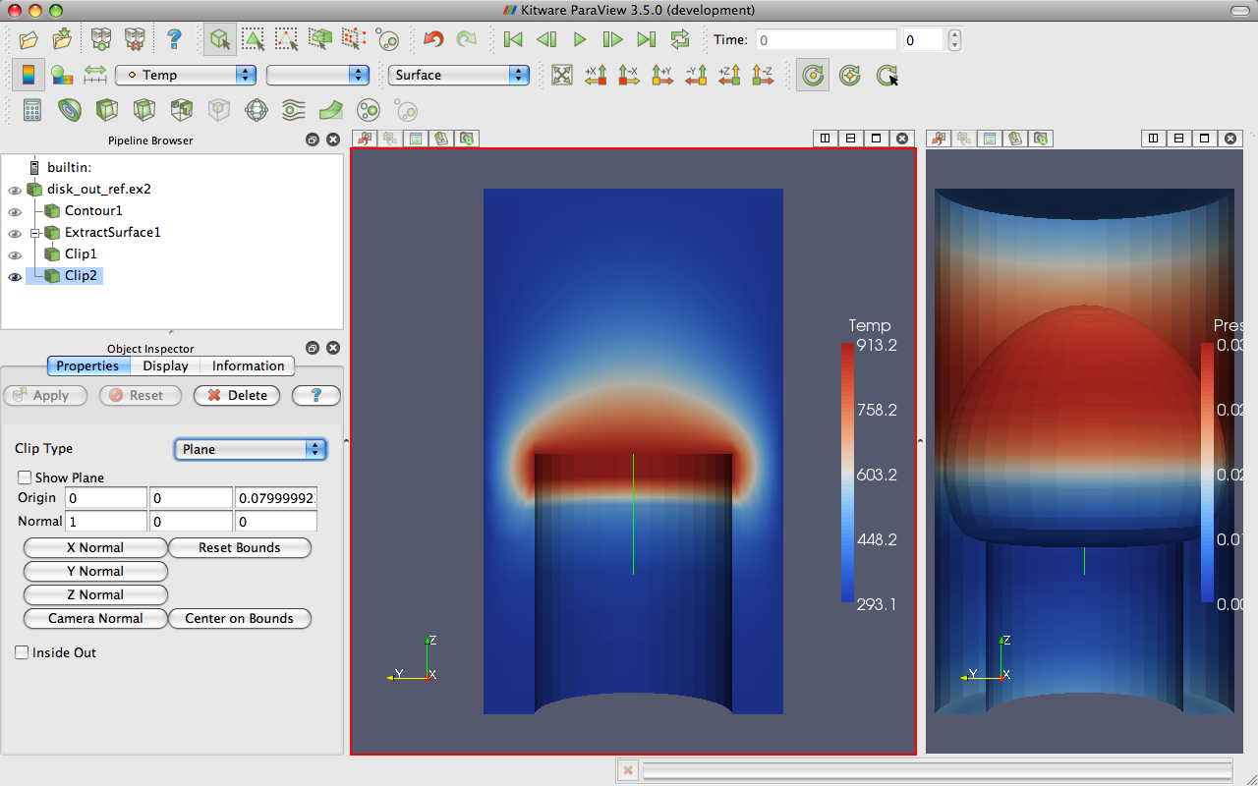
Modifying Views

Slide 59
Reset ParaView
Edit → Reset Session

Slide 60
Streamlines
Open disk_out_ref.ex2. Load all variables.
Add Stream Tracer.

Slide 61
Streamlines
Open disk_out_ref.ex2. Load all variables.
Add Stream Tracer.
From the quick launch, select Tube

Slide 62
Getting Fancy
Select StreamTracer1.
Add Glyph filter.
Change Glyph Type to Cone.
Change Vectors to V.
Change Scale Mode to vector.
Click reset next to Scale Factor.
Color by Temp.

Slide 63
Getting Answers
Where is the air moving the fastest? Near the disk or away from it? At the center of the disk or near its edges?
Which way is the plate spinning?
At the surface of the disk, is air moving toward the center or away from it?

Slide 64
Reset ParaView
Edit → Reset Session

Slide 65

Common Data Analysis Filters
Extract Selection
Plot Global Variables Over Time
Plot Over Line
Plot Selection Over Time
Probe Location

Slide 66
Plotting
Open disk_out_ref.ex2. Load all variables.
Clip, uncheck, ,
Select disk_out_ref.ex2.
Add Plot Over Line filter.

Slide 67


3D Widgets

Slide 68
Plotting
Open disk_out_ref.ex2. Load all variables.
Clip, uncheck, ,
Select disk_out_ref.ex2.
Add Plot Over Line filter.
Once line is satisfactorily located,

Slide 69

Interacting with Plots
Left, middle, right buttons to pan, zoom.
Mouse wheel to zoom.
Reset view to plot ranges.

Slide 70


Plots are Views
Move them like Views.
Save screenshots.

Slide 71
Adjusting Plots
In Display section of properties panel, turn off all variables except Temp and Pres.
Select Pres in the Display options.
Change Chart Axis to Bottom – Right.
Verify the relationship between temperature and pressure.
Notes:
From here, re-verify relationship of temperature and pressure.

Slide 72

Histogram / Bar Chart
Select disk_out_ref.ex2.
Filters → Data Analysis → Histogram
Change Input Array to Temp.

Slide 73
Reset ParaView
Edit → Reset Session

Slide 74
Geometry Representations
Points
Wireframe
Surface
Surface
with Edges
Volume

Slide 75
Volume Rendering +
Surface Geometry
Open disk_out_ref.ex2. Load all variables.
Change variable viewed to Temp.
Change representation to Volume.

Slide 76

Transfer Function Editor
Notes:
Add control points by clicking in color box.
Drag control points to move them.
Delete active point by hitting backspace or delete.
Click active point to change its color.
Can save and load transfer functions.
Load black-body radiation.

Slide 77

Modify Transfer Function
Select disk_out_ref.ex2.
Click Edit Color Map .
Click Choose preset .
Select Black-Body Radiation. Apply. Close.
Try adding and changing control points.

Slide 78
Volume Rendering +
Surface Geometry
Open disk_out_ref.ex2. Load all variables.
Change variable viewed to Temp.
Change representation to Volume.
Add Stream Tracer.
Optional: Add Tubes and Glyphs.

Slide 79
Reset ParaView
Edit → Reset Session

Slide 80



Loading Data with Time
Open the file can.ex2.
Select all variables.

Slide 81
Animation Toolbar

Slide 82


Animation Pitfall
Go to first time step.
Color by EQPS variable.
Play (or skip to last time step ).

Slide 83

Animation Pitfall
Go to first time step.
Color by EQPS variable.
Play (or skip to last time step ).
Fix with Rescale to Data Range.

Slide 84

Data Range Workarounds
Go to representative time and hit
In Settings change On File Open to Goto last timestep.

Slide 85
Data Range Workarounds
Set a custom range.
Notes:
This option also available on the toolbar

Slide 86
Data Range Workarounds
Open color map editor dialog
Rescale to range over all timesteps

Slide 87
Reset ParaView
Edit → Reset Session

Slide 88

Animation View
View → Animation View

Slide 89
Animation View
View → Animation View
Animation Modes: Sequence, Real Time, and Snap To TimeSteps

Slide 90
Changing Animation Timing
Open can.ex2. Load all variables.
View → Animation View
Change Mode to Real Time.
  Default animation duration is 10 sec.

Slide 91
Changing Animation Timing
Open can.ex2. Load all variables.
View → Animation View
Change Mode to Real Time.
  Default animation duration is 10 sec.
Change Duration to 60 sec.
again.

Slide 92
Smoothing the Animation
Make sure can.ex2 highlighted.
From the quick launch, select Temporal Interpolator.
Split view. Show can.ex2 in one and TemporalInterpolator1 in the other. Link the cameras.

Slide 93
Adding Text Annotation
If you fell behind, you can reset ParaView and reload can.ex2.
Sources → Text
Type a message in text edit box

Slide 94

Text Position
Notes:
You can move text around with the mouse or pick a standard window location.

Slide 95
Annotate Time
Sources → Annotate Time

Slide 96
Annotate Time
Sources → Annotate Time
Select can.ex2
From quick dialog, select Annotate Time Filter
Move annotation around.

Slide 97
Save Screenshot/Animation
Choose File → Save Screenshot
Complete the following dialogs.
Turn on Cube Axes around can.
Chose File → Export Scene
Complete the following dialogs.
Chose File → Save Animation
Complete the following dialogs.

Slide 98
Save Screenshot/Animation
Choose File → Save Screenshot
Complete the following dialogs.
Chose File → Save Animation
Complete the following dialogs.

Slide 99
Reset ParaView
Edit → Reset Session

Slide 100
Query-Based Selection
Open can.ex2. All variables.
Go to last time step.
Edit → Find Data.
Top combo box: find Cells.
Next row: EQPS, is >=, and 1.5.
Click Run Selection Query.

Slide 101

Query-Based Selection

Slide 102





Brush Selection
Surface Cell Selection
(shortcut: s)
Surface Point Selection
(shortcut: d)
Through Cell Selection
(shortcut: f)
Through Point Selection
(shortcut: g)
Select Cells (polygon)
Select Points (polygon)
Block Selection
(shortcut: b)
Interactively Select Cells
Interactively Select Points
Hover Point Query
Notes:
Rubber band selection tools and polygon selection tools which create polygon by dragging

Slide 103
Selections
Open Find Data.
Make various brush selections.
Observe results in the Find Data dialog box.
Play with the Invert Selection and Show Frustum options.
Notes:
You may want to move the Selection Inspector

Slide 104
Frustum vs. Id Selections
Make a Select Cells Through
Turn on Show Frustum in Find Data. Rotate 3D view.
Play
Hit Freeze Selection in Find Data.
Play

Slide 105
Adding Labels
Go to the last time step.
Open Find Data.
Create query Global ID is min. Click Run Selection Query.
In the Cell Labels chooser, select EQPS.

Slide 106
Plot Selection Over Time
Open Find Data.
Create query EQPS is max. Click Run Selection Query.
Click Plot Selection Over Time

Slide 107
Reset ParaView
Edit → Reset Session

Slide 108

Extracting a Selection
Open can.ex2. Load all variables.
Perform a sizeable selection.
Add the extract selection filter.

Slide 109
Reset ParaView
Edit → Reset Session

Slide 110
Make an Animation
Sources → Sphere,
Make animation view visible.
Change No. Frames to 50.
Select Sphere1, Start Theta, press

Slide 111
Make an Animation
Sources → Sphere,
Make animation view visible.
Change No. Frames to 50.
Select Sphere1, Start Theta, press
Double-click Sphere1 – Start Theta
Make New keyframe.
First keyframe value→360, second keyframe time→0.5 value→0.
Click OK.

Slide 112
Animating Two Properties
Open Sphere1 – Start Theta.
Delete the first keyframe (at time 0).
Click OK.
Select Sphere1 – End Theta, press
Open Sphere1 – End Theta.
Change second key frame time to 0.5.

Slide 113
Camera Orbit
Place the camera where the orbit should start.
Make animation view visible.
Select Camera – Orbit, press
Accept default values (click OK).

Slide 114
Reset ParaView
Edit → Reset Session

Slide 115
Following Data
Open can.ex2. Load all variables.
Make animation view visible.
Select Camera – Follow Data, press

Slide 116
Batch Scripting

Slide 117
Python Batch Scripting
Interpreter: Tools → Python Shell.
  External programs pvpython and pvbatch.
  Can add bindings to external interpreters.
Run Python scripts or bind to macros.
Can trace actions or capture state.
(Batch scripting is a different set of bindings than programmable sources/filters.)

Slide 118
Reset ParaView
Edit → Reset Session

Slide 119
Tracing ParaView State
Select Tools → Start Trace.

Slide 120

Python Tracing Options

Slide 121
Tracing ParaView State
Select Tools → Start Trace.
Accept defaults (click OK).
Build a simple pipeline (e.g. create a sphere source and clip it).
Select Tools → Stop Trace.
An editing window will open.

Slide 122
Adding a Macro
In Python edit window menu, select File → Save As Macro…
Chose a descriptive name. Save in directory provided.
Close Python edit window.
Select Edit → Reset Session.
Activate your macro (on toolbar or Macros menu).

Slide 123


Creating a Pipeline
In Python Shell create a source
sphere = Sphere()
Show()
Render()
ResetCamera()

Slide 124


Creating a Pipeline
In Python Shell create a source
sphere = Sphere()
Show()
Render()
ResetCamera()
Then feed that into a filter
Hide()
shrink = Shrink()
Show()
Render()

Slide 125


Changing Properties
Get listing of sphere’s properties
dir(sphere)
Examine and then change one
print sphere.ThetaResolution
sphere.ThetaResolution = 16
Render()
Change a different filter
shrink.ShrinkFactor = 0.25
Render()

Slide 126


Branching and Merging Pipeline
Feed sphere’s output into a second filter
wireframe = ExtractEdges(
Input=sphere)
Show()
Render()
Feed two filters into one
group = GroupDatasets(
Input=[shrink,wireframe])
Show()

Slide 127
Finding Pipeline Objects
GetSources() Returns a list of objects listed in the Pipeline Browser
GetActiveSource() Returns the object selected in the Pipeline Browser
SetActiveSource() Sets the object selected in the Pipeline Browser to the given object

Slide 128
Reset ParaView
Edit → Reset Session

Slide 129
Reading Files
Open a dataset
reader = OpenDataFile(
‘<path>/disk_out_ref.ex2’)
Show()
Render()
ResetCamera()

Slide 130

Querying Attributes
Examine all point data ranges
pd = reader.GetPointData()
for ai in pd.values():
… print ai.GetName(),
… ai.GetNumberOfComponents(),
… for i in xrange(ai.GetNumberOfComponents()):
… print ai.GetRange(i),
… print

Slide 131

Coloring Data
Get a hold of and manipulate display properties
readerRep = GetRepresentation()
readerRep.DiffuseColor = [0, 0, 1]
readerRep.SpecularColor = [1, 1, 1]
readerRep.SpecularPower = 128
readerRep.Specular = 1
Render()
Now assign a color transfer function
readerRep.ColorArrayName = 'Pres’
readerRep.LookupTable = \
… AssignLookupTable(reader.PointData['Pres'],
… 'Cool to Warm')
Render()

Slide 132

Controlling the View
Get a hold of, then manipulate view properties
view = GetActiveView()
view.Background = [0, 0, 0]
view.Background2 = [0, 0, 0.6]
view.UseGradientBackground = True
Render()

Slide 133

Save Results
Save Data
plot = PlotOverLine()
plot.Source.Point1 = [0,0,0]
plot.Source.Point2 = [0,0,10]
writer = CreateWriter(‘⟨path⟩/plot.csv’)
writer.UpdatePipeline()
Then save screen capture of plot
plotView = CreateView(’XYChartView’)
Show(plot)
Render()
SaveScreenshot(‘<path>/plot.png’)

Slide 134
Visualizing Large Models

Slide 135

Golevka Asteroid vs.
10 Megaton Explosion
CTH shock physics, over 1 billion cells

Slide 136

Polar Vortex Breakdown
SEAM Climate Modeling, 1 billion cells (500 million cells visualized).

Slide 137

Objects-in-Crosswind Fire
Coupled SIERRA/Fuego/Syrinx/Calore, 10 million unstructured hexahedra

Slide 138

Large Scale AMR
Notes:
Works on huge numbers of cells in an uncharacteristically large number of blocks
Working with data containing 10’s of thousands to 100’s of thousands of blocks and billions of cells.

Slide 139


Wing with Unsteady Crossflow from Synthetic Jet (3.3B tet)
Notes:
Simulation of flow over a full wing where a synthetic jet issues unsteady crossflow jet at 1750Hz.
3.3 billion tetrahedra
Run in situ with PHASTA simulation on 160 thousand cores.

Slide 140

Wake of Deflected Wing Flap
Notes:
Visualized in situ with PHASTA. 1.3 billion elements running on 256K MPI processes.

Slide 141
Data Parallel Pipelines
Duplicate pipelines run independently on different partitions of data.

Slide 142
Data Parallel Pipelines
Duplicate pipelines run independently on different partitions of data.

Slide 143
Data Parallel Pipelines
Many operations will work regardless.
  Example: Clipping.

Slide 144
Data Parallel Pipelines
Many operations will work regardless.
  Example: Clipping.

Slide 145
Data Parallel Pipelines
Many operations will work regardless.
  Example: Clipping.
Will discuss those that don’t later

Slide 146





Parallel Rendering
Notes:
IceT
Sort-last -> image compositing
Insensitive to iamge data size

Slide 147




Parallel Rendering

Slide 148









Tiled Displays

Slide 149
ParaView Architecture
Three tier
  Data Server
  Render Server
  Client

Slide 150
Standalone
Client
Data
Server
Render
Server

Slide 151
Client-Server
Data
Server
Render
Server
Client

Slide 152
Client-Render Server-Data Server
Data
Server
Render
Server
Client

Slide 153
How to Visualize Large Data?
Run server on large machine
  Aggregate memory
  MPI for communication
  Kitware binaries have MPI
  but
  not tuned to any particular machine
  Microsoft MPI (free) not packaged

Slide 154
Requirements for
Installing ParaView Server
C++
CMake (www.cmake.org)
MPI
OpenGL (or Mesa3D www.mesa3d.org)
Python +NumPy +Matplotlib (optional)
Qt 4.7 (optional)
http://www.paraview.org/Wiki/Setting_up_a_ParaView_Server#Compiling

Slide 155



Connecting to a ParaView Server
http://www.paraview.org/Wiki/Setting_up_a_ParaView_Server#Running_the_Server

Slide 156

Batch Parallel Processing
parasphere.py paraview script
from paraview.simple import *
sphere = Sphere()
rep = Show()
ColorBy(rep, (’POINTS’, ’vtkProcessId’))
Render() rep.RescaleTransferFunctionToDataRange(True) Render()
WriteImage("parasphere.png")
Run it in parallel
<path to>mpiexec -np 4 \
<path to>pvbatch parasphere.py

Slide 157
Batch Parallel Processing
More generally
qsub -A <project to charge compute time to> \
-N <number of nodes> \
-n <number of processors on each node> \
mpiexec -np <N*n> \
pvbatch <arguments for pvbatch> \
script.py <arguments for Python script>
Consult system administrators for syntax

Slide 158
Interactive Parallel Processing
Run pvserver instead, but still in parallel
<path to>mpiexec -np 4 \
<path to>pvserver &
$ /Applications/paraview.app/Contents/MacOS/mpiexec -np 4 \
/Applications/paraview.app/Contents/bin/pvserver &
Waiting for client...
Connection URL: cs://kaltuel.local:11111
Accepting connection(s): kaltuel.local:11111

Slide 159

Interactive Parallel Processing
Start ParaView GUI
Connect
Add Server

Slide 160

Interactive Parallel Processing
Specify an TCP/IP path
Just change nick name to “my computer” in this case
my computer

Slide 161

Interactive Parallel Processing
pvserver already waiting, so keep Manual connection

Slide 162
Try a Remote Server Configuration
Start ParaView GUI
Connect
Fetch Servers

Slide 163



Try a Remote Server Configuration
Prerequisites on local machine:
  Windows - need Putty (i.e. ssh) for secure connection
  Mac - need XQuartz (i.e. X11) for login terminal
  Linux - typically OK but do know ‘which xterm’

Slide 164

Try a Remote Server Configuration
Select one
Import it

Slide 165

Try a Remote Server Configuration
Click Connect then
Configure session
  Local terminal and ssh exes
  ParaView version
  Remote username
  Number of nodes
  Amount of time
  Remote project
  Site specific options
Click OK

Slide 166

Try a Remote Server Configuration
Enter credentials
Once logged in, wait for job to reach top of queue. 3D View will return then.
File -> Open, is remote system’s file system, otherwise about the same as normal

Slide 167

Memory Inspector

Slide 168
Data Parallel Pipelines
Some operations will have problems.
  Example: External Faces

Slide 169
Advanced Data Parallel Pipelines
Some operations will have problems.
  Example: External Faces

Slide 170
Advanced Data Parallel Pipelines
Ghost cells can solve most of these problems.

Slide 171
Advanced Data Parallel Pipelines
Ghost cells can solve most of these problems.

Slide 172
Data Partitioning
Partitions should be load balanced and spatially coherent.

Slide 173
Data Partitioning
Partitions should be load balanced and spatially coherent.

Slide 174
Data Partitioning
Partitions should be load balanced and spatially coherent.

Slide 175


Load Balancing/Ghost Cells
Automatic for Structured Meshes.
Partitioning/ghost cells for unstructured is “manual.”
Use Ghost Level Generator to create
Legacy option: D3. Also repartitions

Slide 176
Job Size Rules of Thumb
Structured Data
  Try for max 20 M cell/processor.
  Shoot for 5 – 10 M cell/processor.
Unstructured Data
  Try for max 1 M cell/processor.
  Shoot for 250 – 500 K cell/processor.

Slide 177
Avoiding Data Explosion
Pipeline may cause data to be copied, created, converted.
This advice only for dealing with very large amounts of data.
  Remaining available memory is low.

Slide 178
Topology Changing, No Reduction
Append Datasets
Append Geometry
Clean
Clean to Grid
Connectivity
D3
Delaunay 2D/3D
Extract Edges
Linear Extrusion
Loop Subdivision
Reflect
Rotational Extrusion
Shrink
Smooth
Subdivide
Tessellate
Tetrahedralize
Triangle Strips
Triangulate
Notes:
Ribbon and Tube
Use with caution on unstructured data
Never use with structured data

Slide 179
Topology Changing,
Moderate Reduction
Clip
Decimate
Extract Cells by Region
Extract Selection
Quadric Clustering
Threshold
Similar: Extract Subset
Notes:
Use with caution on unstructured data.
Use with extreme caution on structured data.

Slide 180
Topology Changing,
Dimension Reduction
Cell Centers
Contour
Extract CTH Fragments
Extract CTH Parts
Extract Surface
Feature Edges
Mask Points
Outline (curvilinear)
Slice
Stream Tracer
Notes:
Usually safe with unstructured data.
Requires only mild caution with structured data.

Slide 181
Adds Field Data
Block Scalars
Calculator
Cell Data to Point Data
Compute Derivatives
Curvature
Elevation
Generate Ids
Gen. Surface Normals
Gradient
Level Scalars
Median
Mesh Quality
Octree Depth Limit
Octree Depth Scalars
Point Data to Cell Data
Process Id Scalars
Random Vectors
Resample with dataset
Surface Flow
Surface Vectors
Texture Map to…
Transform
Warp (scalar)
Warp (vector)
Notes:
Usually safe on all data.

Slide 182

Total Shallow Copy or
Output Independent of Input
Annotate Time
Append Attributes
Extract Block
Extract Datasets
Extract Level
Glyph
Group Datasets
Histogram
Integrate Variables
Normal Glyphs
Outline
Outline Corners
Plot Global Variables Over Time
Plot Over Line
Plot Selection Over Time
Probe Location
Temporal Shift Scale
Temporal Snap-to-Time-Steps
Temporal Statistics

Slide 183

Special Cases
Temporal Filters
  Temporal Interpolator
  Particle Tracer
  Temporal Cache
Programmable Filter

Slide 184
Culling Data
Reduce dimensionality early.
  Contour and slice “see” inside volumes.
Prefer data reduction over extraction.
  Slice instead of Clip.
  Contour instead of Threshold.
Only extract when reducing an order of magnitude or more.
  Can still run into troubles.

Slide 185
Culling Data
Experiment with subsampled data.
  Extract Subset
Use caution.
  Subsampled data may be lacking.
  Use full data to draw final conclusions.

Slide 186
Resample To Image
Structured Grid representations are compact
Efficiently copies values onto regular grid
Can downsample at same time

Slide 187


Resample To
Image
DIY2 handles block data transfer

Slide 188
Rendering Modes
Still Render
  Full detail render.
Interactive Render
  Sacrifices detail for speed.
  Provides quick rendering rate.
  Used when interacting with 3D view.

Slide 189



Level of Detail (LOD)
Geometric decimation
Used only with Interactive Render
Original Data
Default Decimation
Maximum Decimation

Slide 190

3D Rendering Parameters
Edit → Settings, Render View

Slide 191




Image Size LOD
ParaView’s parallel rendering overhead proportional to image size.
Can use smaller images for interactive rendering.
Original Data
Subsample Rate: 2 pixels
Subsample Rate: 4 pixels
Subsample Rate: 8 pixels

Slide 192

Parallel Rendering Parameters
Edit → Settings, Render View

Slide 193
Parameters for Large Data
Use display lists for GPU, off for CPU.
Try outline instead of decimated geometry.
  Also try lowering decimation factor.
Avoid shipping large data back to client.
Turn on subsampling.
Image Compression on.

Slide 194
Parameters for Low Bandwidth
  Try larger subsampling rates.
Try Zlib compression and fewer bits.

Slide 195
Parameters for High Latency
Turn up Remote Render Threshold.
  Allow more data to go to client.
Play with the LOD Threshold and LOD Resolution to control geometry sent to client.
Turn on Use outline for LOD rendering if decimated geometry too big for client.
Try turning on interactive render delay.

Slide 196


Slide 197
Why In Situ?
System Parameter | 2011 | “2018” |  | Factor Change
System peak | 2 PF | 1 EF |  | 500
Power | 6 MW | ≤20 MW |  | 3
System Memory | 0.3 PB | 32-64 PB |  | 33
Node Performance | 0.125 Tf/s | 1 TF | 10 TF | 8-80
Node Concurrency | 12 | 1,000 | 10,000 | 83-830
Network BW | 1.5 GB/s | 100 GB/s | 1,000 GB/s | 66-660
System Size (nodes) | 18,700 | 1M | 100k | 50
Total Concurrency | 225 K | 10 B | 100 B | 40k-400k
Storage Capacity | 15 PB | 300-1,000 PB |  | 20-67
I/O BW | 0.2 TB/s | 20-60 TB/s |  | 100-300
Source: “Scientific Discovery at the Exascale: Report from the DOE ASCR 2011 Workshop on Exascale Data Management, Analysis and Visualization.”
Notes:
Source Ken Moreland
HPC calculations produce complex datasets that are increasingly difficult to explore and understand using traditional post-processing workflows. To advance understanding of underlying physics, uncertainties, and results of HPC codes, SNL must gather as much relevant data as possible from large simulations. This drives SNL to couple data analysis and visualization capability with a running simulation, so that high fidelity data can be extracted and written to disk.

Slide 198



Why In Situ?
Need a supercomputer to analyze results from a hero run
2 orders of magnitude difference between each level
Notes:
Titan features 18,688 compute nodes, a total system memory of 710 terabytes, and Cray’s high-performance Gemini network. Its 299,008 CPU cores guide simulations while the accompanying GPUs that can handle hundreds of calculations simultaneously. The system provides decreased time to solution, increased complexity of models, and greater realism in simulations.
Rhea is a (196)-node commodity-type Linux cluster. The primary purpose of Rhea is to provide a conduit for large-scale scientific discovery via data analysis and visualization of simulation data generated on Titan. Each of Rhea’s nodes contain two 8-core 2.0 GHz Intel Xeon processors with Hyper-Threading and 64GB of main memory. Rhea is connected to the OLCF’s 32PB high performance Lustre filesystem “Atlas”.

Slide 199





In Situ Analysis and Visualization
Simulation
ParaView Catalyst
Output Processed Data
Polygonal Output
with Field Data
Statistics
Series Data
Rendered Images
Notes:
Another advantage is that you can use the ParaView application to guide the co-processing analysis.
From the ParaView application you can load a proxy geometry, define a desired analysis, and automatically generate a script understood by ParaView Catalyst.

Slide 200
Reduced File IO Costs
Time of Processing | Type of File | Size per File | Size per 1000 time steps | Time per File to Write at Simulation
Post | Restart | 1,300 MB | 1,300,000 MB | 1-20 seconds
Post | Ensight Dump | 200 MB | 200,000 MB | > 10 seconds
In Situ | PNG | .25 MB | 250 MB | < 1 second
XRAGE (LANL) simulation
Notes:
Costs of in situ XRAGE

Slide 201

Access to More Data
Dump Times
Post-processing
In situ processing
CTH (Sandia) simulation with roughly equal data stored at simulation time
Reflections and shadows added in post-processing for both examples

Slide 202

Faster Time to Solution
CTH (Sandia) simulations comparing different workflows

Slide 203


Quick and Easy Run-Time Checks
Expected wind stress field at the surface of the ocean
Wind stress in new run, quick glance indicates using wrong wind stress
MPAS-O (LANL) simulation
Notes:
MPAS-O simulation

Slide 204
Small Run-Time Overhead
XRAGE (LANL) simulation
Notes:
XRAGE Cx60j with basic In Situ Weak Scaling 100k Cells/Core on Moonlight

Slide 205
High Level View
Simulation Users
Knowledge of ParaView as a post-processing/analysis tool
  Basic interaction with GUI Catalyst script generator plugin
  Incremental knowledge increase to use the in situ tools from basic ParaView use
Programming knowledge can be useful to extend the tools
Simulation Developers
Pass necessary simulation data to ParaView Catalyst
Need sufficient knowledge of both codes
  VTK for grids and field data
  ParaView Catalyst libraries
Transparent to simulation users
Extensible
Notes:
Most of the day is focused on the Developer perspective
How do you implement these technologies into a simulation

Slide 206

In Situ Analysis and Visualization
# Create the reader and set the filename.
reader = servermanager.sources.Reader(FileNames=path)
view = servermanager.CreateRenderView()
repr = servermanager.CreateRepresentation(reader, view)
reader.UpdatePipeline()
dataInfo = reader.GetDataInformation()
pDinfo = dataInfo.GetPointDataInformation()
arrayInfo = pDInfo.GetArrayInformation("displacement9")
if arrayInfo:
# get the range for the magnitude of displacement9
range = arrayInfo.GetComponentRange(-1)
lut = servermanager.rendering.PVLookupTable()
lut.RGBPoints = [range[0], 0.0, 0.0, 1.0,
range[1], 1.0, 0.0, 0.0]
lut.VectorMode = "Magnitude"
repr.LookupTable = lut
repr.ColorArrayName = "displacement9"
repr.ColorAttributeType = "POINT_DATA"
Simulation
Augmented script in input deck.
Script Export
ParaView Catalyst
Output Processed Data
Polygonal Output
with Field Data
Statistics
Series Data
Rendered Images
Notes:
Another advantage is that you can use the ParaView application to guide the co-processing analysis.
From the ParaView application you can load a proxy geometry, define a desired analysis, and automatically generate a script understood by ParaView Catalyst.

Slide 207
In Situ Exercise
$PVSOURCE/Examples/Catalyst/PythonFullExample
  fedriver.py - simulation main loop
  fedatastructures.py - toy simulation kernel on regular grid
  coprocessing.py - generic adaptor that runs catalyst scripts
  cpscript.py - catalyst script with simple pipeline
Run it in parallel
<path to>mpiexec -np 2 \
<path to>pvbatch --symmetric \
fedriver.py
Examine output with ParaView
<path to>paraview full_grid_0.pvti

Slide 208
ParaView GUI Plugin
Creates Catalyst scripts (e.g. cpscript.py) to insert into simulation runs
Mostly just use ParaView as normal
  Setup desired pipelines
  Ideally, start with a representative data set from the simulation
Plugin lets you add extra pipeline information to tell what to take in and output during simulation run
  What will simulation produce?
  Add data extract writers
  Create screenshots to output

Slide 209


In Situ Exercise – Load Plugin
Notes:
Loading the plugin while running ParaView.
Auto Load option means the plugin will be loaded whenever ParaView is run.

Slide 210

In Situ Exercise – New Menus
Notes:
Loading the plugin will add 2 new menu items – CoProcessing and Writers.

Slide 211
In Situ Exercise
Bootstrap with some similar data
fedriver.py made fullgrid_*_.pvti files
open one
Customize the visualization pipeline for simulation
  Produce different results
  Almost anything ParaView can make is fair game
  Insert an Extract Subset Filter
  Insert a writer to have the simulation save its output
  Export View
  Save Script
Notes:
Writers will work when co-processing is performed, NOT while creating the script. Only proper writers are available (e.g. can’t use the parallel image data writer to write out polydata. Note that there is a file instead of an eyeball for visibility because the writer is a sink and doesn’t have any output ports. Not required to write out data extract files.

Slide 212

In Situ Exercise– Adding in Writers
Only valid writers available in Writers menu
Parameters:
  File Name – %t gets replaced with time step
  Write Frequency
Notes:
Writers will work when co-processing is performed, NOT while creating the script. Only proper writers are available (e.g. can’t use the parallel image data writer to write out polydata. Note that there is a file instead of an eyeball for visibility because the writer is a sink and doesn’t have any output ports. Not required to write out data extract files.

Slide 213

In Situ Exercise –
Exporting the Script

Slide 214

In Situ Exercise– Select Inputs
Usually only a single input but can have multiple inputs
Each pipeline source is a potential input
1
2
Notes:
Multiple inputs could correspond to things like multi-physics (fluid input & solid input) or independent vs. derived fields (velocity, pressure input & vorticity input)
Essentially telling the script generator what inputs we want to use.

Slide 215

In Situ Exercise – Specify Renderings
Parameters/Options:
  Live visualization
  Rescale to Data Range (all images)
  Individual images
    Image Type
    File Name
    Write Frequency
    Magnification
    Fit to Screen
%t gets replaced with time step
Notes:
Not required to output images or do live visualization but required to do one of: write out data extract, write out image or do live viz.

Slide 216
In Situ Exercise
Run the simulation again
It will produce data subsets and rendered images
Notes:
Writers will work when co-processing is performed, NOT while creating the script. Only proper writers are available (e.g. can’t use the parallel image data writer to write out polydata. Note that there is a file instead of an eyeball for visibility because the writer is a sink and doesn’t have any output ports. Not required to write out data extract files.

Slide 217
ParaView Catalyst Possibilities
Just scratched the surface
  Don’t need ParaView GUI
  Don’t need Python
  Don’t need full ParaView library
  Can connect to running simulations
  Output Cinema databases for image based deferred rendering interactive and queriable visualization.

Slide 218
Want to Learn More?
Catalyst User’s Guide:
  http://paraview.org/Wiki/images/4/48/CatalystUsersGuide.pdf
Website:
  http://catalyst.paraview.org
Examples:
  https://github.com/acbauer/CatalystExampleCode
Notes:
Many of the paraview classes derive from VTK – can follow the inheritance hierarchy to get to VTK doxygen
http://paraview.org//Wiki for the main wiki page – also a paraview users guide there in pdf format

Slide 219
Further Reading
ParaView’s documentation page.
  http://www.paraview.org/documentation
The ParaView User’s Guide
http://www.paraview.org/Wiki/ParaView
http://www.paraview.org/Wiki/Setting_up_a_ParaView_Server

Slide 220
Further Reading
Visualization and Customization
Will Schroeder, Ken Martin, and Bill Lorensen. The Visualization Toolkit. Kitware, Inc., fourth edition, 2006.
Kitware Inc. The VTK User’s Guide. Kitware, Inc., 2006.
Jasmin Blanchette and Mark Summerfield. C++ GUI Programming with Qt 4. Prentice Hall, 2006.

Slide 221
Further Reading
Parallel VTK Topics
Kenneth Moreland. “A Survey of Visualization Pipelines.” IEEE Transactions on Visualization and Computer Graphics, 19(3), March 2013. DOI 10.1109/TVCG.2012.133.
James Ahrens, Charles Law, Will Schroeder, Ken Martin, and Michael Papka. “A Parallel Approach for Efficiently Visualizing Extremely Large, Time-Varying Datasets.” Technical Report #LAUR-00-1620, Los Alamos National Laboratory, 2000.
James Ahrens, Kristi Brislawn, Ken Martin, Berk Geveci, C. Charles Law, and Michael Papka. “Large-Scale Data Visualization Using Parallel Data Streaming.” IEEE Computer Graphics and Applications, 21(4): 34–41, July/August 2001.

Slide 222
Further Reading
Advanced Pipeline Execution
Andy Cedilnik, Berk Geveci, Kenneth Moreland, James Ahrens, and Jean Farve. “Remote Large Data Visualization in the ParaView Framework.” Eurographics Parallel Graphics and Visualization 2006, pg. 163–170, May 2006.
James P. Ahrens, Nehal Desai, Patrick S. McCormic, Ken Martin, and Jonathan Woodring. “A Modular, Extensible Visualization System Architecture for Culled, Prioritized Data Streaming.” Visualization and Data Analysis 2007, Proceedings of SPIE-IS&T Electronic Imaging, pg 64950I-1–12, January 2007.
John Biddiscombe, Berk Geveci, Ken Martin, Kenneth Moreland, and David Thompson. “Time Dependent Processing in a Parallel Pipeline Architecture.” IEEE Visualization 2007. October 2007.

Slide 223
Further Reading
Parallel Rendering
Kenneth Moreland, Brian Wylie, and Constantine Pavlakos. “Sort-Last Parallel Rendering for Viewing Extremely Large Data Sets on Tile Displays.” Proceedings of IEEE 2001 Symposium on Parallel and Large-Data Visualization and Graphics, pg. 85–92, October 2001.
Kenneth Moreland and David Thompson. “From Cluster to Wall with VTK.” Proceddings of IEEE 2003 Symposium on Parallel and Large-Data Visualization and Graphics, pg. 25–31, October 2003.
Kenneth Moreland, Lisa Avila, and Lee Ann Fisk. “Parallel Unstructured Volume Rendering in ParaView.” Visualization and Data Analysis 2007, Proceedings of SPIE-IS&T Electronic Imaging, pg. 64950F-1–12, January 2007.

