Slide 1
SimpleITK
Daniel Blezek

Slide 2
What’s in a name?
SimpleITK

Slide 3
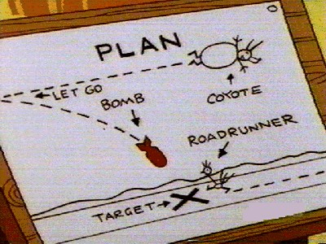
Today’s Plan
Example
Design decisions
Architecture
What’s coded
What’s not
Next steps

Slide 4
Jump in anytime

Slide 5
Overflow of design ideas
little of this
much of this

Slide 6
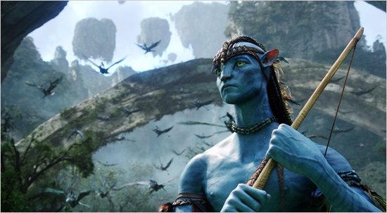
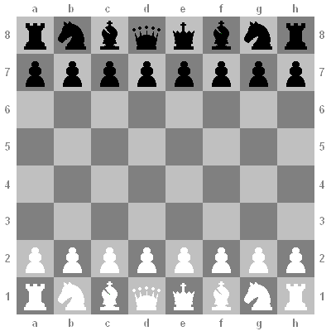
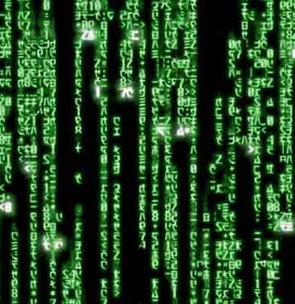
Decisions: Images
2D
3D
“standard” scalar types
scalar, vector, label image
compile-time extensible

Slide 7
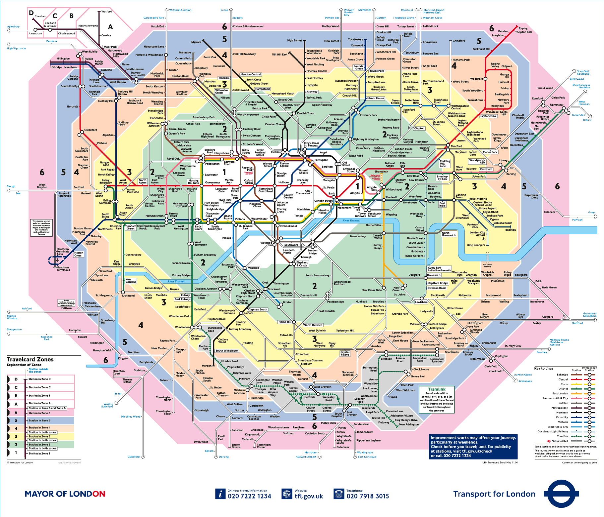
Decisions: Dispatch
run-time dispatch
template meta-programming

Slide 8
Decisions: Code Generation
templates
classes described in JSON
auto-generate tests

Slide 9
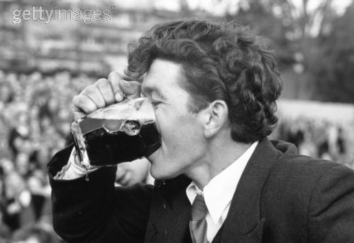
Decisions: SWIG
generates wrappers
1st class languages
tested, supported
2nd class languages
contributed, untested

Slide 10
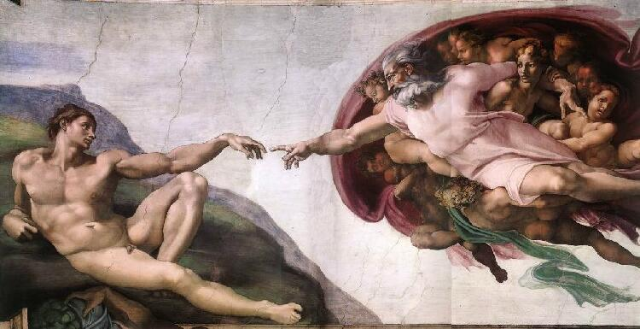
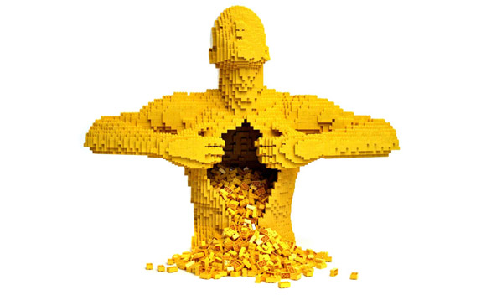
Architecture: Image
itk::simple::Image
“typeless”
itk::Image inside

Slide 11
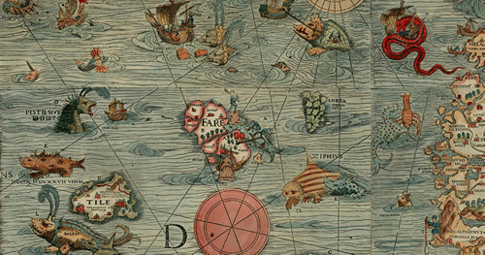
Architecture: Filter
dynamic dispatch
1 & 2 inputs
decides output type
maps input to template method

Slide 12
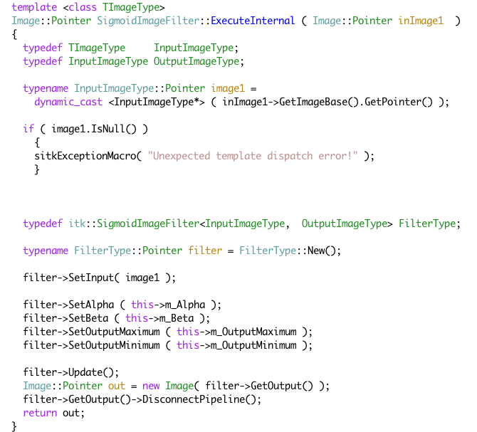
Architecture: Filter

Slide 13
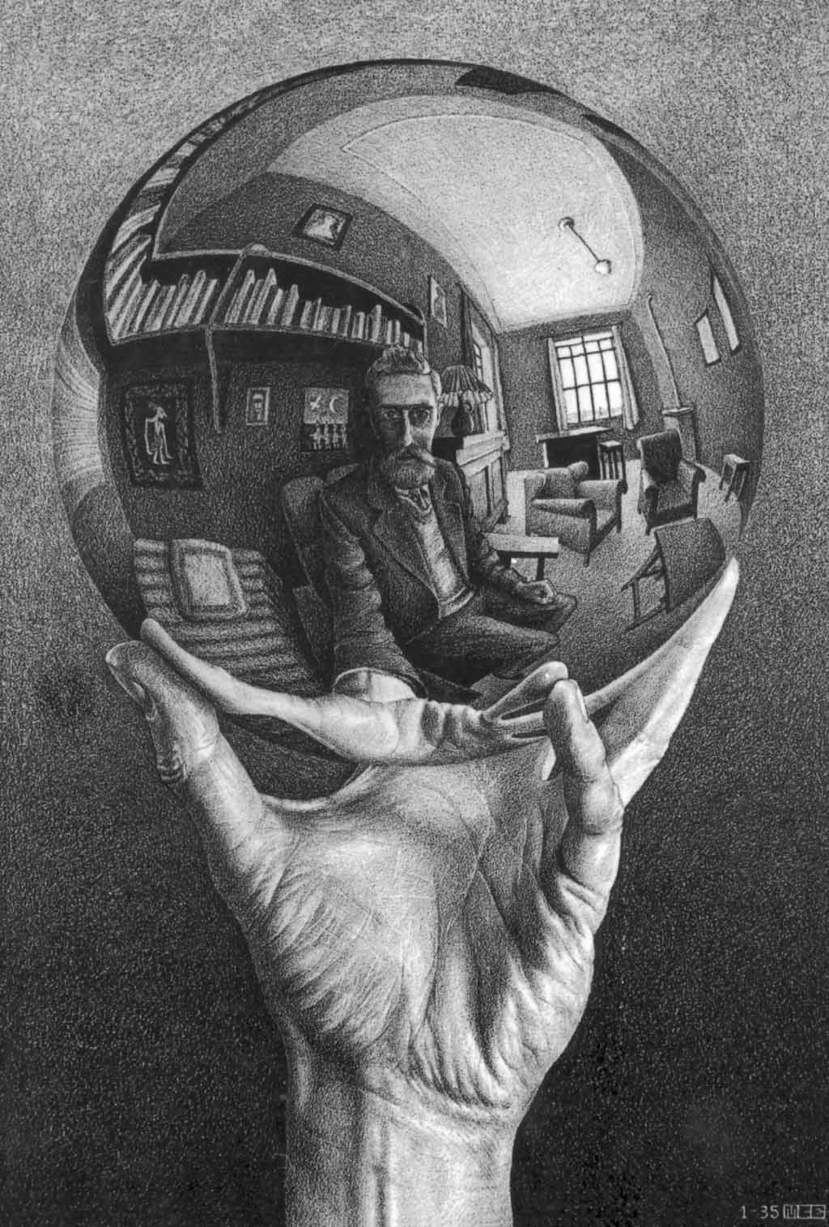
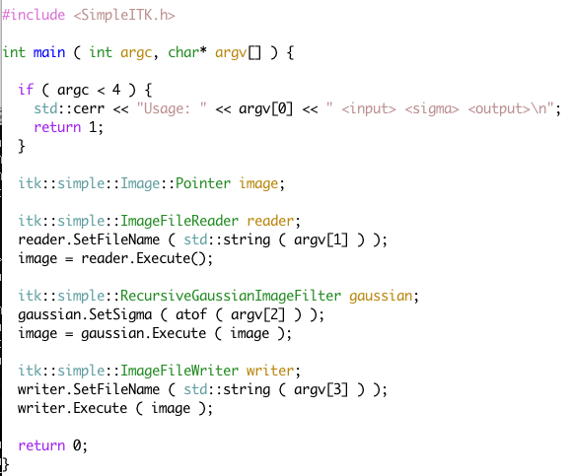
Inside: OO interface

Slide 14
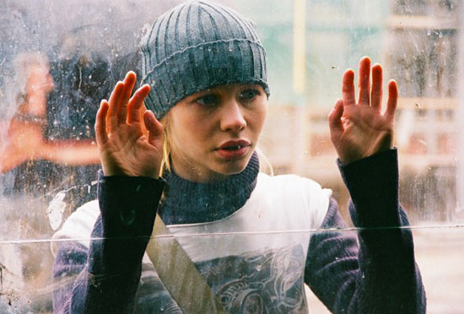
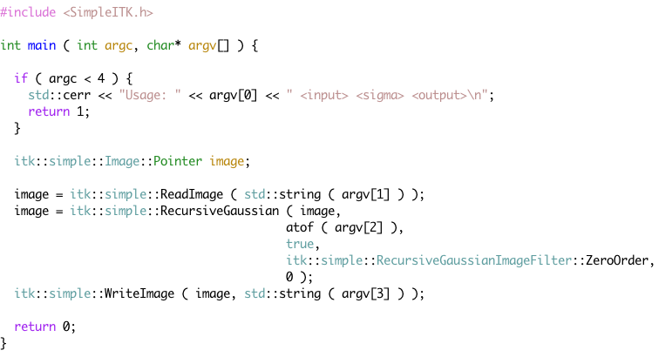
Inside: Functional interface

Slide 15
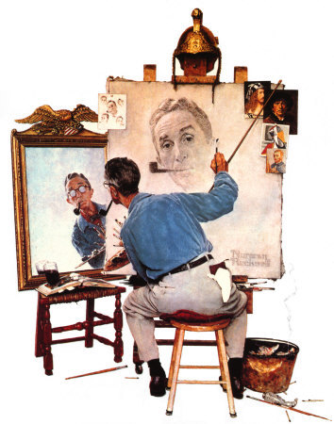
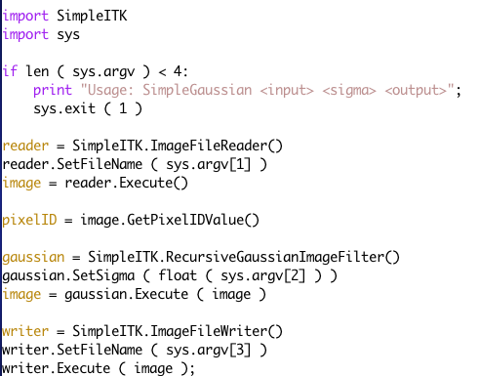
Inside: Python

Slide 16
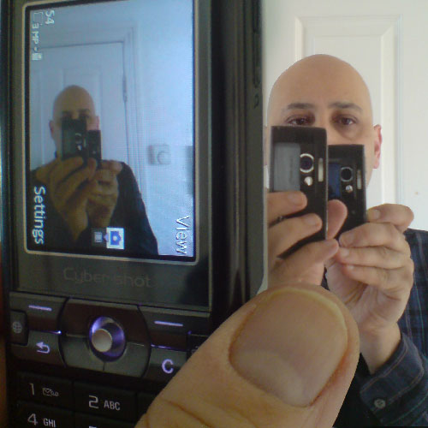
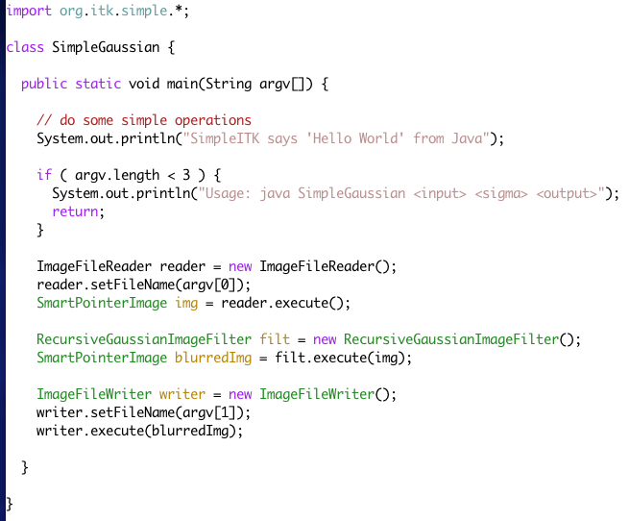
Inside: Java

Slide 17
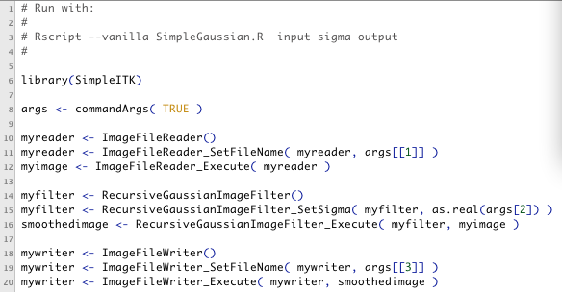
Inside: R

Slide 18
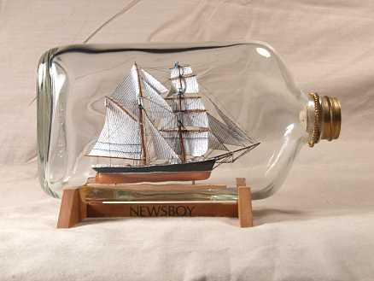
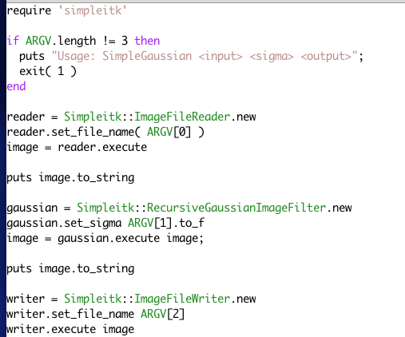
Inside: Ruby

Slide 19
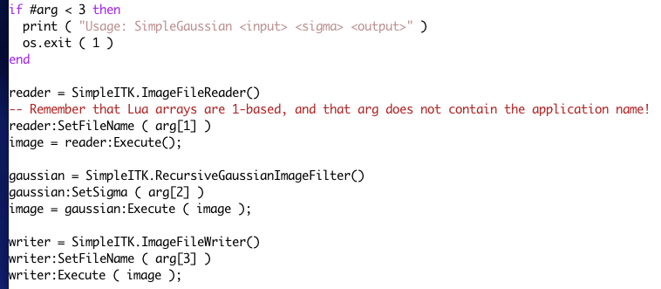
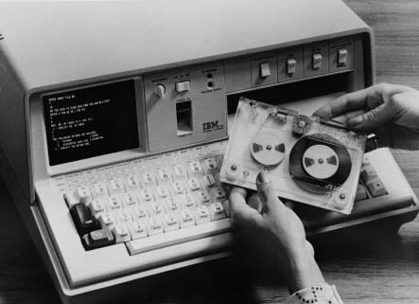
Inside: Lua

Slide 20
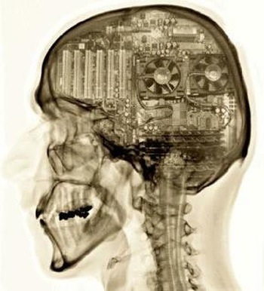
Functional layer

Slide 21
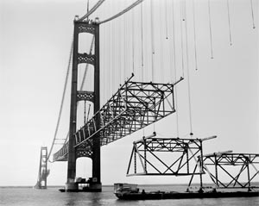
Progress: since Iowa
focus on infrastructure
meta-template programming
code generation
testing

Slide 22
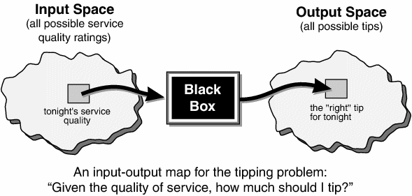
Progress: IO
ImageFileReader
ReadImage
ImageFileWriter
WriteImage

Slide 23
Progress: Common
itk::simple::Image
Pixel types
metaprogramming support
stl::vector for Index, Size

Slide 24
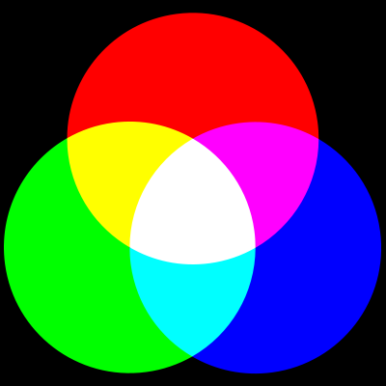
Progress: BasicFilters
52 generated filters
some custom filters
-Cast
templates for:
Level sets
Region growing
Simple filters

Slide 25
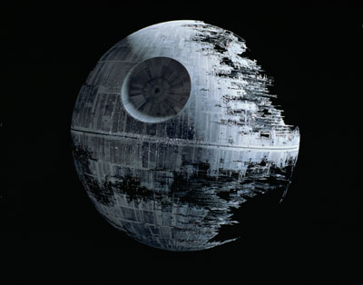
To be completed...
Algorithms (straightforward)
Registration (more complicated)
SpatialObjects (TBD)
Meshes (TBD)

Slide 26
Next steps...
Algorithms
Registration
Closer look at wrapped languages
... more “Python-like”, “Java-like”
Packaging
MICCAI Tutorial
1.0 beta

Slide 27
SimpleITK
Daniel Blezek

Slide 28
Design Decisions
Support 2D and 3D images
“standard” pixel data types
scalar, vector and label image types
Template meta programming
Dynamic dispatch of execution
“Typeless” image
Code generation
SWIG wrapping

Slide 29
Architecture: Image
itk::simple::Image
Runtime typed
Stores itk::Image internally
Access to pixel data
Can be constructed from ITK image

Slide 30
Architecture: Filter
Support for 1 and 2 input filters
Dynamic dispatch
map data type to member function
inputs of same/different types

Slide 31
Architecture: IO
Using ITK IO mechanism
hand-coded typing
supports scalar & vector images
2D and 3D supported

Slide 32
Architecture: Code Generation
JSON description
template engine generates code
C++ classes
Basic filters
Level sets
Region growing
C++ tests
Python, Java, Ruby, R, Lua, Tcl tests

Slide 33
Architecture: Wrapping
SWIG
Parses C++ headers directly
1st class languages
have tests / are tested
Python, Java, Ruby, R, Tcl, Lua
2nd class languages
no tests
C#

Slide 34
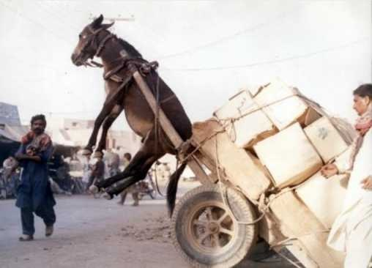
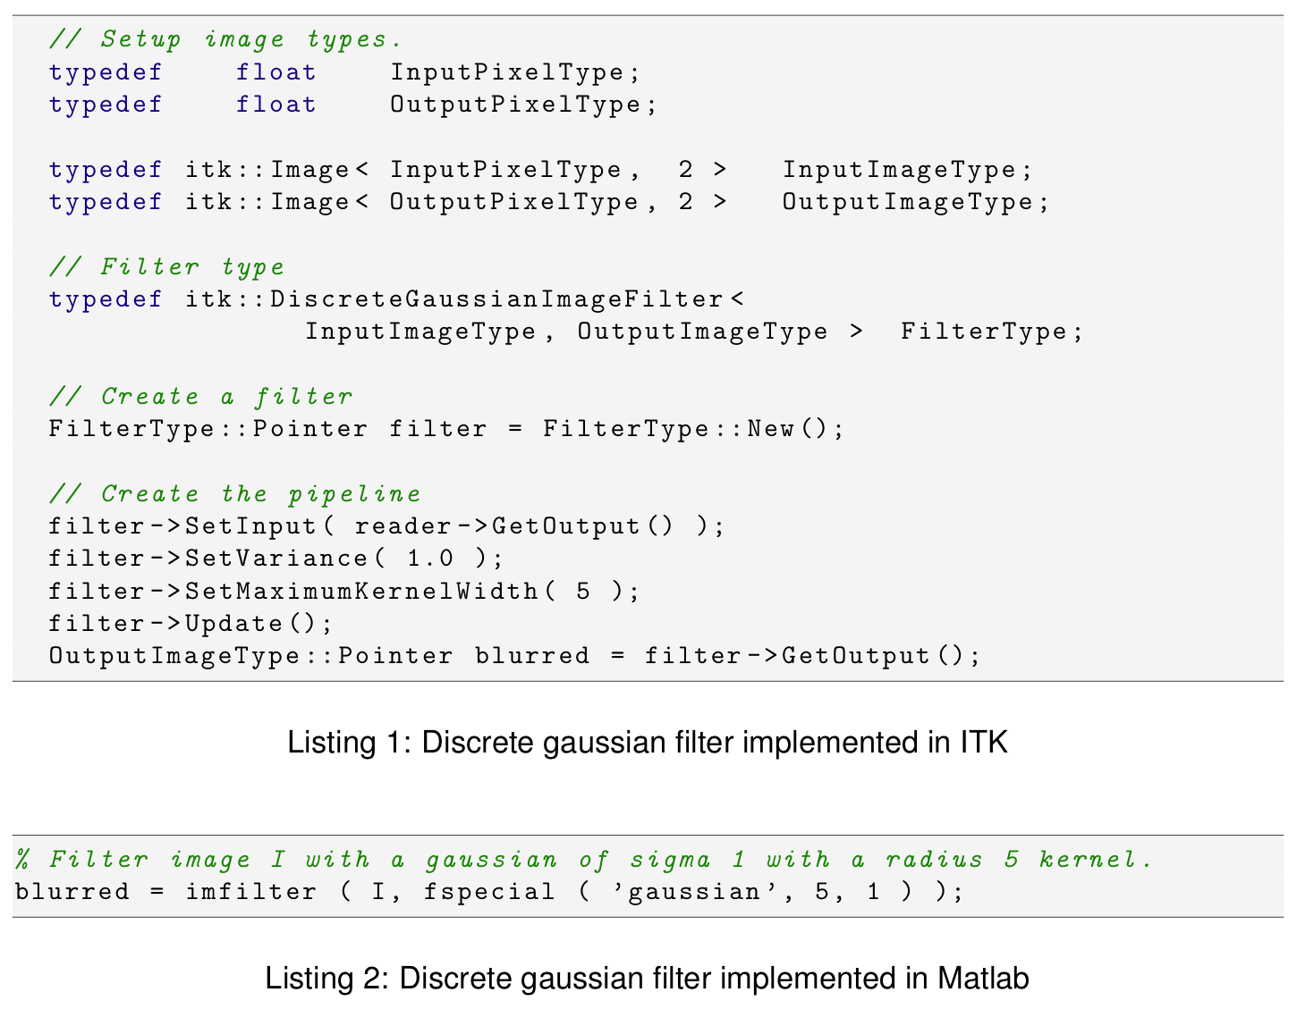
Problem

Slide 35
Complexity
Powerful but complex
Steep learning curve
ever had 2 pages of compile errors?
C++
ITK often unused
But it’s the best...

Slide 36
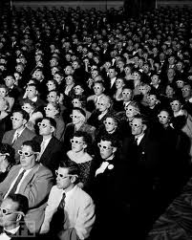
Audience
Students
Grad students
Researchers
Microscopy
Computer vision
Remote sensing
Application developers

Slide 37
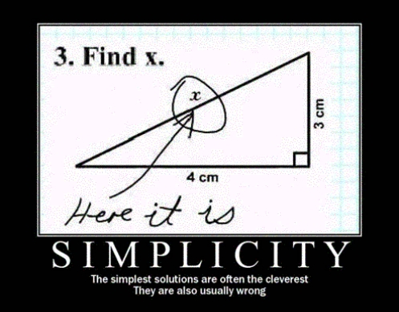
Simplify
As simple as possible...
...but no simpler
Simple for:
users
application developers
SimpleITK developers

Slide 38
Goals
Simple
“On ramp”
Wrapping
Integration
In apps
With ITK, VTK, etc
Extensible

Slide 39
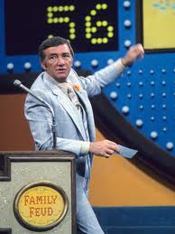
Survey Says!
Compiled packages
Documentation / Examples
3D & 4D
Out of core processing
Object model
char, short, float/double, vector(?)
Visualization
Gabe Hart

Slide 40
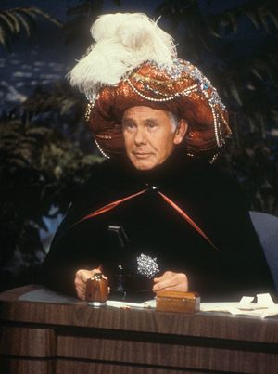
Getting inside their heads
253 participants (11/6/10)
Non-C++ users:
21.34% (54 participants) have never used or don’t feel comfortable using C++
Specific distribution: 16 + 38
51% (28) of non-C++ users have used ITK
26 have never used ITK
Non-ITK users:
17.78% (45 participants) have never used ITK
207 have used ITK
44.44% (20) of non-ITK users are C++ users

Slide 41
C++

Slide 42
Competition

Slide 43
Competition
Note that all of the top libraries / applications among non-C++ developers provide processing and visualization.

Slide 44
Functional / Objects

Slide 45
Pipeline
Note:
Most non-C++ users (including the 51% that have used ITK), don’t understand the pipeline.

Slide 46
Streaming
Note:
Most ITK, non-ITK, and C++ users don’t have a clear understanding of streaming

Slide 47
Out-of-core

Slide 48
Out-of-core

Slide 49
Languages
Q:
Can we say that Matlab, Python, C++, Java, and R are the most important programming languages?

Slide 50
Pixel Types
More important
Less Important
uchar
double
ushort
float
RGB3
short
float
uchar
ushort
short
double
matrix
Top 6 (Non-ITK users)
Top 6 (Overall)

Slide 51
Comments: defaults
“Important to give users relatively straightforward advice on algorithm…”
“Simple defaults with optional alternatives”
“I generally want to be able to try something off the shelf with sensible defaults”
“Sensible defaults should be provided to avoid long code”
“Full flexibility is needed but a good selection of default parameters for all modules would be also important”
“initialized with reasonable default components”

Slide 52
Comments: GUI
“offer both...a GUI … and build scripts from there”
“connect display to view intermediate images”
“handling ability to visualize quickly (even at run time) images and histograms”
“A GUI to build up the application pipeline by arranging icons of filters and I/O connectors”
“visual tool for connecting filters to a pipeline

Slide 53
Comments: Complexity
“writing ITK codes can be a complex task but with more examples and a thorough documentation these difficulties can be overcame”
“One good way to compromise is more flexible but with lots of example code that can be cut-and-pasted for typical applications.”
“Actually I think much of the motivation for SimpleITK could go away, if someone updated + improved the documentation”
“some of the image filters modules are not sufficiently documented”
“Lots of sample code that can be modified for specific purposes”

Slide 54
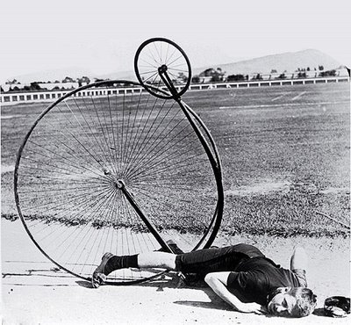
Ouch
“I am not using ITK for registration purposes, and this is because of the complexity of it”
“Extensive use of templates makes debugging difficult in VisualC++”
“Most of filter called *VectorImageFilter are in fact not able to process itk::VectorImage ... This is confusing and sometimes frustrating”
Ability to open differing file formats (dimensions, data types) without all the stupid c++ template nonsense.

Slide 55
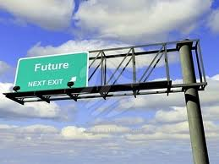
Decisions
API
Datatypes
Dimensionality
Pipeline?
Out of core processing
Wrapping
Distribution

Slide 56
Coffee-cupping

Slide 57
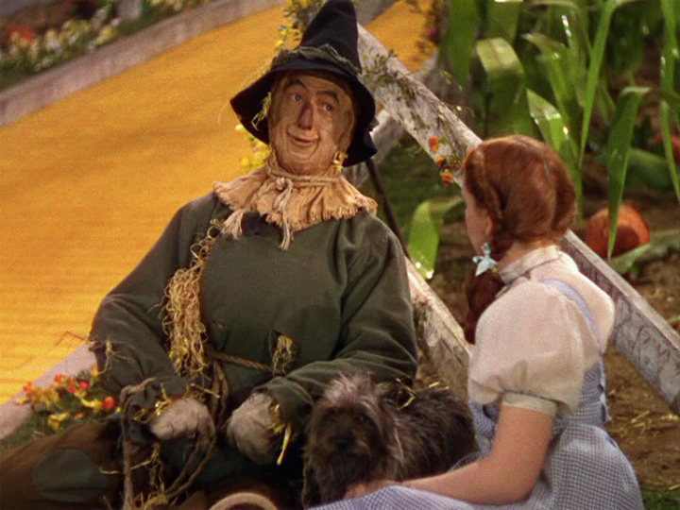
Strawman Proposal
Object model
3D images (& slice-by-slice for 2D)
4D as vector of images, labelmap class
char, short, float (double?)
No exposed pipeline
Out of core orchestration framework
VOI readers/writers
Call list of filters / handle boundaries
SWIG wrapping

Slide 58
API
Procedural / functional?

Slide 59
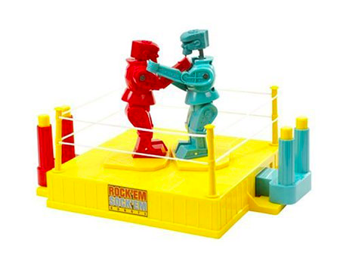
Alternative
C++ should be the same as wrapped languages
Accessibility to as many developers as possible
Python, Java, and non-templated C++ programmers
VTK wraps into python, java, C#, Tcl
The C++ code is 90% available
As VTK grows the simple VTK grows
What is different than ITK?
Templates!
Custom API would get old and not maintained
For this to “stick” we would have to drink our own beer

Slide 60
Data types
Which to support?
Scalar in all filters?
Vector in limited set?
How to support?
Dynamic loading?
Compile time configured?
Template meta programming?
Macros?

Slide 61
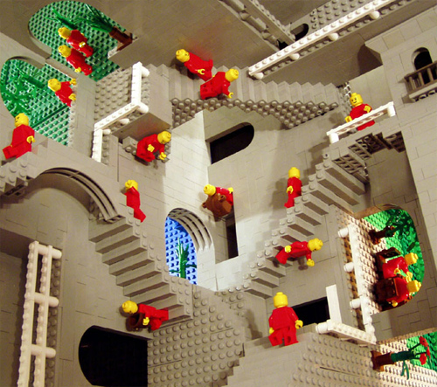
Dimensionality
3D critical
4D nice
How to support?
4D == 4D itk::Image?
4D == vector of 3D images?
4D == 3D with vector pixels?

Slide 62
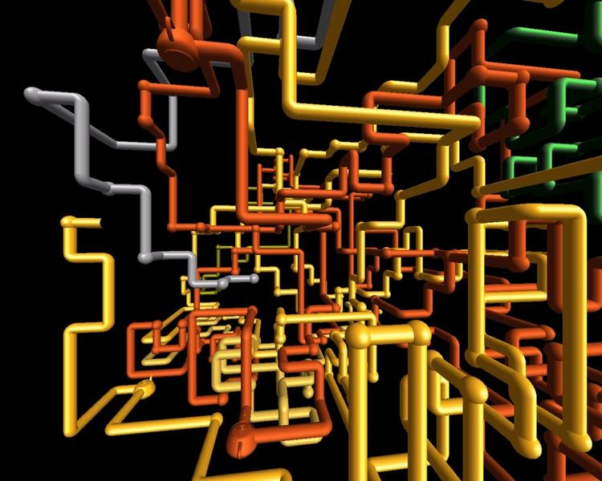
Pipeline
Unnecessary complexity
Utility in streaming
Not (fully) implemented in ITK

Slide 63
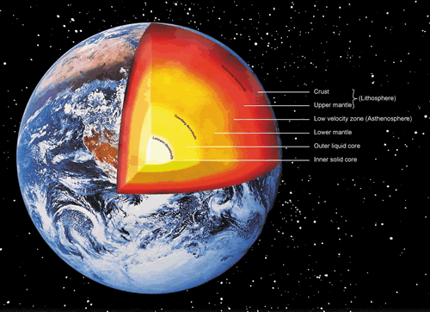
Out of core processing
Essential
ITK Pipeline?
OpenCL model?
single pixel kernel pixel
called for all pixels
“orchestration” framework

Slide 64
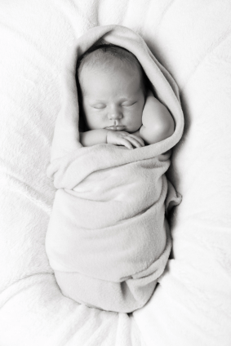
Wrapping
SWIG
Languages
Matlab
Python
Java
C#
Others: Tcl, R, Perl, Ruby...
Interface to WrapITK a “nice to have”

Slide 65
Distribution
Binary
Matlab (somehow)
Python egg
Java jar
C++ lib/dll/so & include
Source
Less useful

Slide 66
SimpleITK
Daniel Blezek

